Slide 1

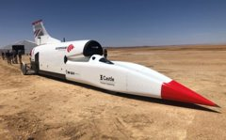

Bloodhound Education
Bringing engineering to life.
Exploring sustainable futures.
Inspiring a generation..
#SUPERSONIC STEAM
@Bloodhound_Edu
Notes:
Today we are going to look at engineering for the future – & I'll need you help to do it.
You're going to be engineers designing and building a prototype rocket car which you are going to race later and see how it performs.
Do you know what the Car is in the logo?
Have you heard of Bloodhound? Bloodhound is a Land Speed Record Car designed and built in the UK. It uses surprisingly green technology which we are going to look at today.

Slide 2
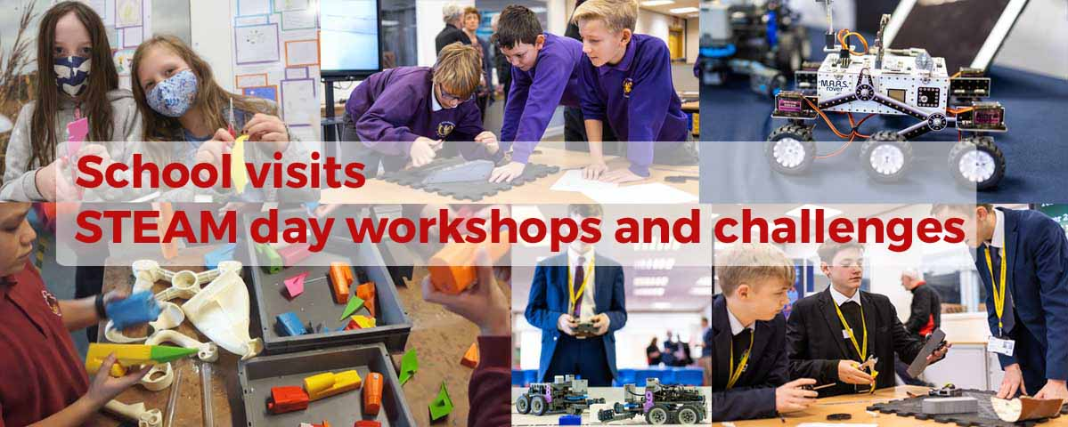
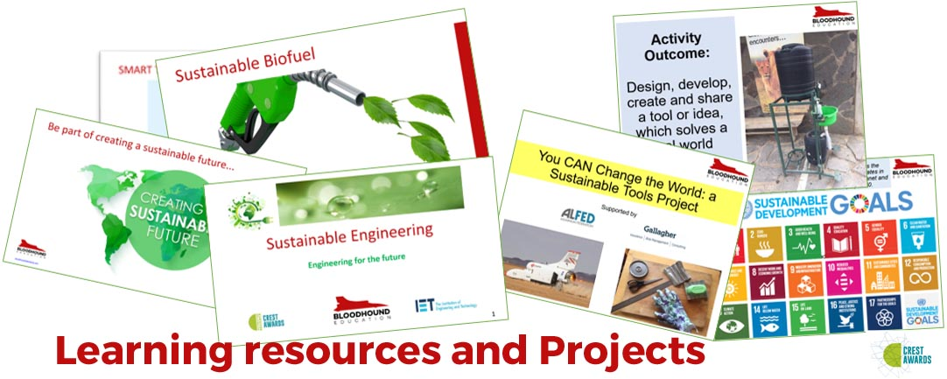
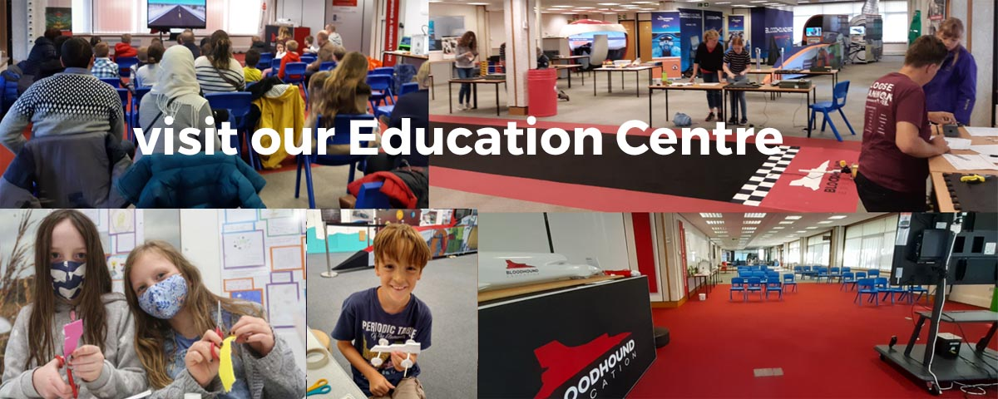
Bloodhound Education Charity
Notes:
A charity whose vision is to inspire a generation to understand how STEM impacts all of our lives
Take the excitement of real engineering projects into schools to talk about projects– like Bloodhound LSR – to highlight what how scientists and engineers work
Make the link between the classroom and careers.
Give presentations (like today by Bloodhound Ambassadors) and run hands-on activities like rocket cars, coding, engineering challenges and projects – putting learning into practice
Have replica models of the Bloodhound LSR which we can bring into your school
Over 2 million children have engaged with the Education Programme since 2008
Visit our Education Centre
Website with free on line projects

Slide 3

Remember …. STEAM is for all !!!
Notes:
Can you think of a job that doesn't use STEM?
No, there isn’t one. It runs through everything.
Science & Technology is what engineers use
We need curious young people who like solving problems to be the scientists and engineers of the future.
What is an engineer?
What do they do?
Solves problems
Designs new solutions

Slide 4
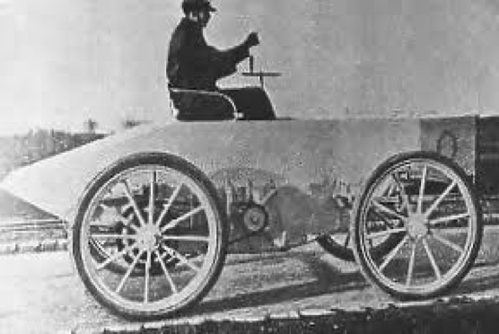
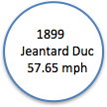
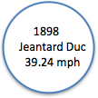
What's this?
4
Notes:
The first land speed record car.
What do you think this is?
A 'horseless carriage' a Car.
What's powering it?
Get suggestions......
It's actually an electric car. We think of electric cars as new technology , but it's actually very old.
Count Gaston de Chasseloup-Laubat (7 June 1866 – 20 November 1903) was a French aristocrat and race car driver.
He is known for setting the first recognised automobile land speed record on 18 December 1898, in Achères, Yvelines using a Jeantaud electric car.
The record was set as part of a competition organised by the French automobile magazine La France Automobile.
He completed a single flying 1 kilometre (0.62 mi) run in 57 seconds to give an average speed of 63.13 km/h (39.23 mph)

Slide 5
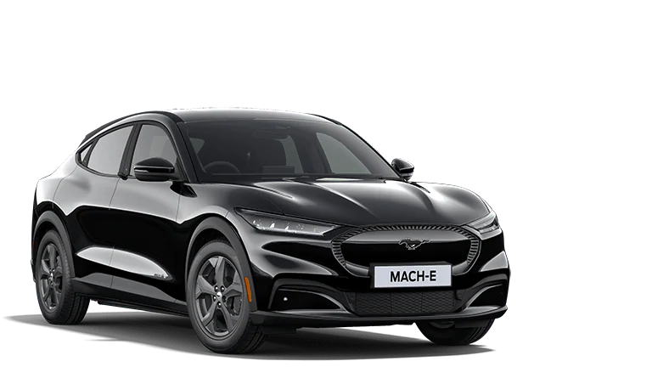
What's this?
Notes:
What's this?
What's the connection between this car and Count Gaston's
Plug in Electric car – Ford Mustang Mach-E
0 – 62 mph in 6.1 sec
It can travel - 250 miles on one charge (example – Portsmouth to Manchester)
Power 269 PS
You've heard of Tesla?
Not just a car but named after an inventor & engineer Nikola Tesla. Alternating Currant (AC) is credited to him.
From 2030 no one will be allowed to buy a new petrol or diesel car or van.
Think about pollution and the environment

Slide 6
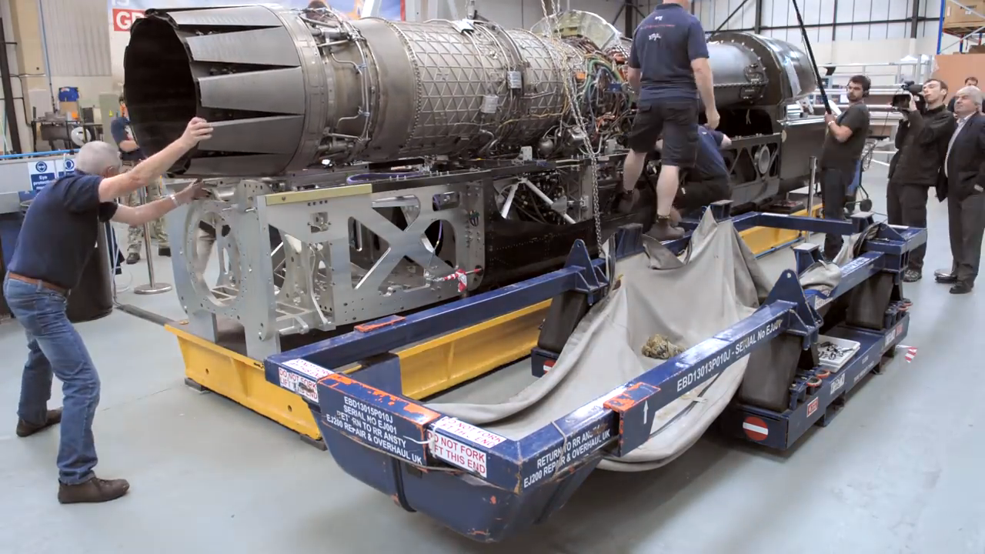
BLOODHOUND Engineering
Notes:
An introduction to the Bloodhound project.
Highlighting some of the extraordinary facts as we look at sustainable technology and building a environmentally friendly camp and land speed car

Slide 7
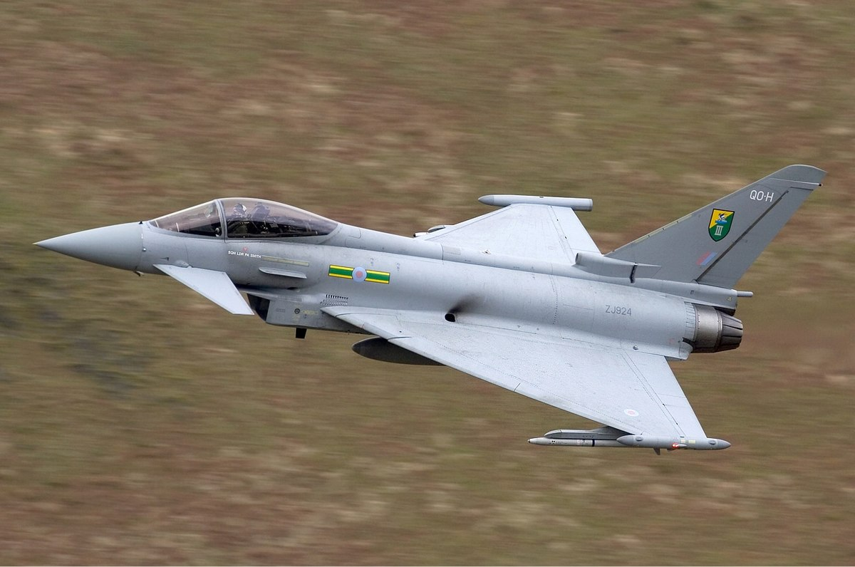
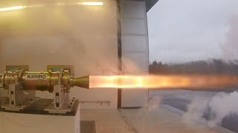
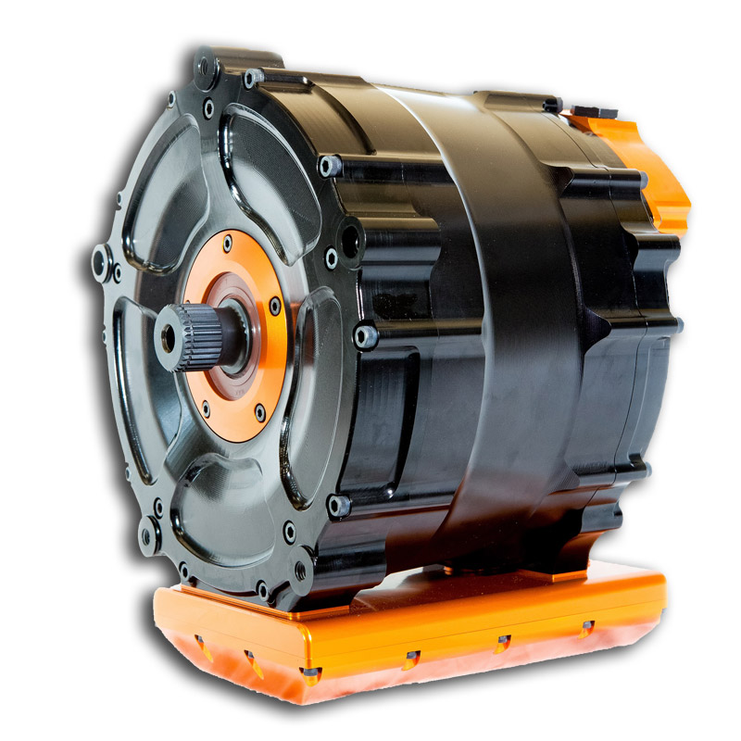
POWER
Notes:
21 tonnes of thrust (212kN) for 7.5 tonnes of car from a jet engine and a rocket
135,000 equivalent horsepower
180 F1 cars (750bhp) or 650 powerful saloon cars (200 bhp) or 500 horsepower less than the Queen Elizabeth Aircraft carrier
Jet engine: from a Typhoon Rolls Royce EJ200
Can run on Bio Fuel – Reducing emissions by up to 115%
Mono Rocket. Using the process of decomposition to produce heat and thrust
Liquid oxidiser: 87.5% proof - High Test Peroxide (HTP) – up to 3% for cleaning materials, hand sanitizer and 6% in hair dye. H2O2. Breaks down into Oxygen and superheated steam. O and H20
Controllable – we can control the flow of oxidizer
Zero emissions
Fuel Pump will be an electric motor similar to those in formula E cars

Slide 8
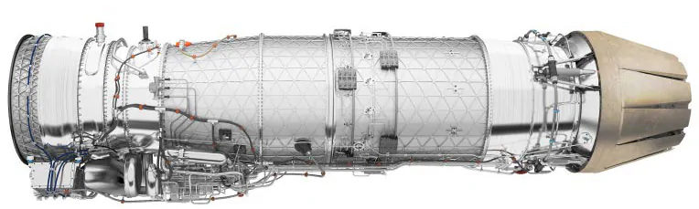
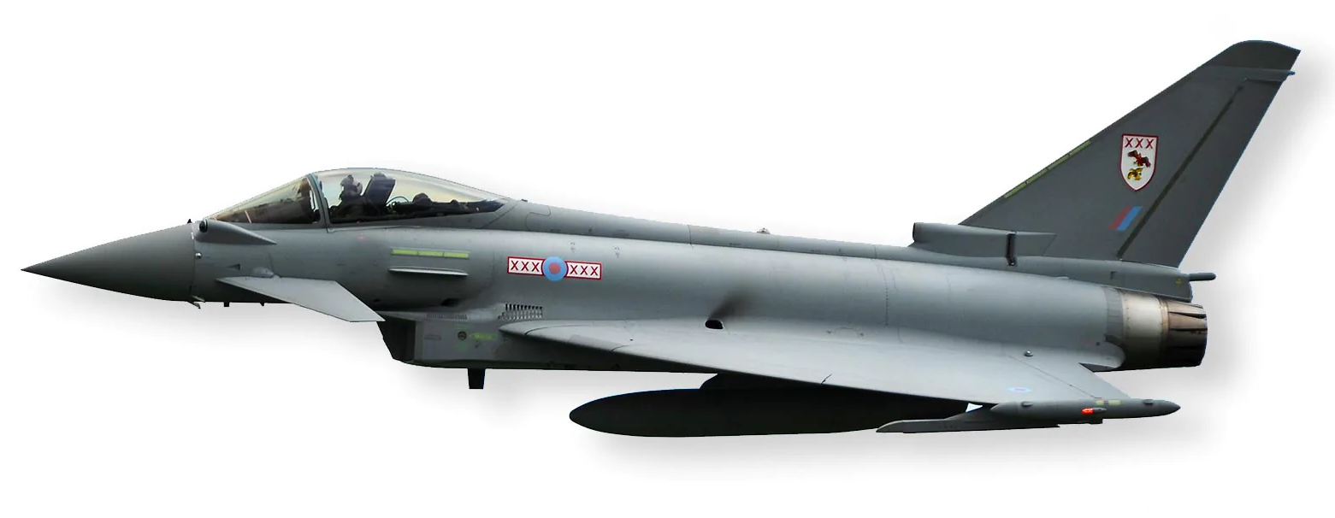
How does this work?
Notes:
Used in the Typhoon - Eurofighter
not the most powerful but well-tested, reliable and best power-to-weight ratio 9:1
suck-squeeze-bang-blow (like a car engine but linear)
Suck the air out of your house in 3 seconds
Squeeze that air house into the size of a shoe box
Ignite it and can burn over 600 degrees

Slide 9
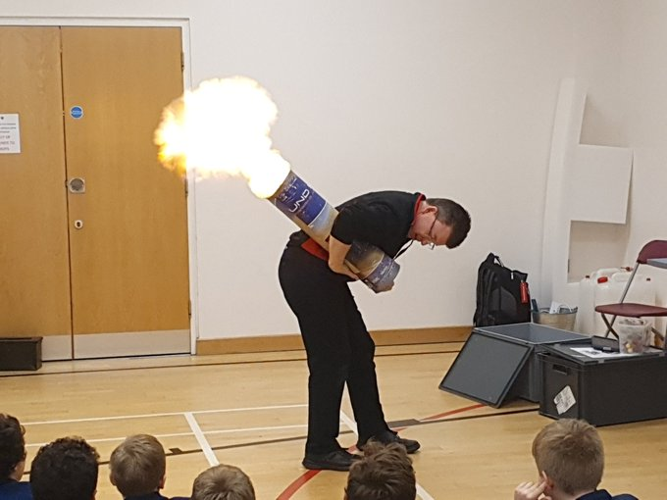
Combustion demonstration
Notes:
This experiment is a fantastic demonstration of combustion & how it produces energy....i.e. Thrust
https://youtu.be/JCPxlC2gKRA
Here's me showing how it is done!
You will need:
Can of hair spray – Highly flammable is best
An ignitor
A pringles tube or larger tube if available, like a poster tube.
The 'bottom' needs a hole made in the centre, around 1cm. Tape the poster tube bottom on so doesn’t come off during experiment.
Remember
Never have your face directly at the bottom
Never point at people (look how far the flame travels from the chamber)
Enjoy, the group you're engaging with will!
Ask the question
What happened?
Why did the lid blow off? (Expansion due to heat)
If it was on wheels would it have moved? Newton's 3rd Law. Every action has an equal & opposite reaction

Slide 10
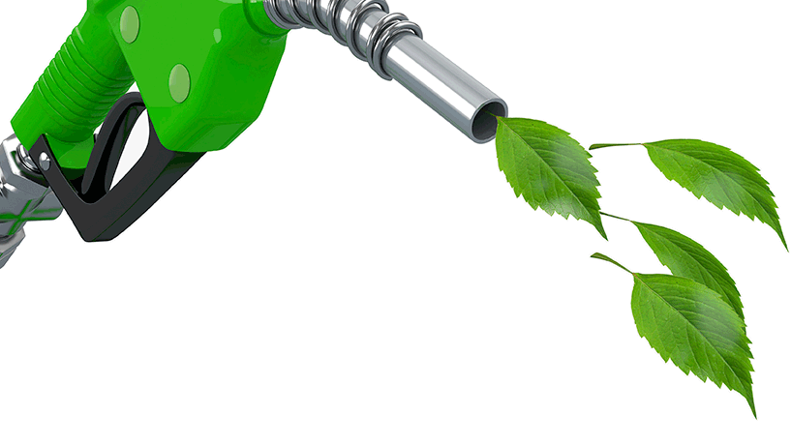
Sustainable Biofuel
Notes:
The jet can run on Bio fuel. In the future airplanes will have to use this technology . Reduce pollution
Here are some of the benefits
Reduce Greenhouse Gases by up to 65%
Sustainability. They're made from plants that can grow and be replanted again and again. Perennial crops don't even have to be replanted. Still, not all biofuels are created equal. Some "energy crops" produce more energy than others. For example, rapeseed has a higher oil content than other vegetable plants, which means rapeseed can generate more energy when burned. Perennial plants, such as switchgrass, provide an abundant source of power, generating five times as much energy as they take to grow
Positive Economic Impact. This new industry is cresting new sustainable jobs globally
High-Quality Engine Performance. Bio fueled engines run 30% more efficiently
Economic Development. In addition to reducing dependence on foreign oil, many countries expect the biofuel industry to fuel economic development in poor, rural areas. For example, experts at the International Food Policy Institute (IFPI) say in Tanzania, ethanol made from a shrub called cassava can help reduce poverty in that West African nation where 80 percent of the labor force is farmers. Tanzania is one of the poorest countries in the world.
Reducing Foreign Oil Dependence
Fuel Economy improvement of 30%
Biofuel Refineries Are Cleaner. For example, ethanol plants fueled by natural gas emit very few pollutants, including greenhouse gases. However, coal-fired ethanol plants release copious amounts of carbon and other greenhouse gases -- not to mention a significant amount of particulate matter -- into the atmosphere. On the other hand, ethanol plants fueled by biomass and biogas produce less gas emissions and are cleaner to run
Health Benefits. The World Health Organisation estimate 7 million people die every year from pollution. When compared to conventional diesel, biodiesel reduces smog-forming particulate matter, which reduces cases of asthma and other respiratory illnesses. In addition, biodiesel doesn't emit any sulfur oxides and sulfates, which contribute to acid rain.

Slide 11
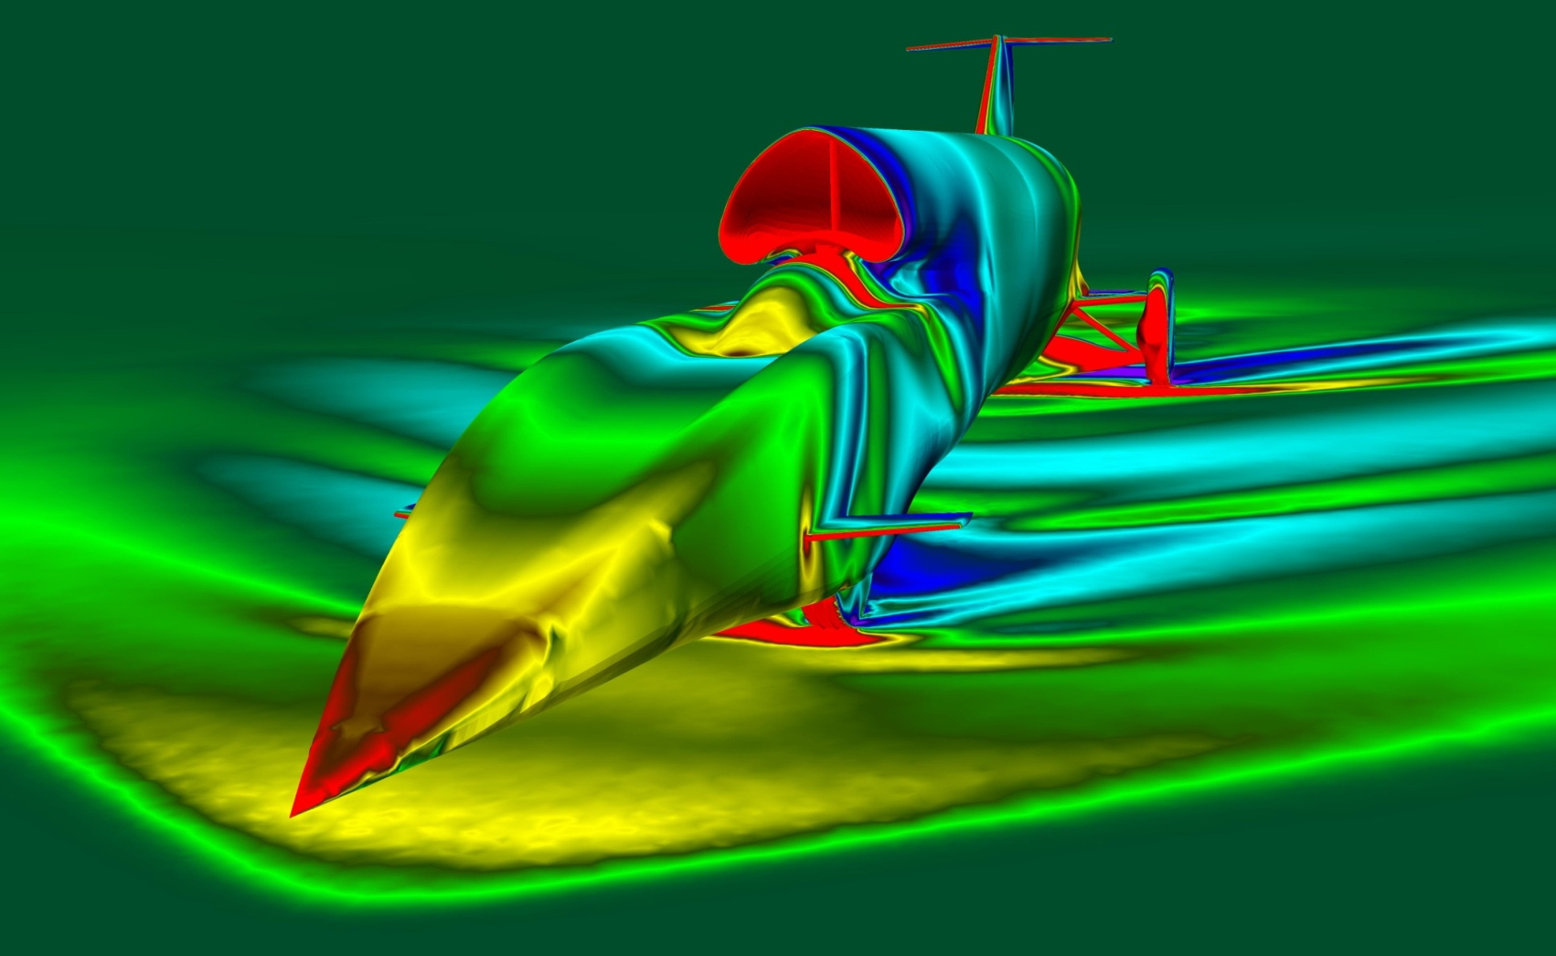
SHAPE. Engineering efficiency
Notes:
Computational Fluid Dynamics (CFD) is using a computer to measure the flow of fluid ( air) over an object. Aerodynamics ( from the Greek Air-movement) The computer is trying to solve an equation
Put simply, the computer designs the best shape to get through air....means less fuel.
Developed by 2 physicists in around 1850. Navier and Stokes
No rolling road was fast enough to test with a physical model

Slide 12
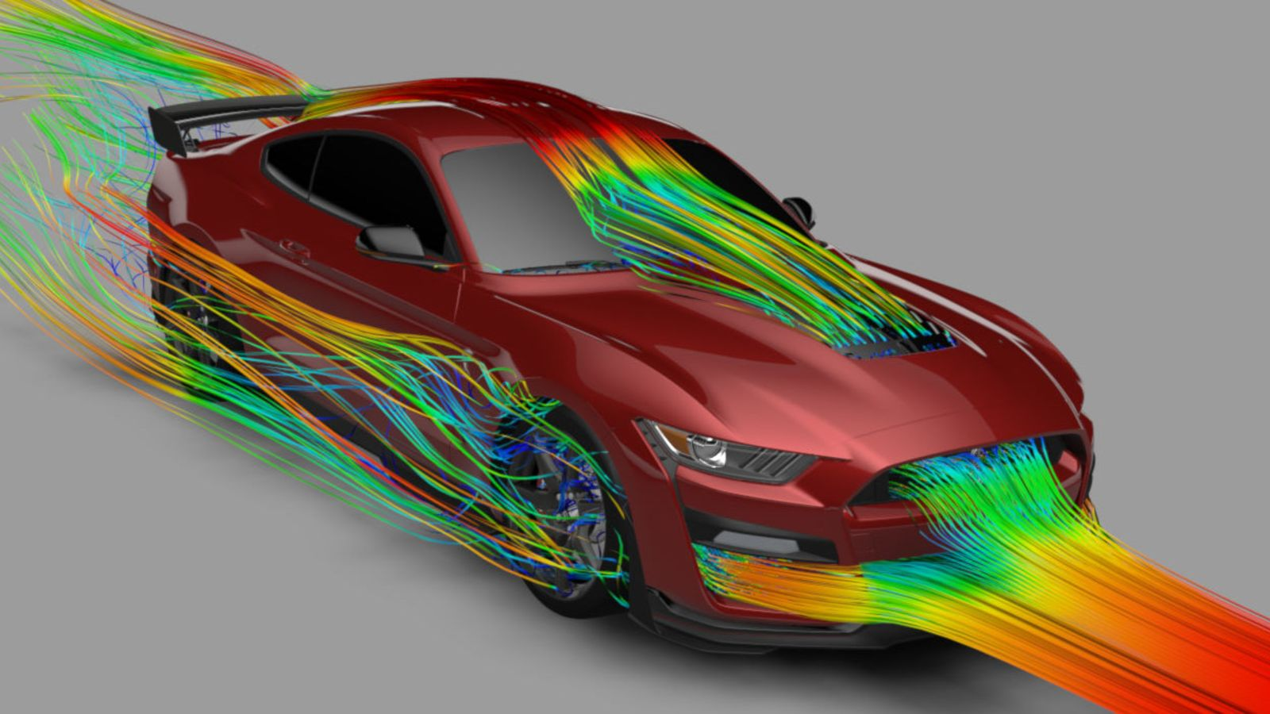
Conventional cars
Notes:
Modern airplanes and cars are designed using this technology. Better shape cars, airplanes and boats using less fuel. Reduce pollution

Slide 13
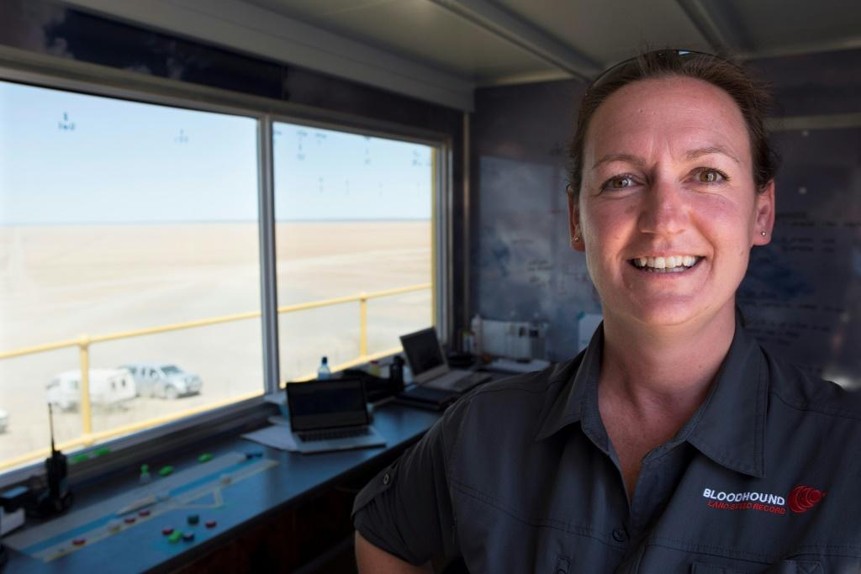
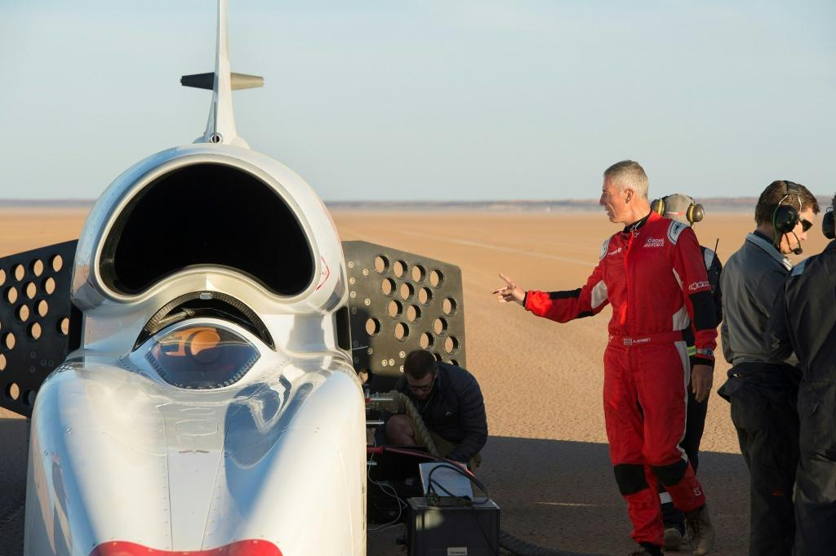
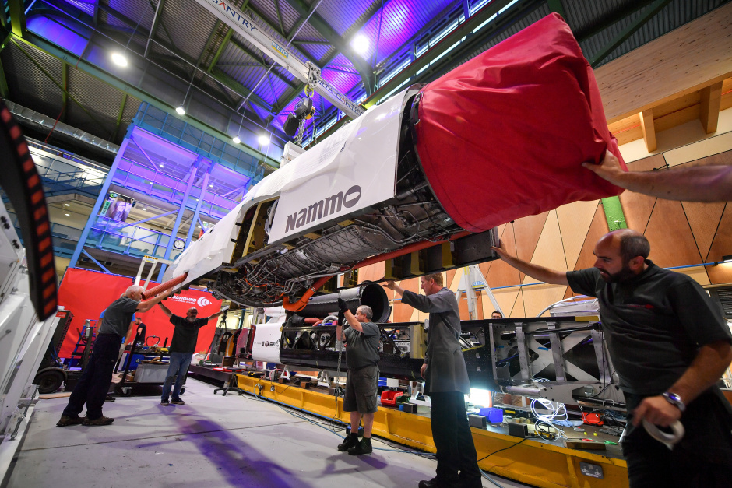
The human element...
Notes:
Jessica Kinsman is an air traffic controller who oversees the Bloodhound's safety on the track (Pictured)
The Engineers & Technicians assembling the car
Andy Green, the driver who’s feedback on the performance of the car is uniquely valuable. His perspective is like no one else on earth.
Do you have some of the skills needed to make a successful 'prototype' vehicle?

Slide 14
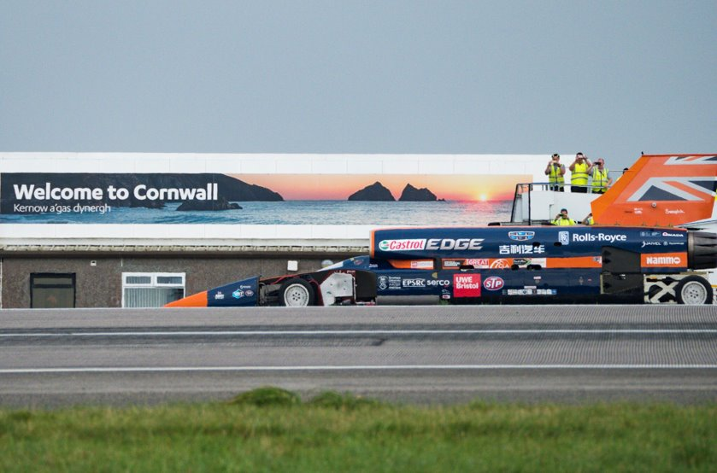
Newquay 2017 Low Speed Testing
Notes:
October 30th 2017 low speed testing 0-210 mph 8 seconds.
Notice the runway wheels have tyres. These were not used for high speed testing. The rubber would simply fly off.
October 2017 achieved 210mph with jet engine only
0-200mph in 8 seconds on a 2.7km runway
Bloodhound ran better than anticipated – the jet achieved reheat when stationary meaning it was more powerful than expected

Slide 15
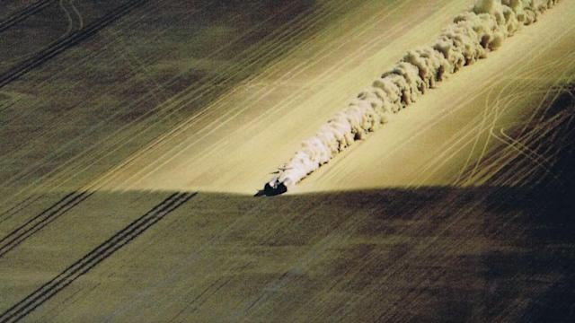
25th Anniversary
Thrust SSC
15th October 1997
Notes:
October 15th 1997 Any Green sets a new world land speed record of 1,227.985 km/h (763.035 mph; Mach 1.020) over 1 mi (1.6 km) in the Black Rock Desert, Nevada, USA.

Slide 16
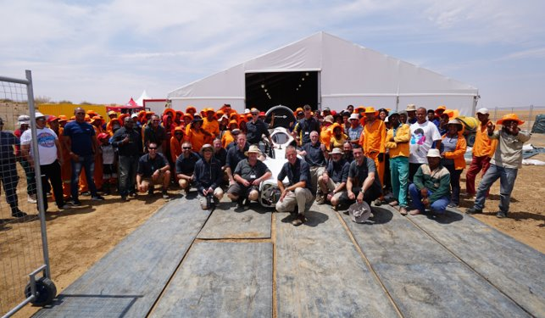

2019 High Speed Testing
Notes:
In 2019 the team took the car to Hakskeen Pan, Northern Cape Province, South Africa for high speed testing.
The support of the Mier people was invaluable. The project could not take palce without their local knowledge, experience and support.
Here is an additional video about them
Meet the incredible people that build the world's fastest track

Slide 17
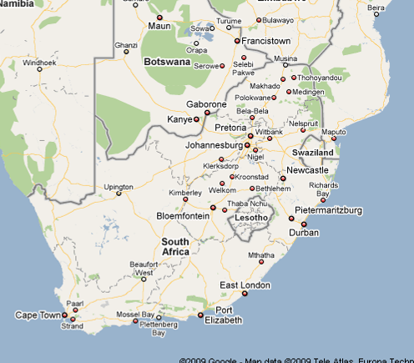
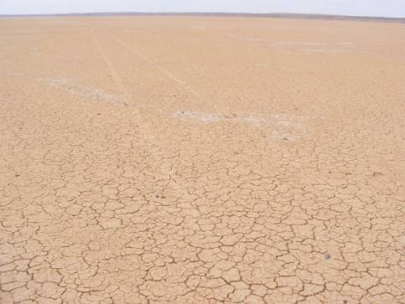
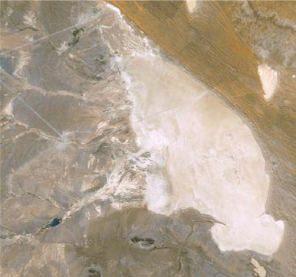
HAKSKEEN PAN, South Africa
Notes:
A very flat, mud and salt lakebed in north-west South Africa with alkali playa (same as Black Rock) - a bit like an apple crumble…hard crust on top and softer underneath, which offers some give (salt flats like Bonneville are too hard to run on)
long-term improvement of the area and legacy:
communication masts
existing water pipeline has been extended to areas that did not have access to running water
equivalent SA education programme translated into Afrikaans
over 300 people cleared almost 16,000 tonnes of stones (anything bigger than a pea) from an area the size of 3,500 football pitches
A video showing how Bloodhound Looked after the Environment

Slide 18
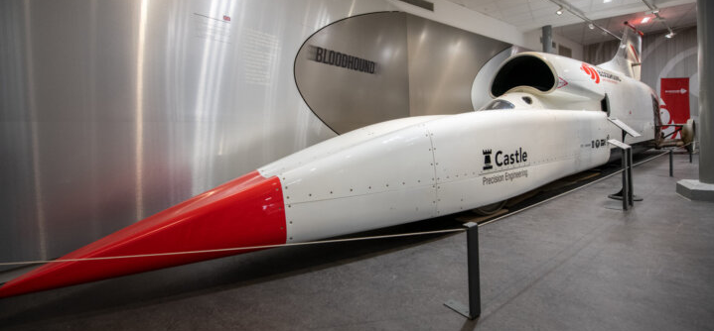
Where is Bloodhound now?
Notes:
Following the successful hi-speed tests in South Africa, the project was paused due to Covid and lack of opportunitties to raise further funding for the rocket development.
The move from Bloodhound’s former HQ in Gloucestershire to safe storage in Coventry Transport Museum will enable the project’s loyal supporters and the half a million members of the general public, who visit the museum each year, to see the car following its successful high speed testing campaign in the Kalahari Desert, South Africa, while it awaits further funds to set a new world record.

Slide 19
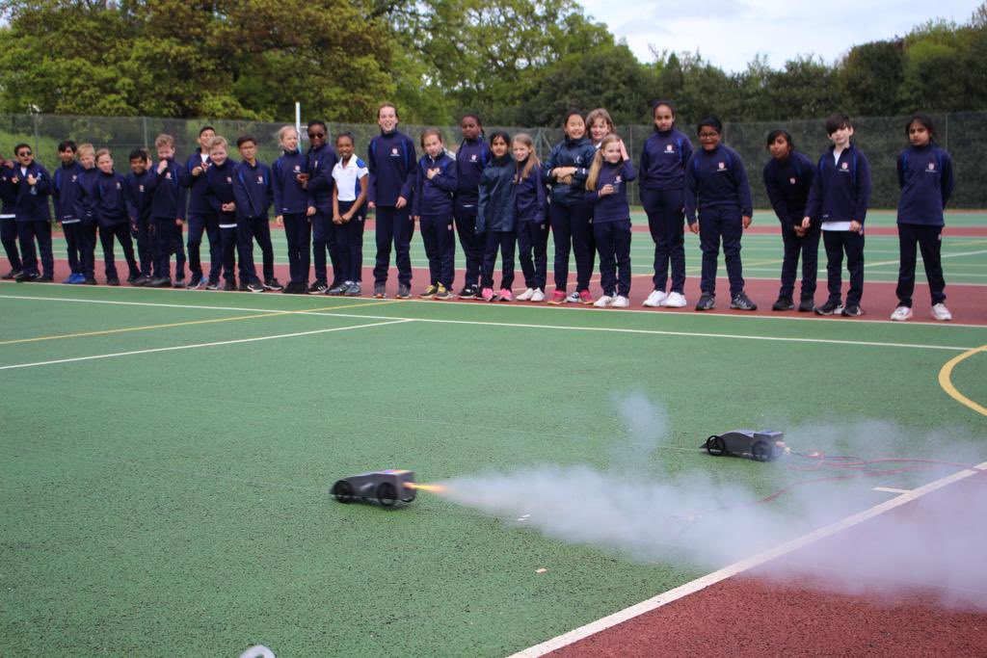
Workshop Challenges
  Set up Team Structure – Key Roles
  Leader, Designer, Engineer, Comms etc.
  Plan the Task
  Predict Speed of Car
  Build the Car to Plan
  Test Run
  Refine the Build
  Measure Actual Speed
  Report Back to team
Notes:
The workshop challenge and how to structure the Teams and Workshop.
The team structure is only generally used for the more senior students.

Slide 20
Bloodhound Configurations
Notes:
A slide showing how BLOODHOUND has changed shape over the years. Its all about shape / Aerodynamnics

Slide 21
Who is this?
Isaac Newton
Notes:
Ask the question ?
Why was he important?
Did he have some Laws, explore these Laws, 1st , 2nd ,3rd and there relevance to todays activities

Slide 22
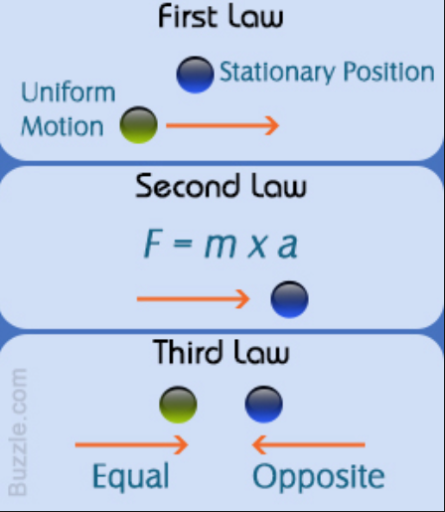
Newtons - 3 Laws of Motion
Notes:
Summary of Newtons Laws.
Go thru One at a time with following slides

Slide 23

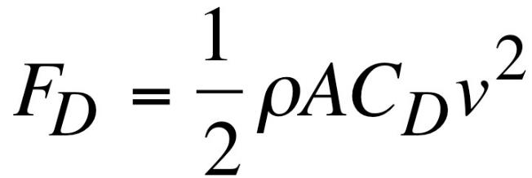

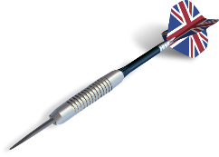
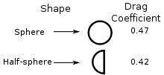


Reducing
Drag
Coefficient of drag (based on shape)
Cross
Sectional
Area
Drag Force
Air
density
Air speed over the object

Slide 24
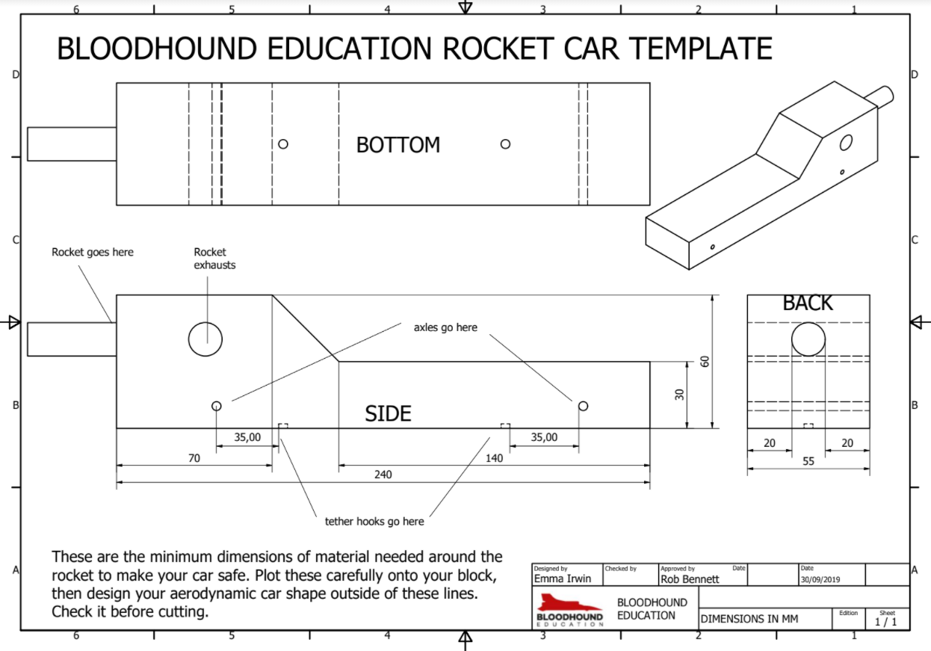

Slide 25
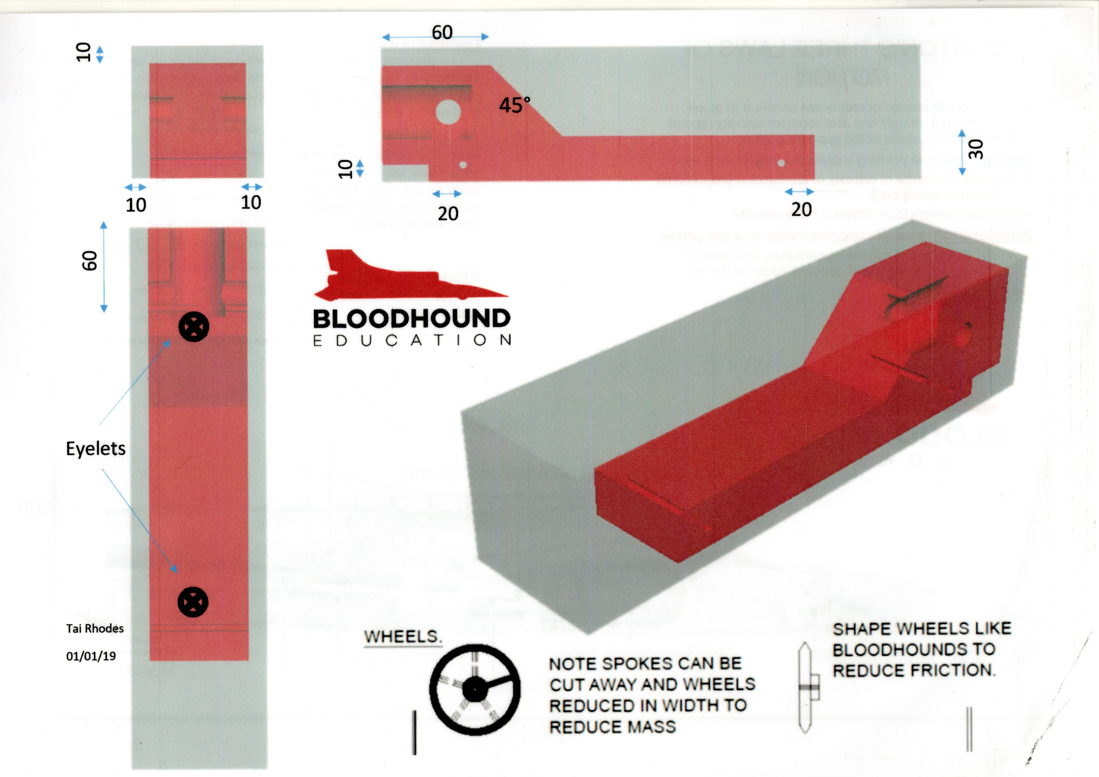

Slide 26
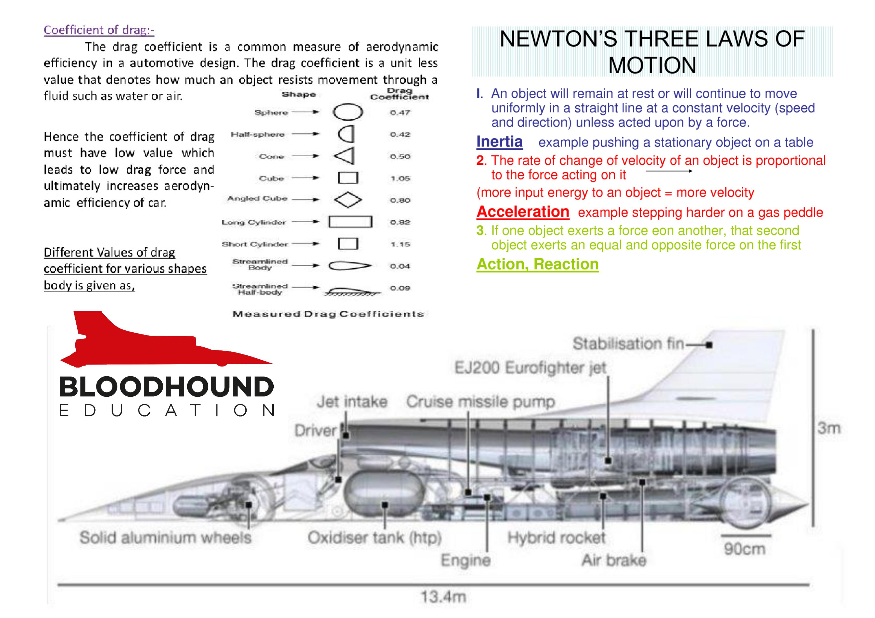

Slide 27

Any Questions?
Notes:
Any questions you want to ask about the Bloodhound Car and the sustainable technologies we have just explored?
This might be the End of the presentation or you may then lead to the workshop, if you are doing one

Slide 28
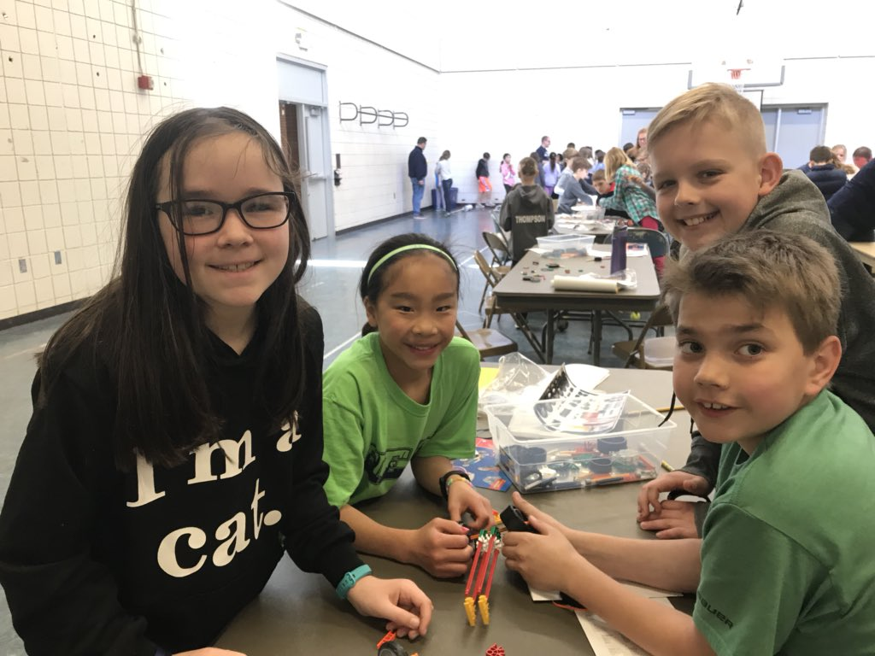
JOIN THE ADVENTURE:
Notes:
You can find our more on social media, our website and through you tube
Contact us
Email: Enquiries@bloodhoundeducation.com
Tel: 0208 150 3767

