Slide 1
The RAF Youth STEM Team
ROCKET STEM Day

Slide 2
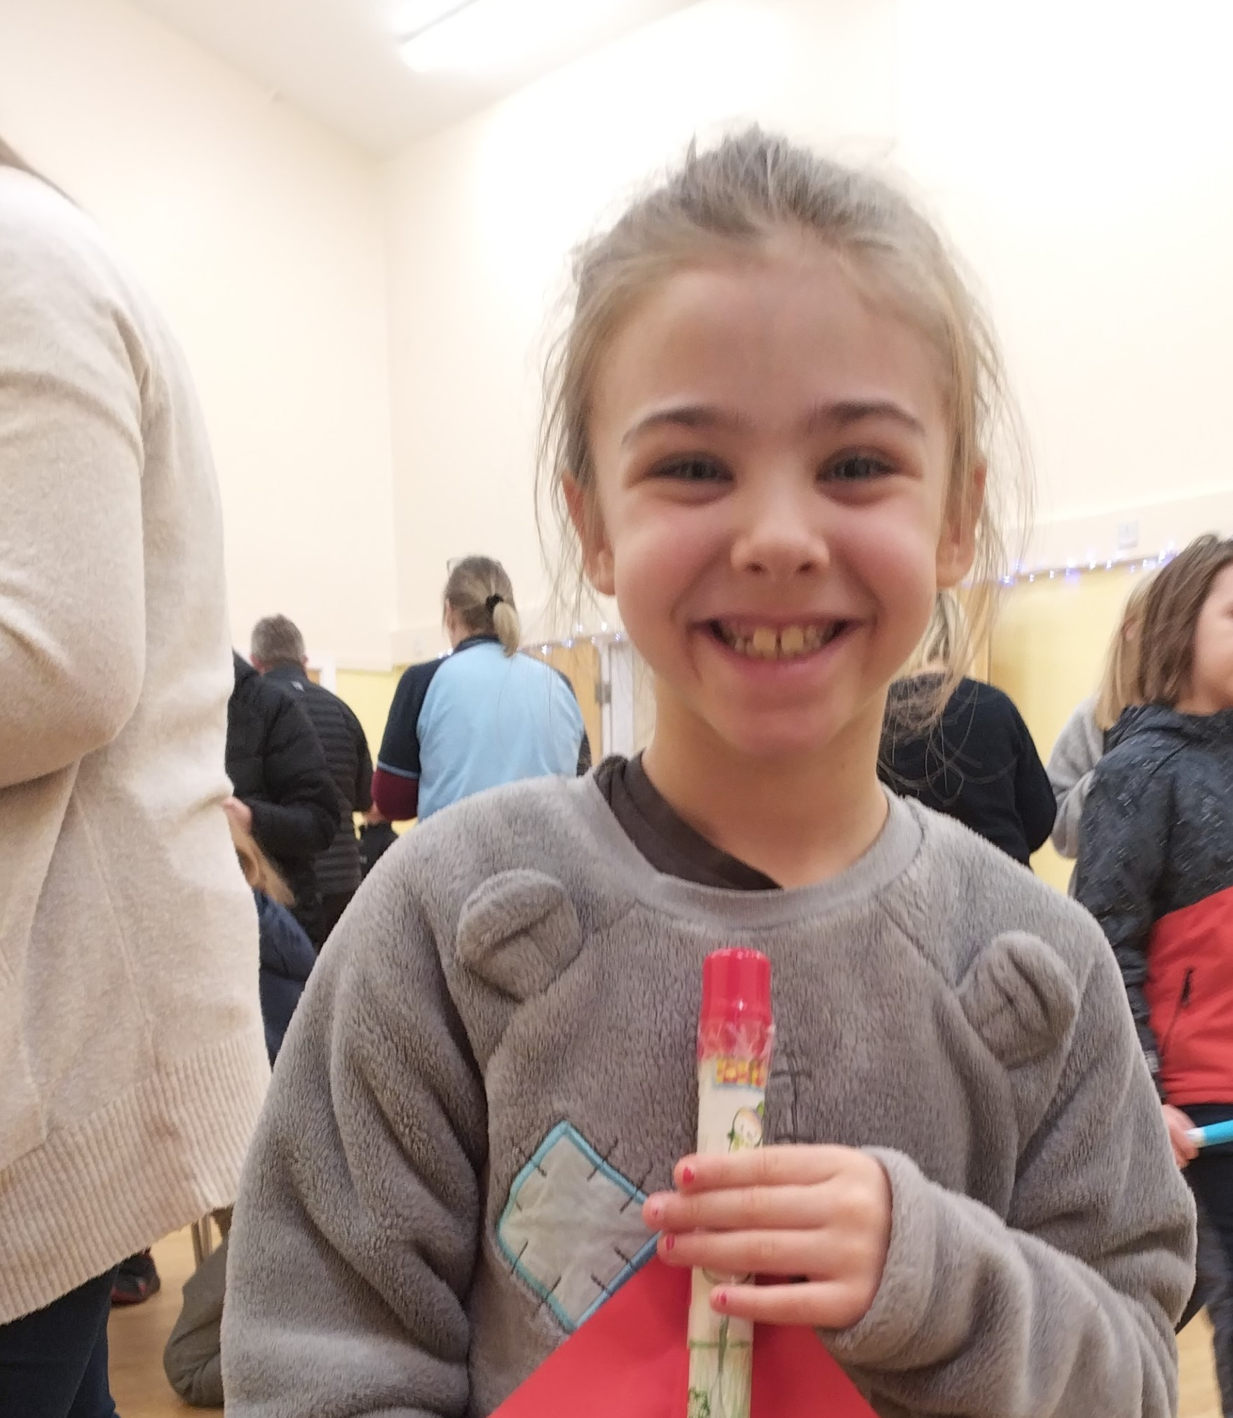
Objectives
Know where Rockets came from and the milestones for modern rocketry.
Identify the main components of a rocket and understand what they do.
Understand the main forces that act on Rockets during take-off.
Design, Build and Test your own rocket.

Slide 3
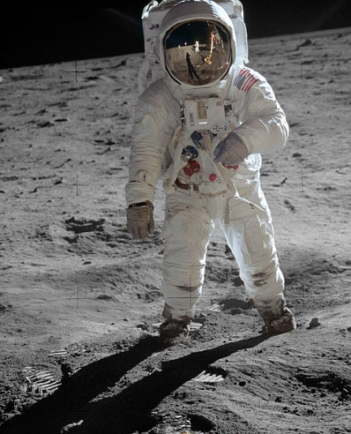
Modern Rocketry and the Space Race
Who do you think invented rockets?
1957 – Sputnik 1. First successful earth-orbiting satellite launched by the Soviet Union.
1958 – NASA formed.
1961 – Yuri Gagarin first human to journey into outer space aboard Vostok 1 capsule.
1969 – Apollo 11 took it’s crew into space; Neil Armstrong and Buzz Aldrin first men to land and walk on the moon.
Notes:
Originated by the Chinese in the 13th century to propel arrows during the battles with the Mongols.
Ques for audience; what do they think happened to the arrows when a rocket was attached?
What problems might have occurred?

Slide 4
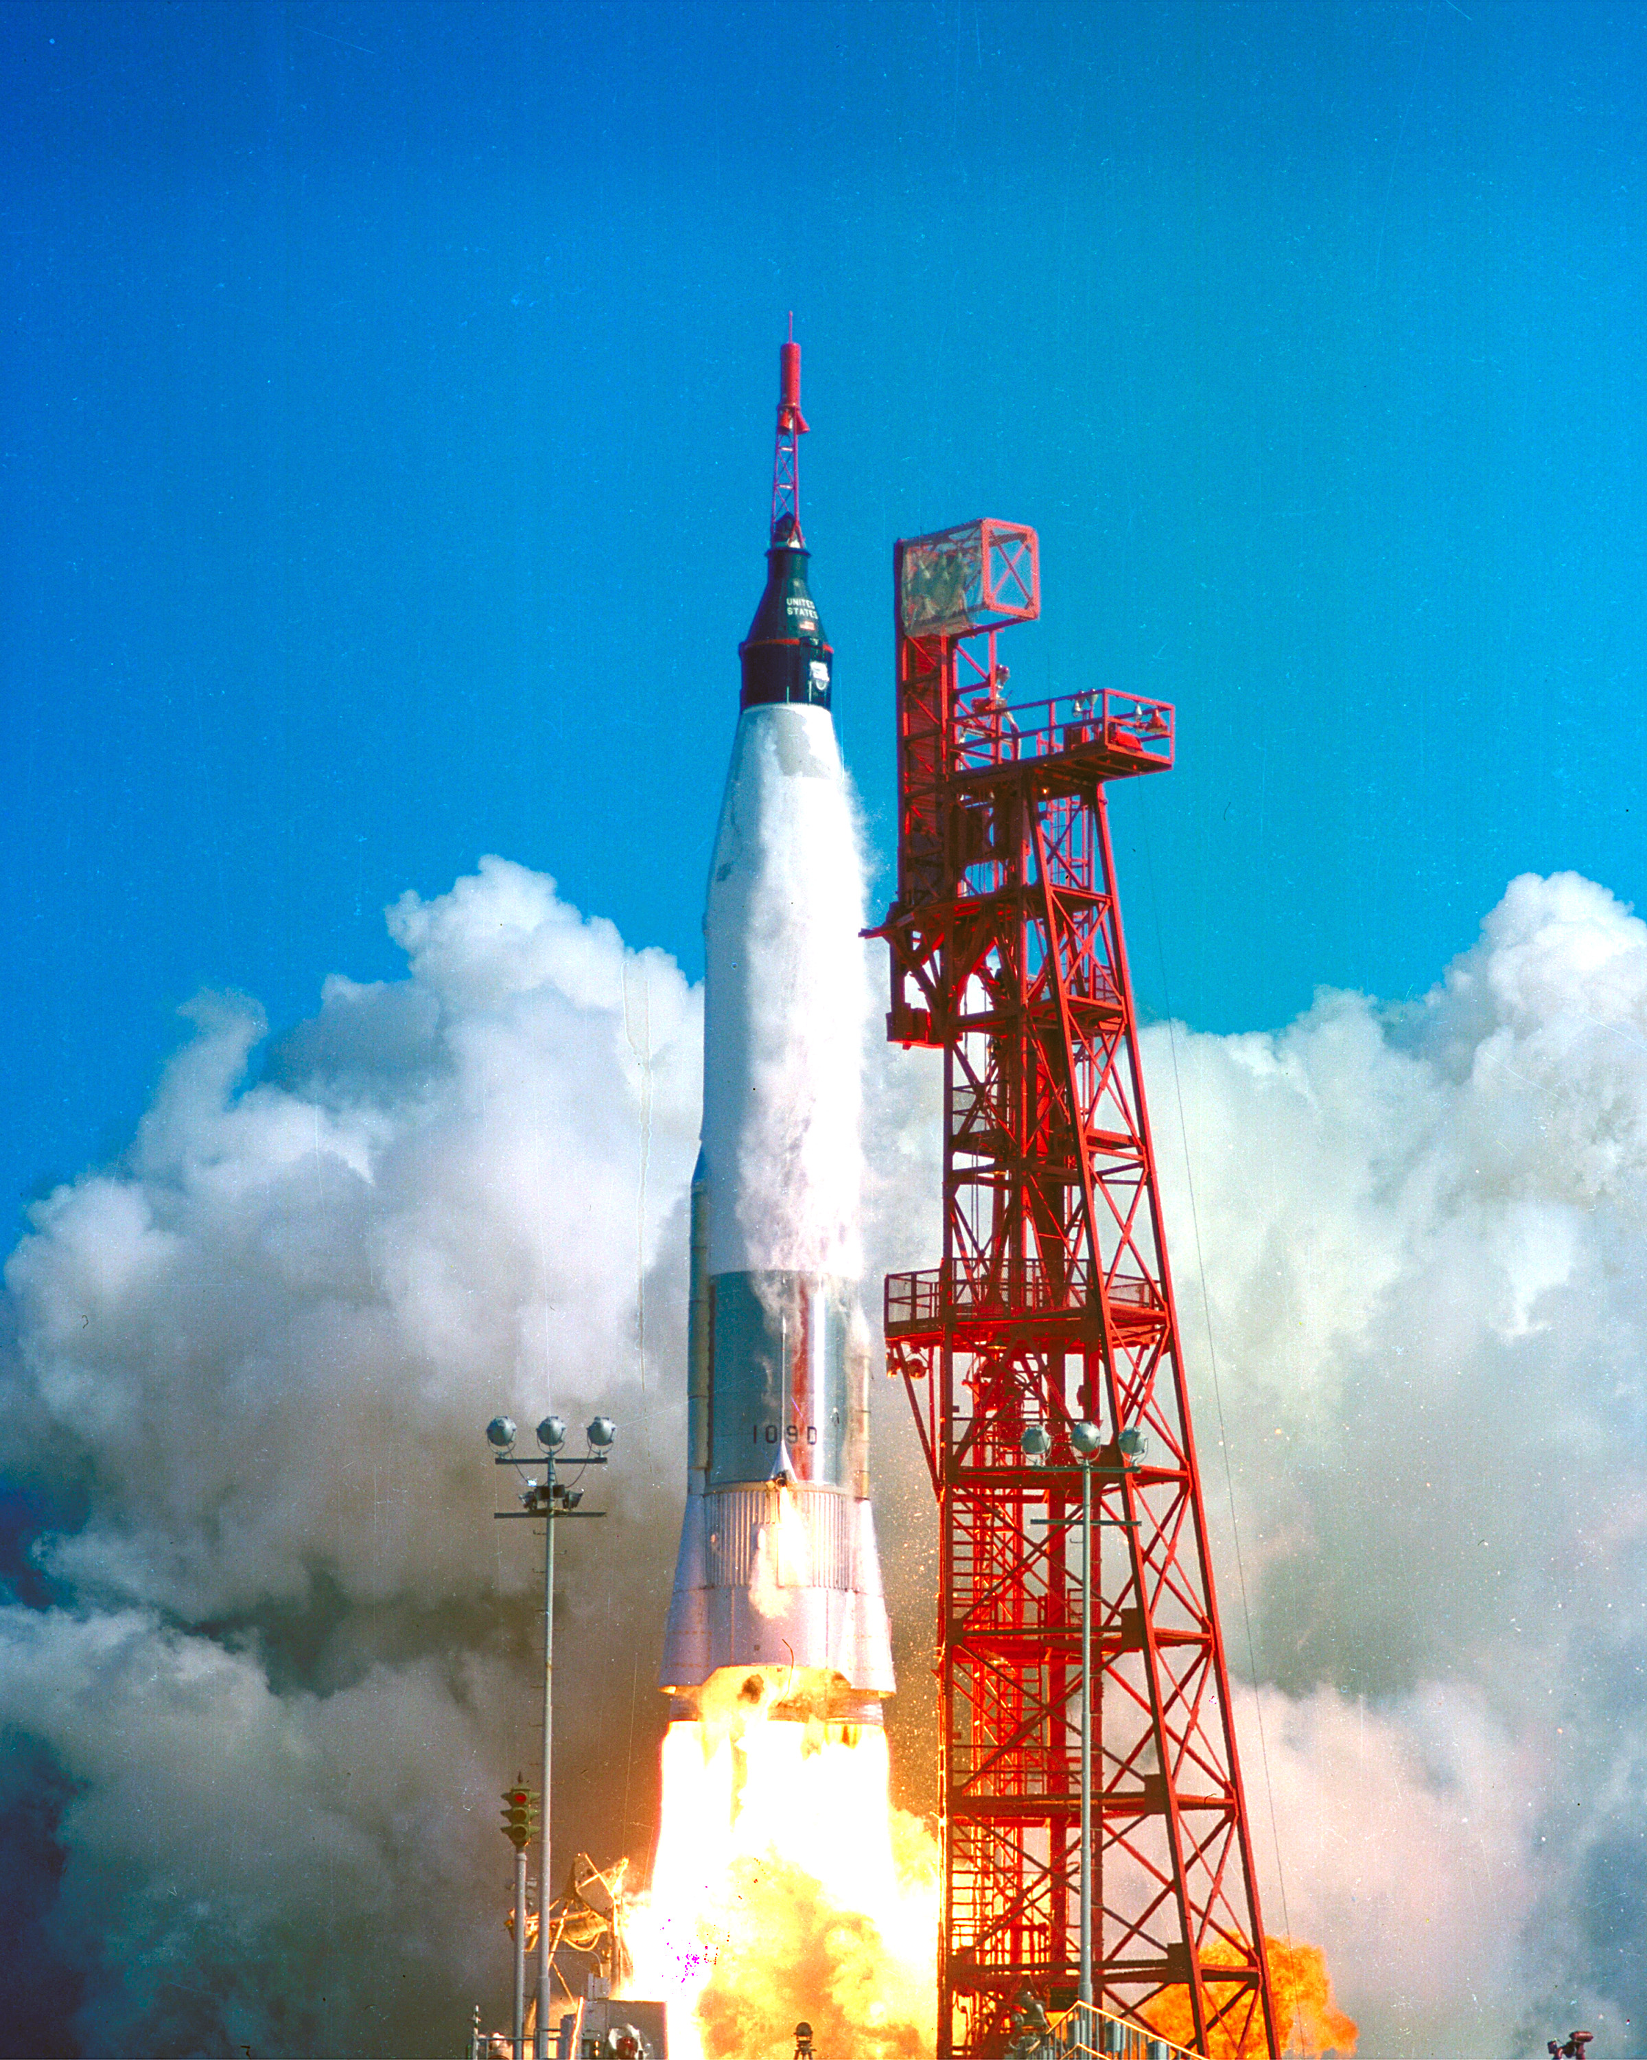
Rocket Components.
Nose cone – carries payload.
Guidance system – tells the rocket where to go.
Propulsion system – liquid or solid propellant creates the force of thrust to move the rocket.
Fins – control direction and stability.
Notes:
Get audience to guess where the payload is in the rocket picture
Liquid propulsion – components separate and can be mixed in a controlled manner to generate thrust
Solid propulsion – components pre-mixed, once lit can’t be stopped – like a firework

Slide 5
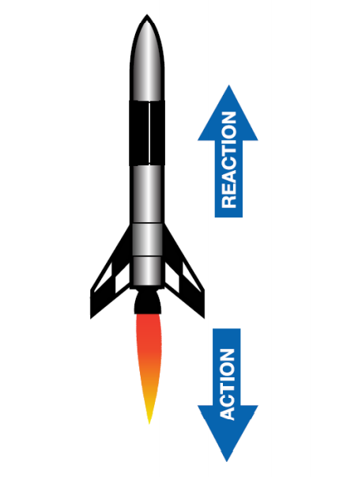
How Does a Rocket Fly?
Sir Isaac Newton, the pioneer of modern physics developed 3 laws of motion:
1st Law: An object will not change its motion unless a force acts on it.
3rd law: For every action there is an equal and opposite action.
Forces on a rocket at Take-off are:
Thrust which overcomes the force of Weight.
https://www.youtube.com/watch?v=o2FFtPPM3iY
Notes:
2nd Law: The force on an object is equal to its mass times acceleration. (in case someone asks!)
Get audience to demo Thrust. All stand up, bend knees and jump as high as possible. What created thrust and what did it overcome?
Rockets launch satellites – important to RAF and society – what do satellites help us with everyday?
Video link to NASA explanation on how we launch things into space

Slide 6
Let’s Build our Rocket!
You will need:
1 x Former tube
2 x A4 paper/card – 1 for the body and 1 for the fins
Scissors
Sellotape
Nose cone
Notes:
Demo rocket build

Slide 7
How will we launch our Rocket? What will create thrust for our rockets today?
How do we measure pressure ?
Notes:
Show and talk about rocket launcher over next 2 slides

Slide 8
What is an angle ? How do we measure angles?

Slide 9
Why do we test things?
How do we make the test fair?
What can we measure?
What happens if we change the PSI ?
Predict
What happens if we change the launch angle?
Predict
Notes:
Test to destruction – test to understand – test to inform future decisions

Slide 10
Our Launch Angle test….
We will choose a rocket to test
We will keep the PSI to 10
We will set the angle to be tested
We will measure the distance flown
We will record the results and repeat the test for a new angle.
What have we observed?

Slide 11
Mission: launch your rocket more than 10 meters Choose your Launch angle.. Choose your PSI.. Let’s Launch…
Notes:
Give young person choice of 30, 45 or 70 degrees and PSI of 25, 30 or 40 (dependant on space available for launch and prevailing weather conditions)

