Slide 1
Theory of Flight

Slide 2
PRINCIPLES OF FLIGHT
_ _ _ _ _ _
_ _ _ _
_ _ _ _ _ _
_ _ _ _

Slide 3
THRUST
Thrust is a mechanical force generated to move an aircraft through the air
What creates the force of Thrust on an airplane?
Discuss
What types of engine do you know about?
What will create the force of Thrust on your glider?

Slide 4
THRUST
Engines generate Thrust for an airplane
Many types; Jet, Turbo Propellor, Electric, Piston, Rockets
Gliders don’t have engines. In real time they receive a ‘tow’ – today they will use your arm!

Slide 5
DRAG
Drag is the force generated by a solid object moving through a fluid (air!)
Air particles create friction when they come into contact with a moving solid
Drag is generated by every part of the airplane (even the engines!)
Discuss
What can we do to reduce Drag?

Slide 6
DRAG
Drag is the force generated by a solid object moving through a fluid (air!)
Curved Edges
Smooth surfaces
Aerodynamic shapes

Slide 7
WEIGHT
Weight is caused by Gravity and is the force that keeps objects on the ground
What do you think makes up the weight of an airplane?
Discuss
What can we do to make an airplane lighter?

Slide 8
WEIGHT
Structure, Crew, Payload (that’s the cargo/passengers) and Fuel determine an aircrafts weight
Overcome weight limitations by constructing the body with lightweight materials; remove unnecessary material; wing shape, engine size

Slide 9
LIFT
Lift is the force on an item that moves it perpendicular (90 degrees) to the direction of motion
Which part of the airplane do you think helps generate Lift?
What airplane wing shapes do you know?
Discuss

Slide 10
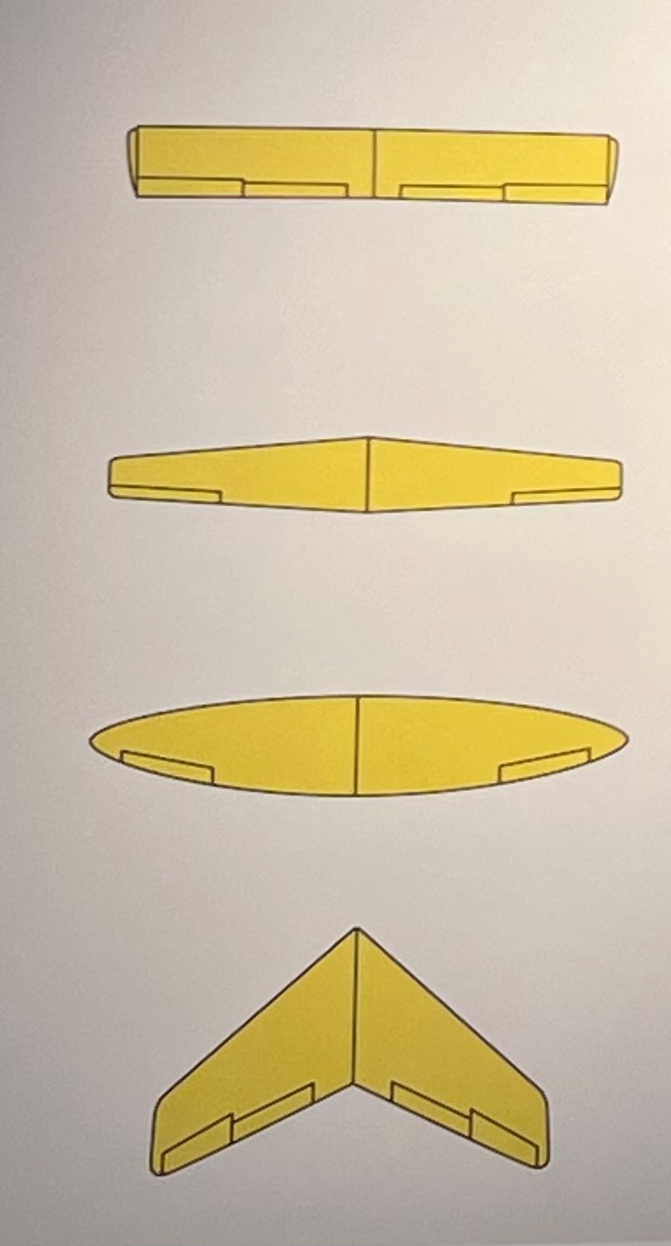
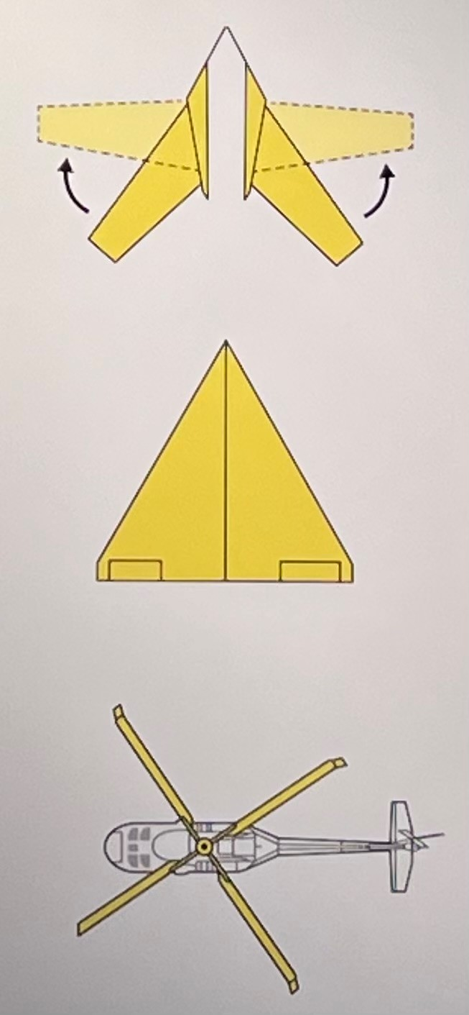
TYPES OF WING SHAPE
STRAIGHT WING
Good for low speed, low height & low cost in production
SWING WING
Good for aircraft required to work at both low and high speeds
TAPERED WING
More aerodynamic than a straight wing which improves lift
DELTA WING
Good for flying subsonic, transonic and supersonic
ELLIPTICAL WING
Good for steering the aircraft
STRAIGHT WING
Good for vertical take-off
SWEPT WING
Good for stability at greater heights

Slide 11
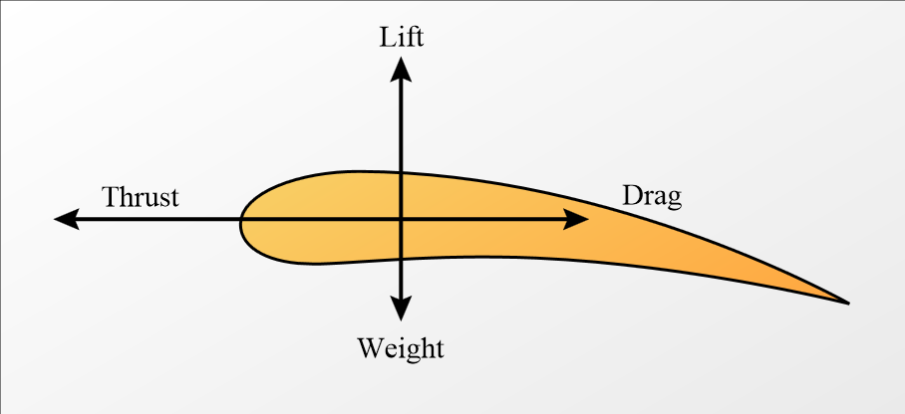
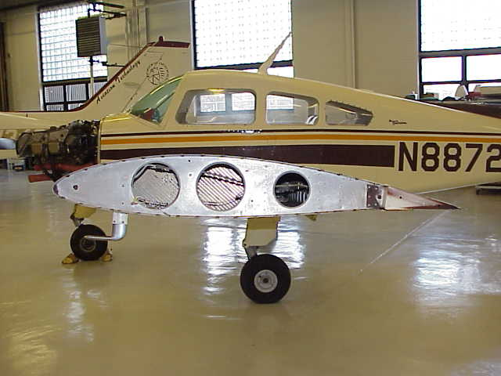
WINGS
Cross section of an airplane wing has a soft round front that tapers to a point – known as an Aerofoil

Slide 12
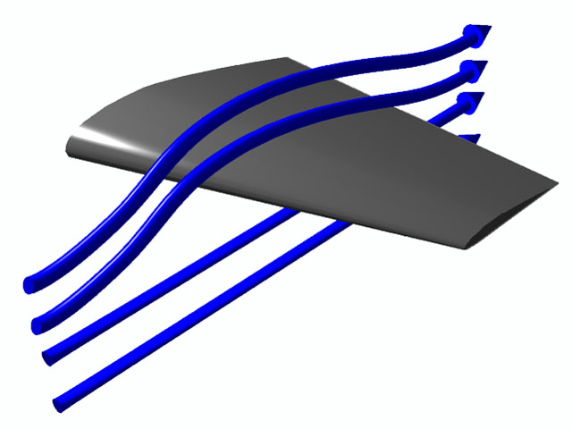
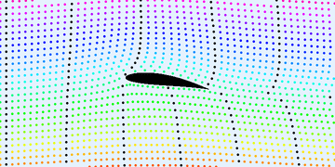
WINGS
Low pressure
Air pressure
Using aerofoils we can change the air pressure around wing to create lift.
The air over the wing has further to travel. The air particles speed up and the gaps between them get bigger. This causes the air to exert a LOWER pressure on top of the wing.
The air under the wing moves slower which causes it to exert a HIGHER pressure under the wing.
High pressure

Slide 13
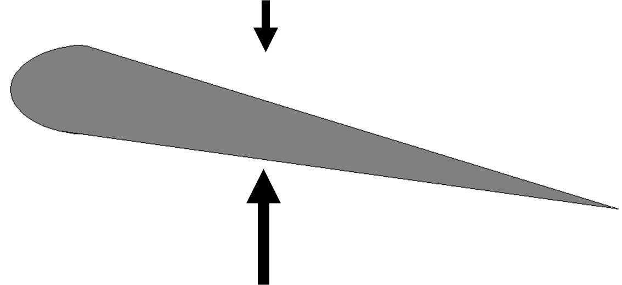
Low pressure above the wing
High pressure below pushes up on the wing
HIGH PRESSURE UNDER THE WING LIFTS THE AIRCRAFT IN THE AIR

Slide 14
PRINCIPLES OF FLIGHT RE-CAP
WEIGHT
THRUST
DRAG
LIFT

Slide 15
Lets build a glider!

Slide 16
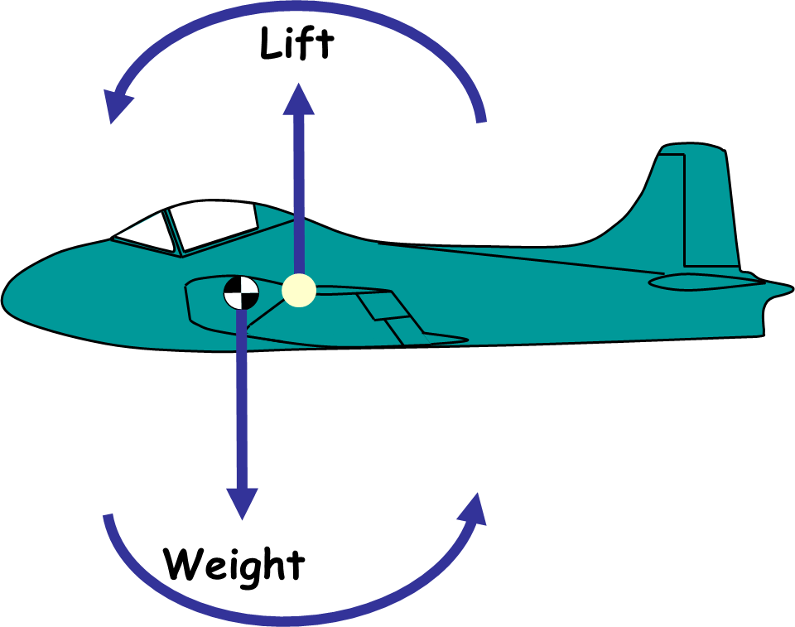
BALANCE
(Centre of Pressure)
(Centre of Gravity)

Slide 17
BALANCE
A weight (the nut) is applied to the front of the glider to help balance the aircraft .
(Centre of Gravity)
(Centre of Pressure)
If an aircraft is balanced the centre of gravity (down) and the centre of pressure (up) will be in the same location to help make the aircraft more stable in the air

Slide 18
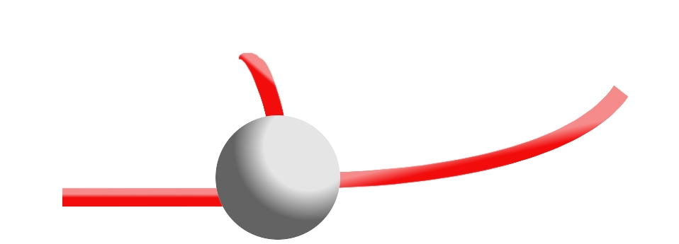
How to balance your glider

Slide 19
Move the wing backwards and forwards along the fuselage to find the balance point

Slide 20
Lets go Fly!

