Slide 1
Coding With Sphero Bolt
Getting Started
OScar Stringer

Slide 2
Open the App Sphero Edu
Keep your Sphero Mini Close to your iPad

Slide 3
Keep your Sphero Mini Close to your iPad
Select the tab Home

Slide 4
Keep your Sphero Close to your iPad
Tap connect Sphero

Slide 5
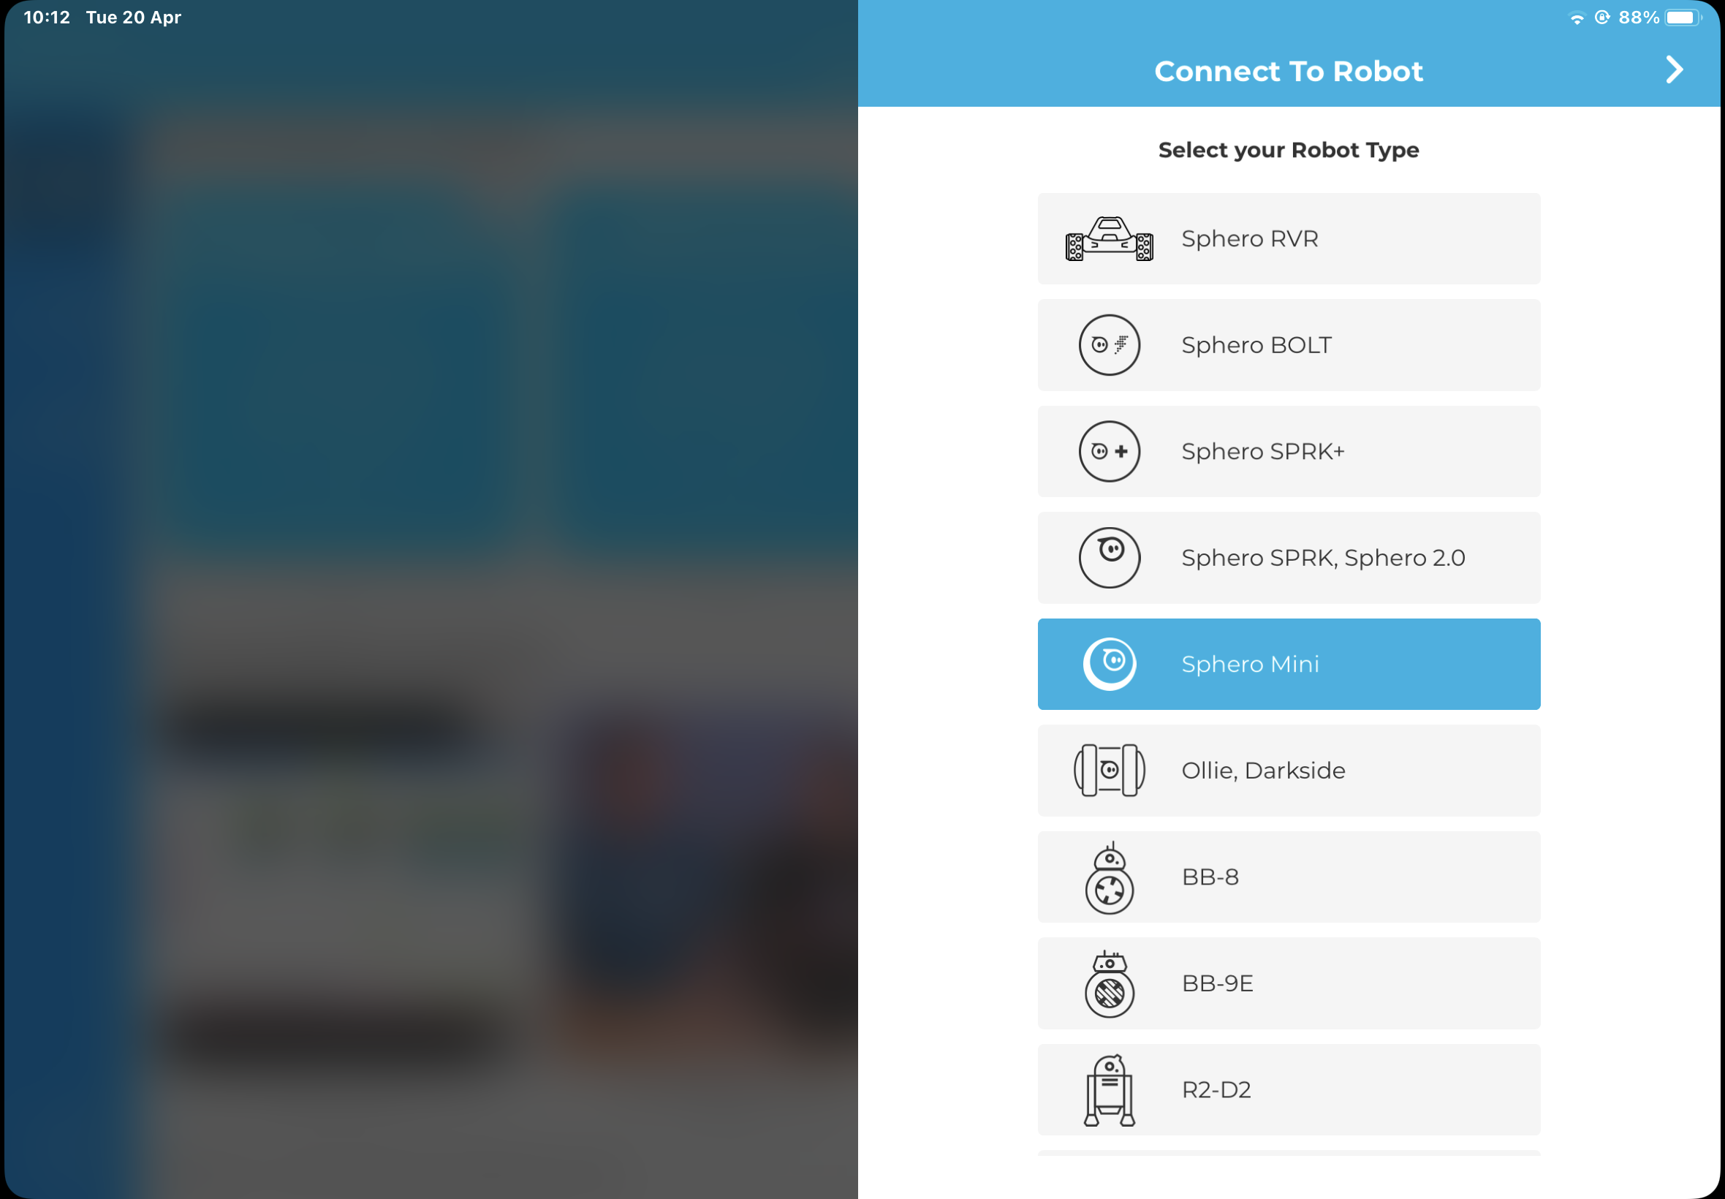
Keep your Sphero Close to your iPad
Select Sphero Mini from the list to connect.

Slide 6
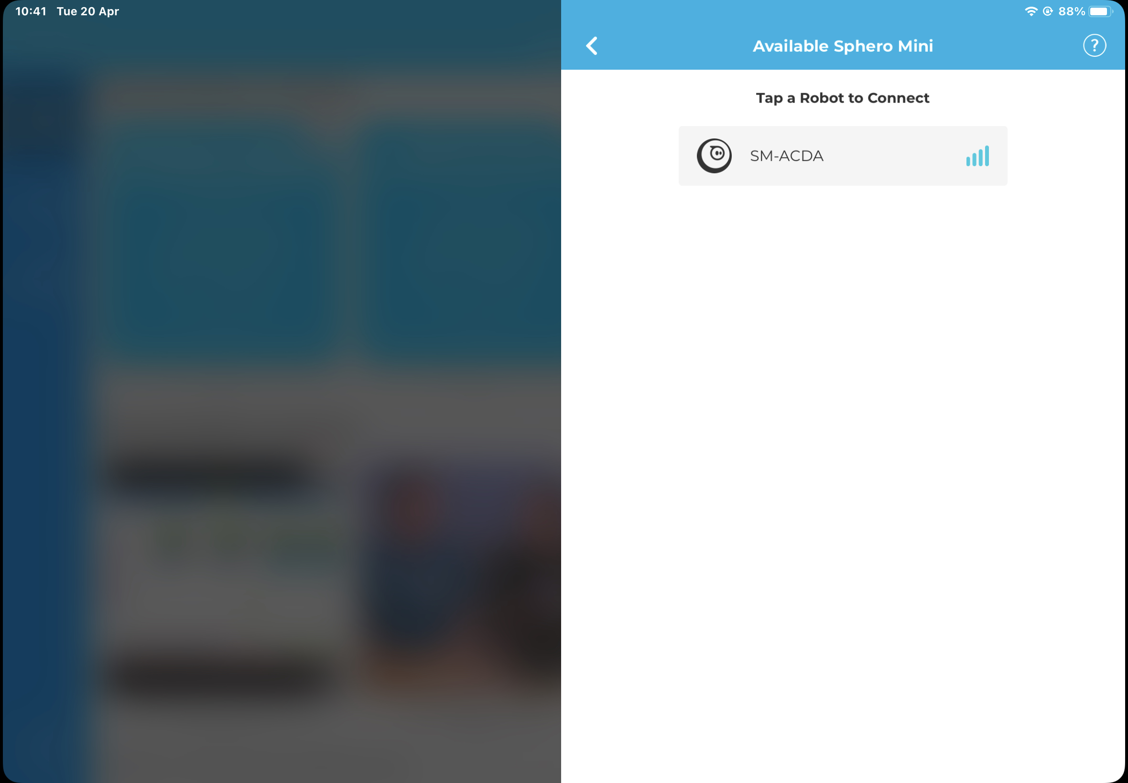
Keep your Sphero Close to your iPad
Select the Sphero Mini name to connect.

Slide 7
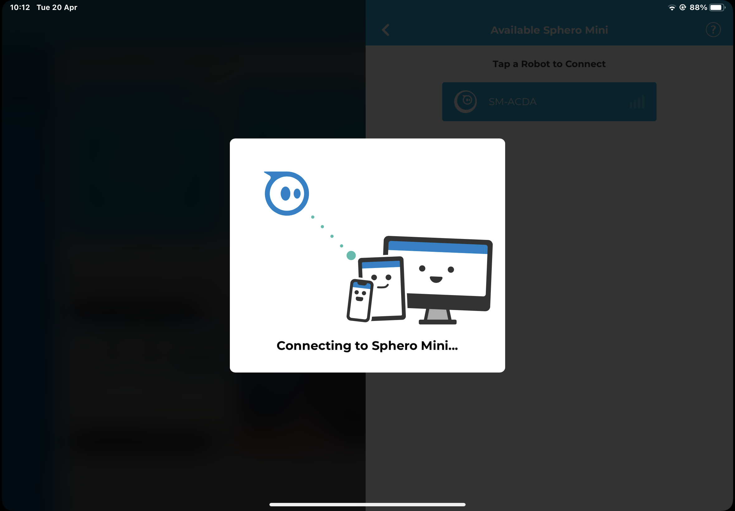
Keep your Sphero Close to your iPad

Slide 8
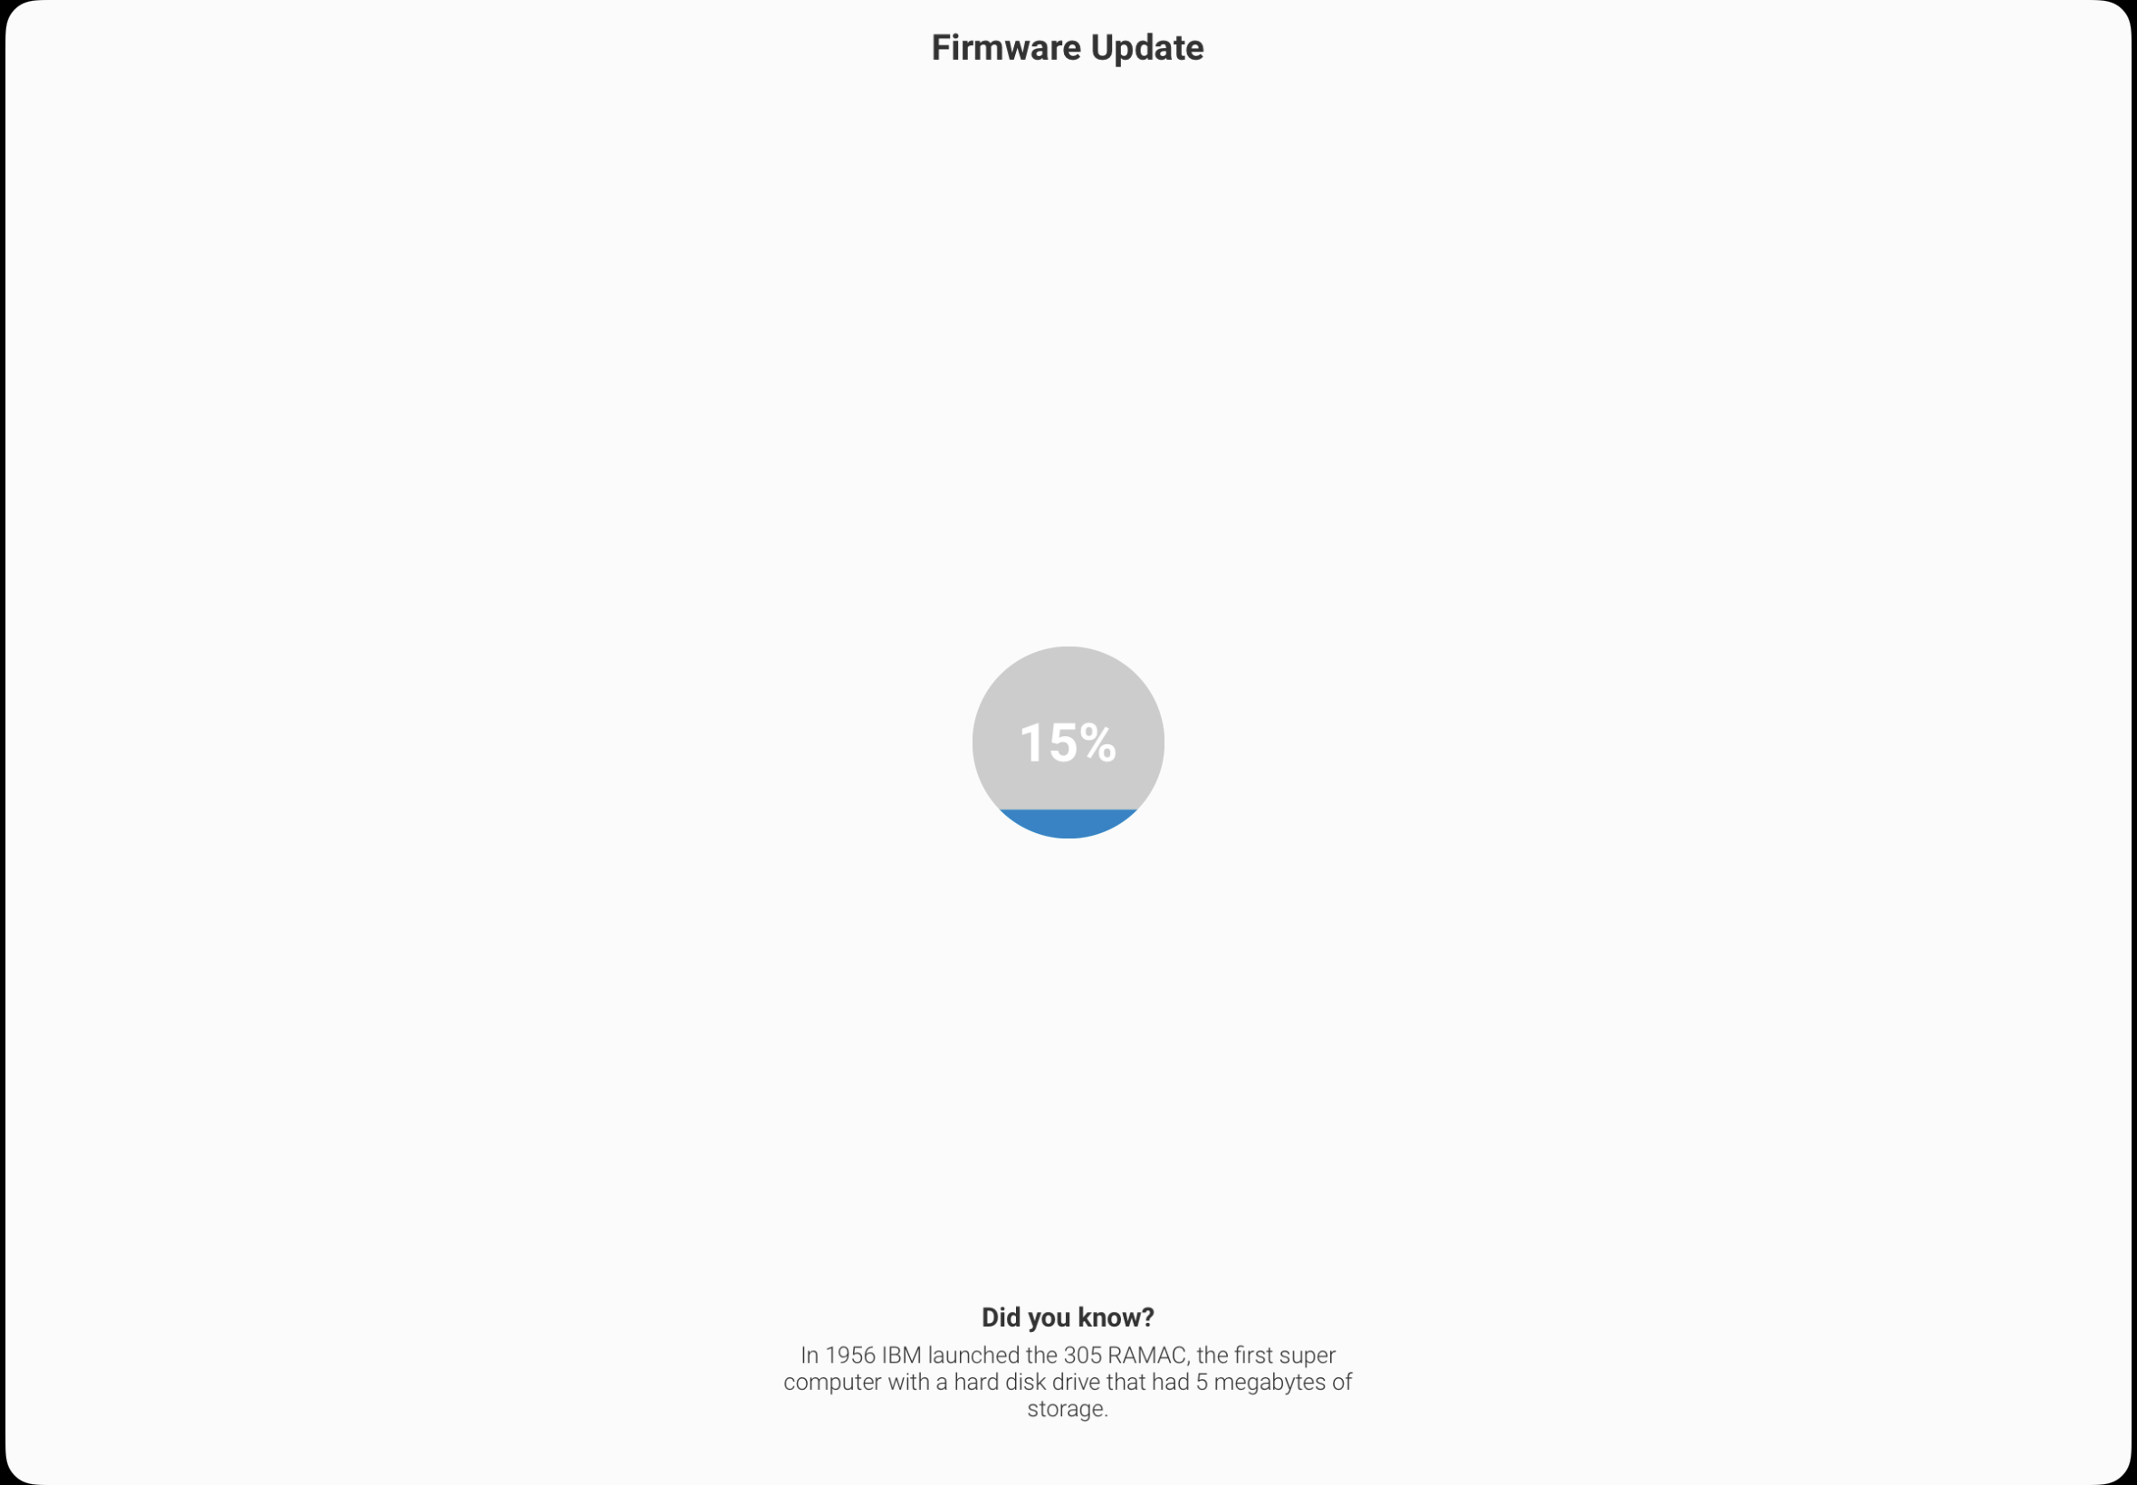
Keep your Sphero Close to your iPad
This might happen, it will only take a minute to install.

Slide 9
Keep your Sphero Close to your iPad
This battery icon tells us we are connected and also how much power is in the Sphero.

Slide 10
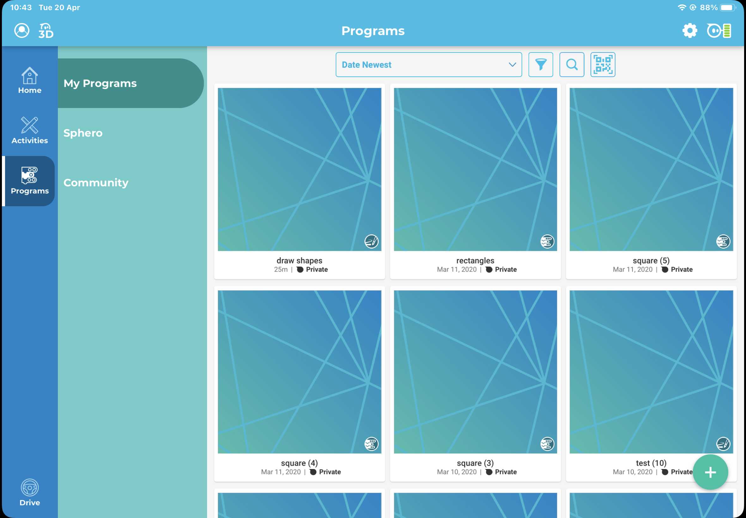
Keep your Sphero Close to your iPad
To start coding the Sphero Mini and give it commands, tap on Programs.

Slide 11
Keep your Sphero Close to your iPad
Next tap + to start a new project.

Slide 12
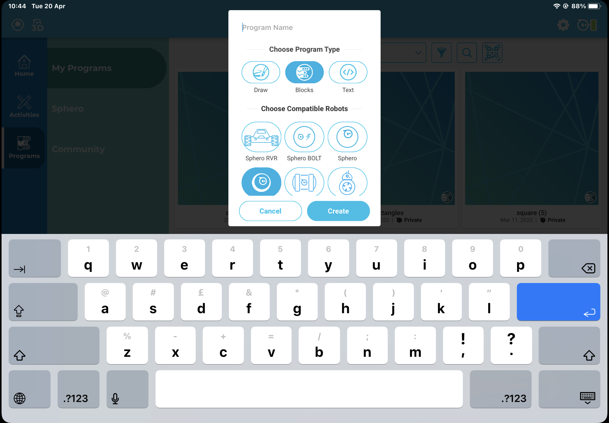
Keep your Sphero Close to your iPad
Give your Program a Name and Select Draw. Then tap Create

Slide 13
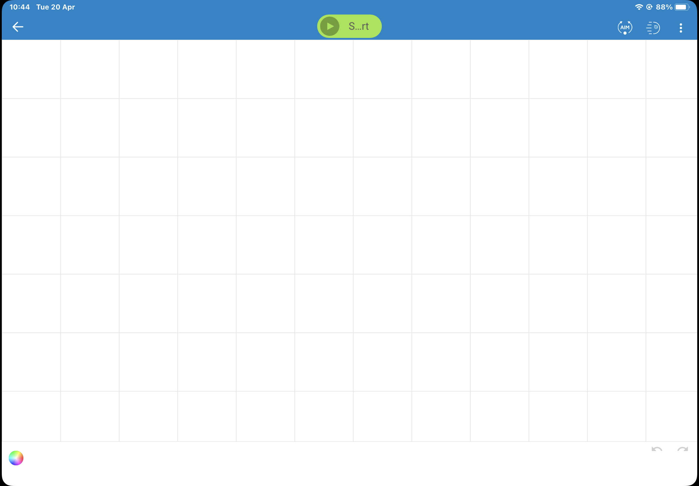
Keep your Sphero Close to your iPad
Before using the Sphero we must always aim the sphero.

Slide 14
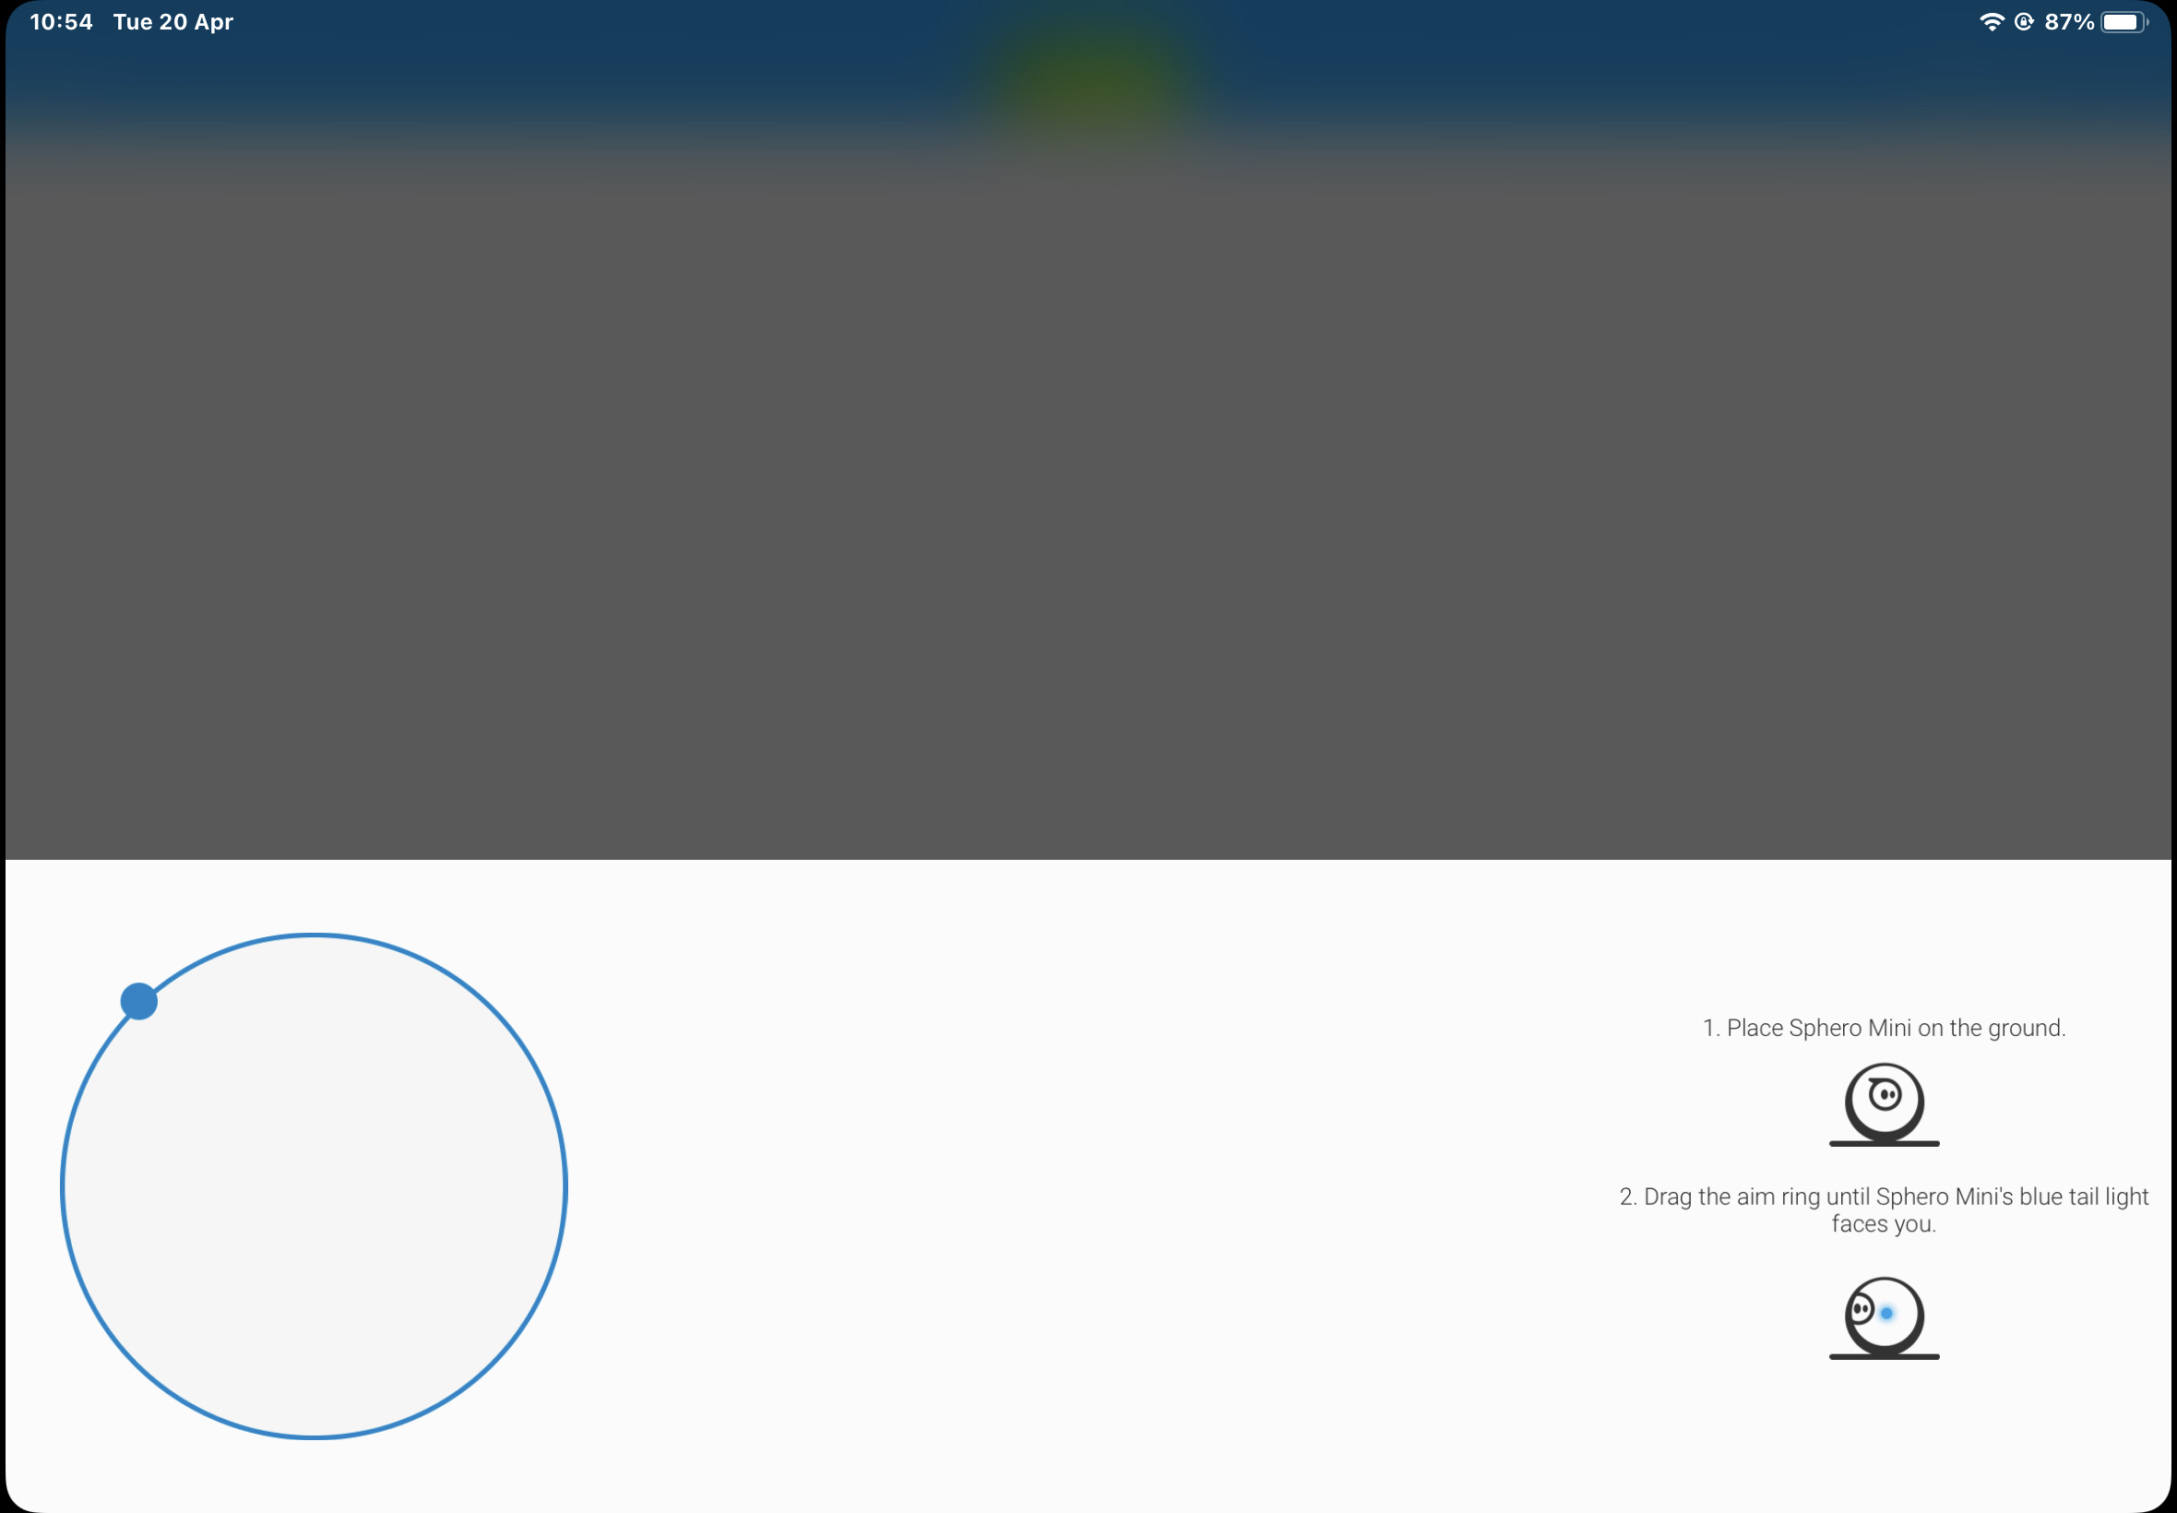
Keep your Sphero Close to your iPad
Before using the Sphero we must always aim the sphero.
We need to tell the Sphero which way it will travel, by telling it which way is forward.

Slide 15
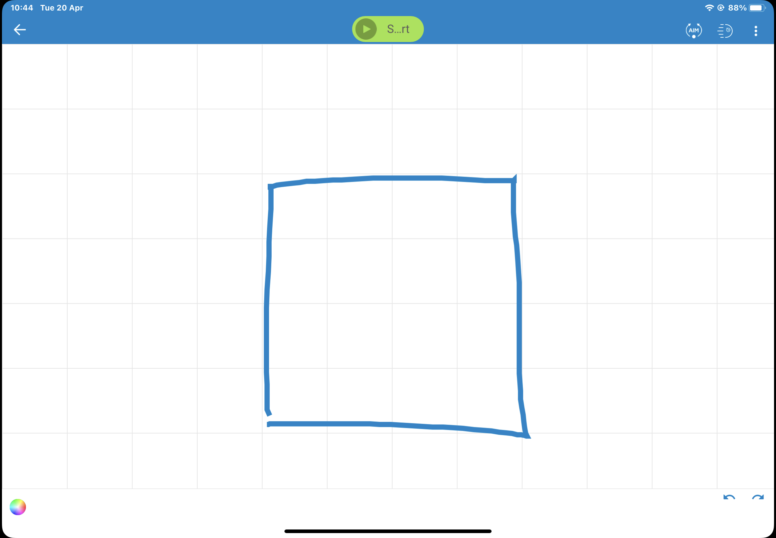
Keep your Sphero Close to your iPad
Draw a shape
Tap on the colour wheel.

Slide 16
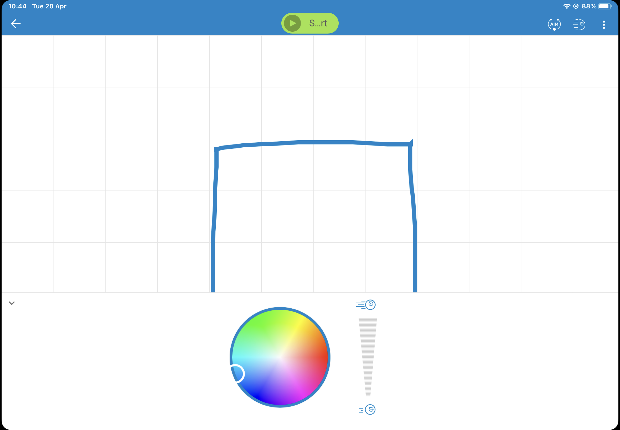
Keep your Sphero Close to your iPad
What can we change here?

Slide 17
Keep your Sphero Close to your iPad
Tap the Start button

Slide 18
Keep your Sphero Close to your iPad
What happens if you make the shape really big?
How slow can you make the Sphero Mini travel?
Can you change the colour of each side of shape? What happens to the Sphero Mini when you do?

Slide 19
Remember
If you pick your Sphero up, you must aim it again before tapping Start.
Use the undo arrows in the bottom right of the screen to undo.
Control the Sphero with the Speed control, too fast and it will loose accuracy.

Slide 20
What does Code look like?
Tap on the Three Dots

Slide 21
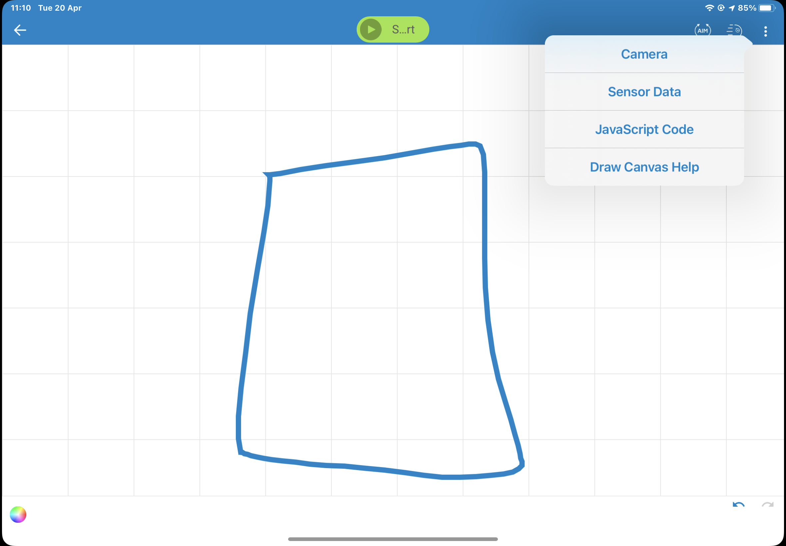
What does Code look like?
Select JavaScript Code.
JavaScript is a programming language commonly used in web development.

Slide 22
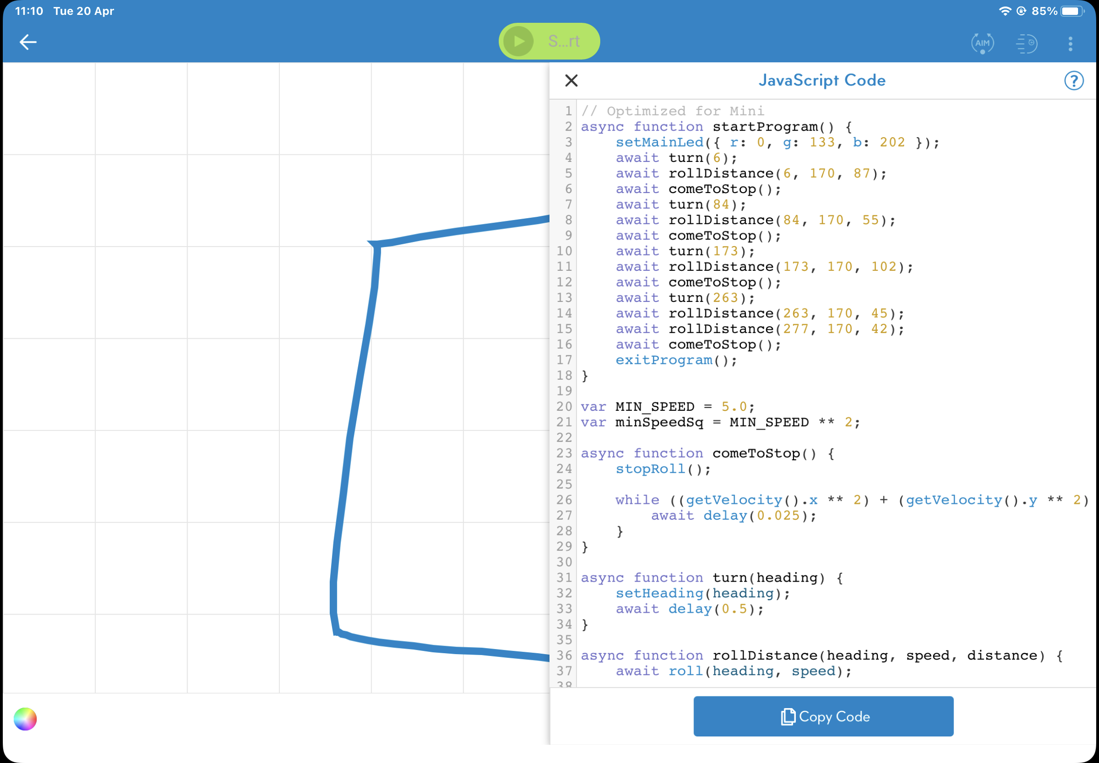
What does Code look like?
JavaScript is a programming language commonly used in web development.
There are many different programming languages that are used for different areas of technology.

Slide 23
What does Code look like?
JavaScript
Can you see the commands in the code? How are they written?
Can you see the values in the code? What do they relate to?
Within the code can you see where the values for the colour of the Sphero light are?

Slide 24
What does Code look like?
JavaScript
Draw a new shape and make it red. What do you notice about the code now? Can you see what has changed?

