Slide 1

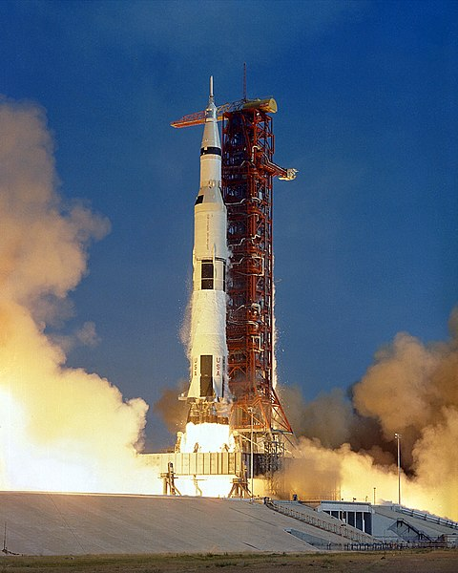
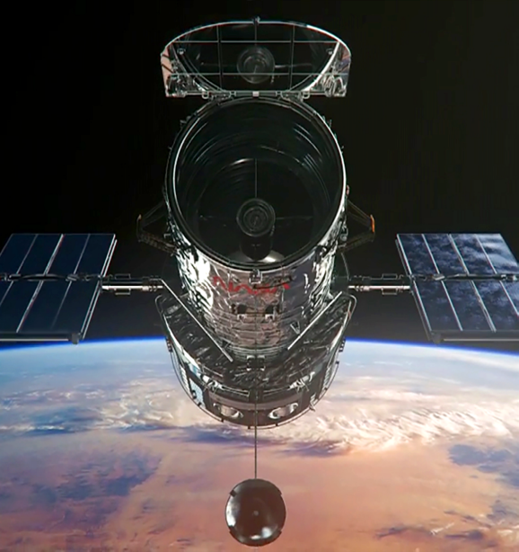
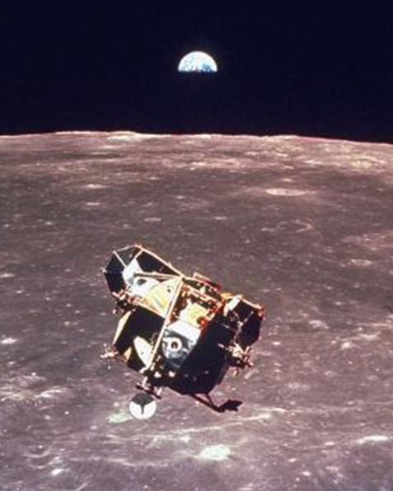
A User's Guide to Space

Slide 2
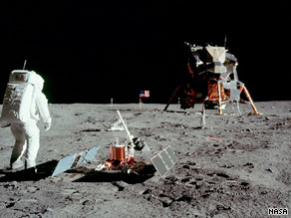
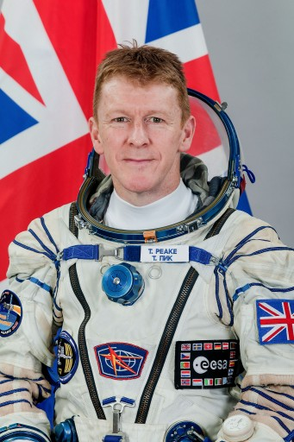
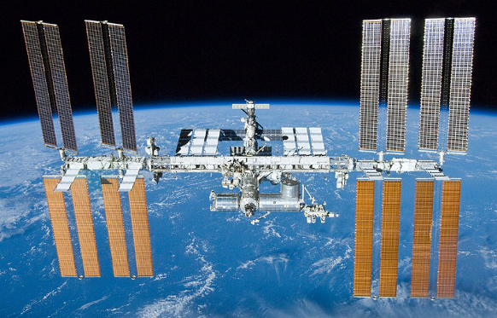
Exploring Space Quiz

Slide 3
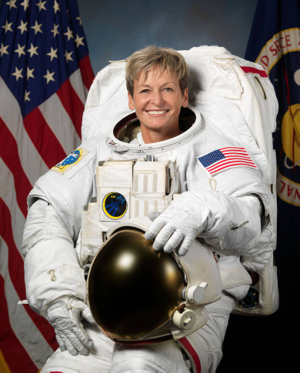
Exploring Space Quiz

Slide 4
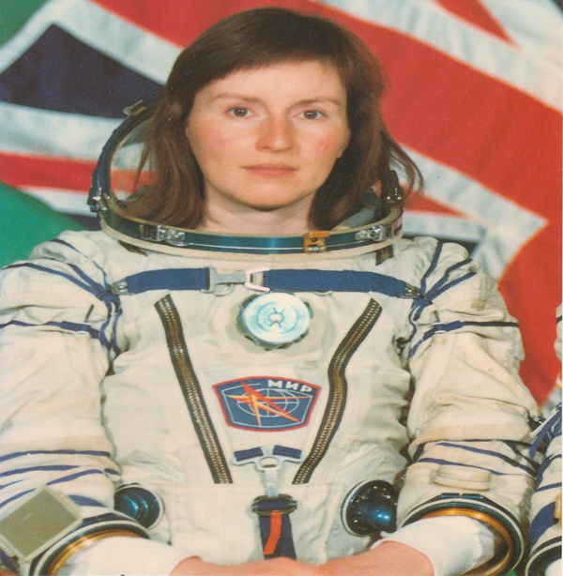
Exploring Space Quiz

Slide 5
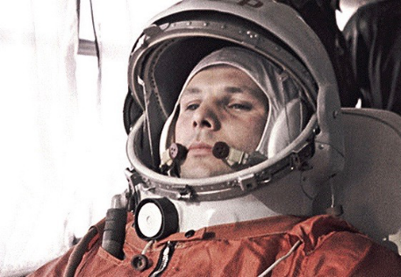
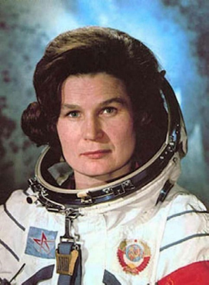
Exploring Space
1969 - 1972
1961 - 1963
2000 - Today

Slide 6
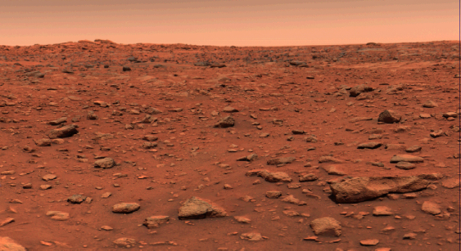
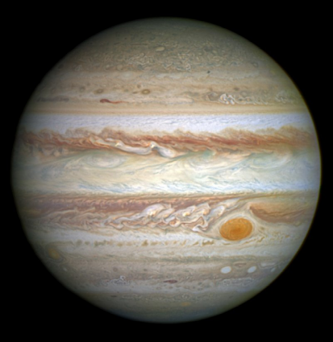
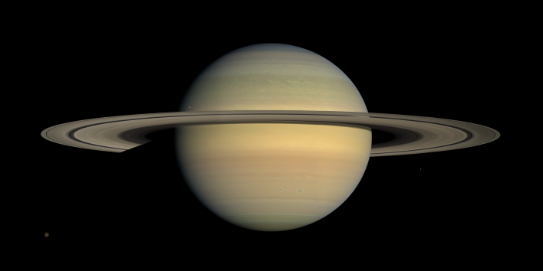
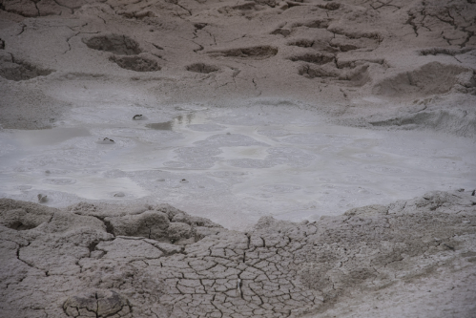
Understanding Space Quiz

Slide 7
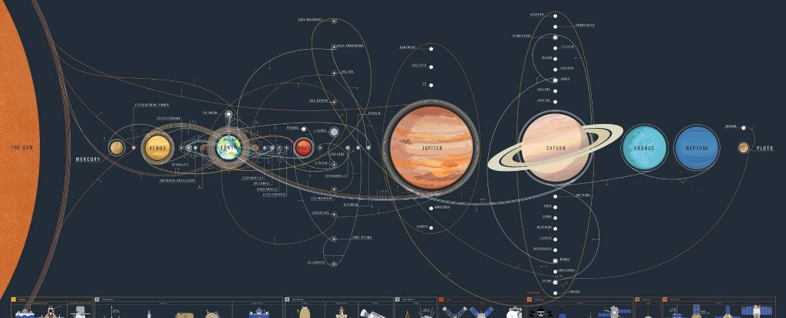
Understanding Space

Slide 8
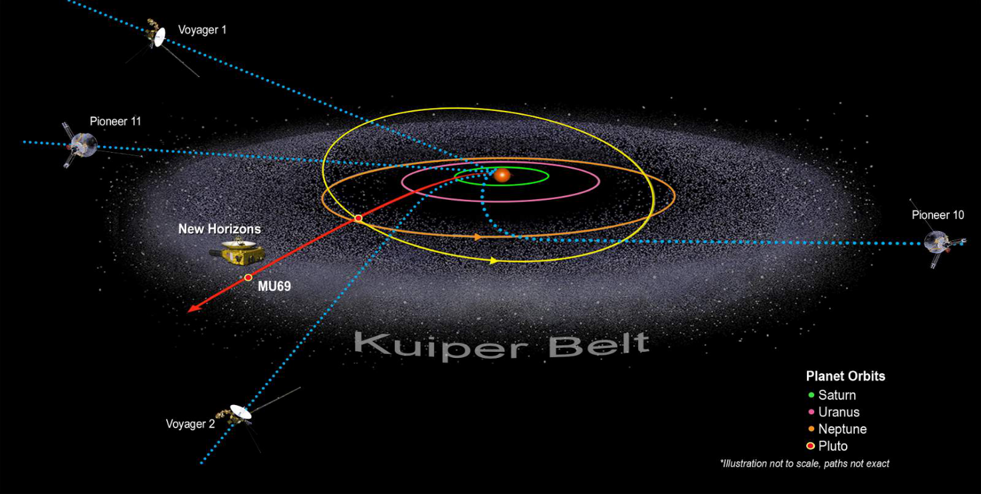
Understanding Space

Slide 9
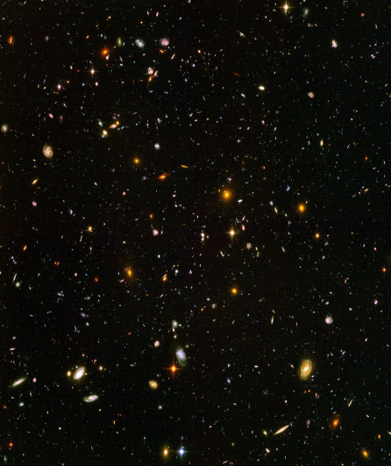
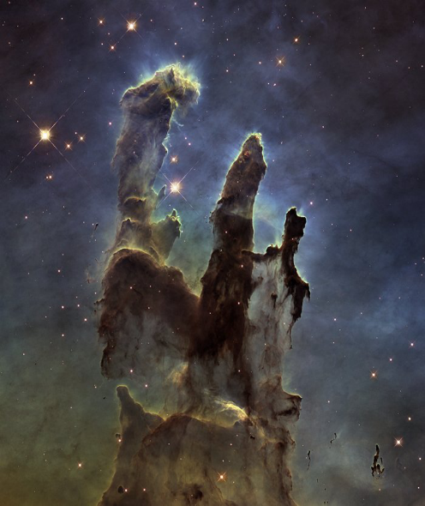
Understanding Space
Watching the birth of stars
Orbiting the Earth
Seeing the Universe

Slide 10

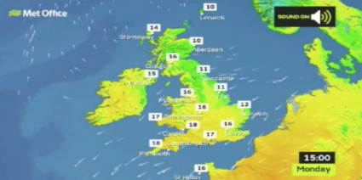
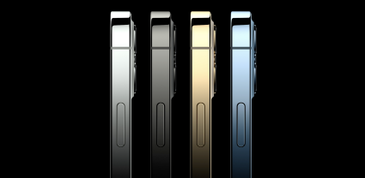
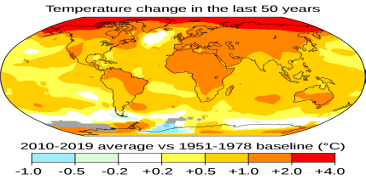
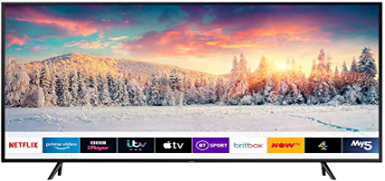
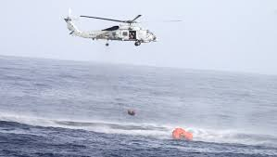
Using Space
Using Space Quiz
The Internet | Weather Forecasts | Mobile Phones
Climate Change | Television | Rescuing Sailors

Slide 11
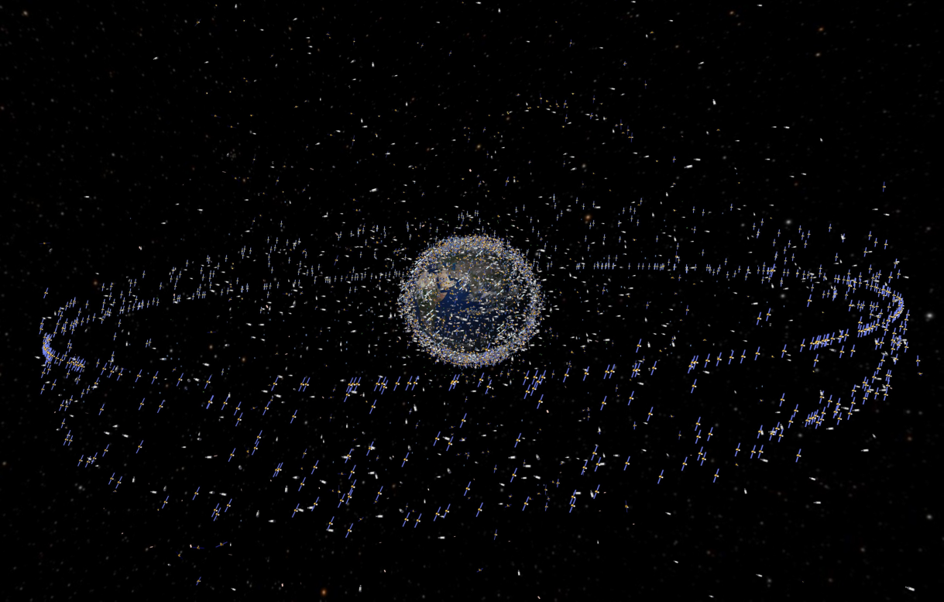
Using Space

Slide 12

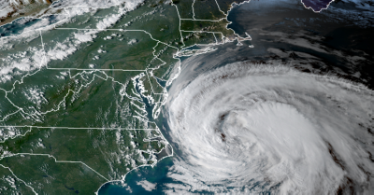
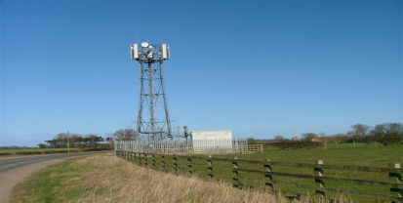
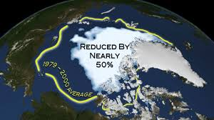
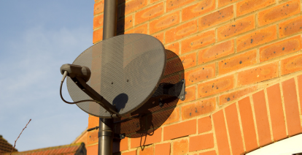
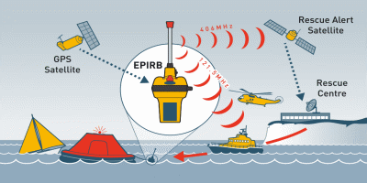
Using Space
Using Space Quiz – the answers
The Internet | Weather Forecasts | Mobile Phones
Climate Change | Television | Rescuing Sailors

Slide 13
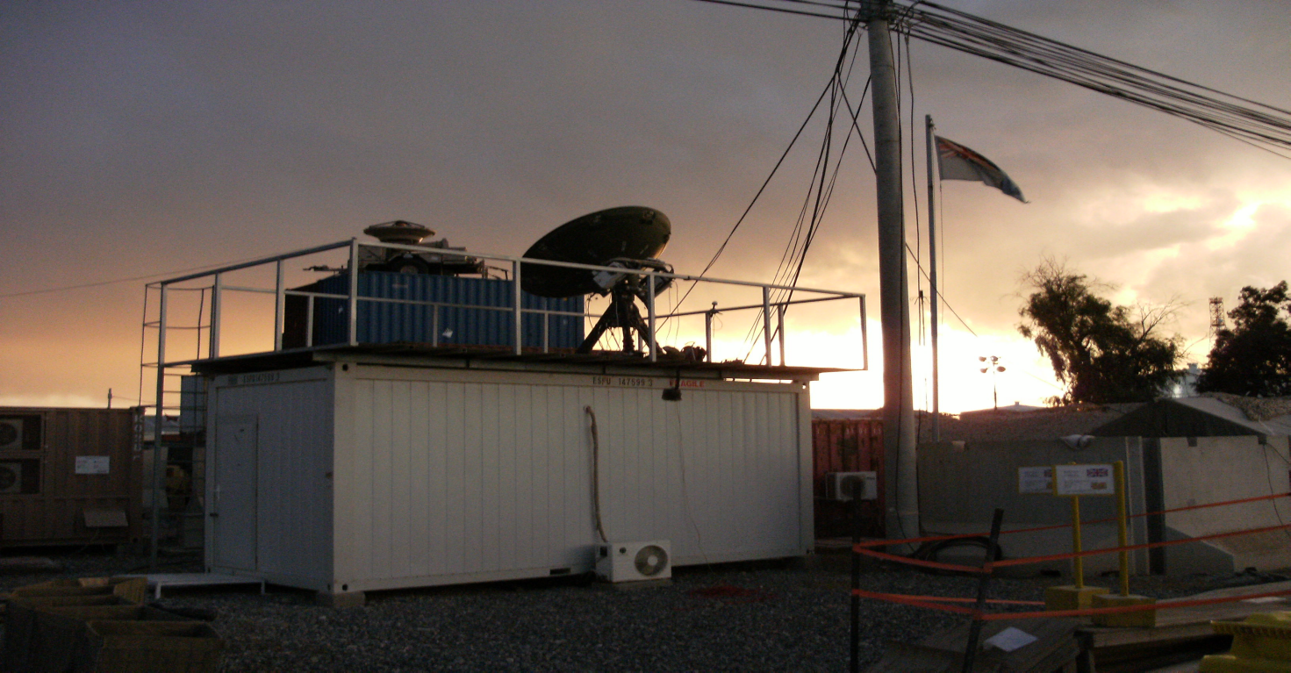
Using Space

Slide 14
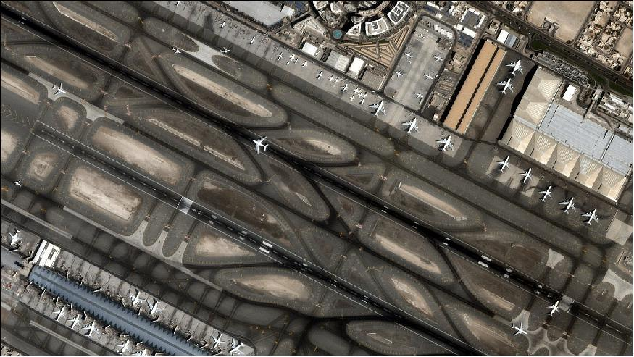
Using Space

Slide 15
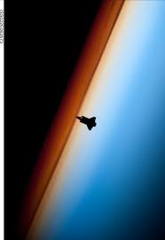
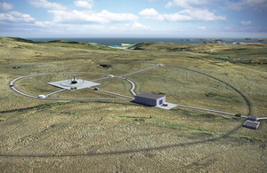

Next 'Giant Leaps' in Space
Giant Leaps Quiz

Slide 16
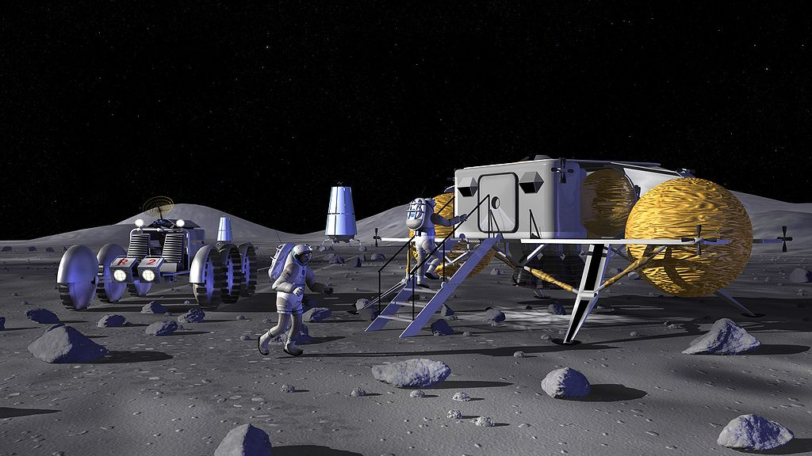
Next 'Giant Leaps' in Space

Slide 17
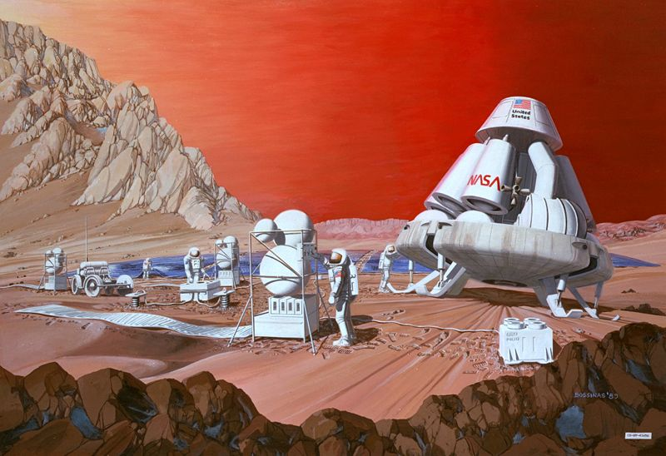
Next 'Giant Leaps' in Space

Slide 18
Who Are Our Rocket Scientists?
Quiz Results
  Work out your score
  One point for every correct answer
    For the 'Using Space' question, you get one point for every use you circled
  Best possible score is 16

Slide 19
A User's Guide to Space

Slide 20
A User's Guide to Space
Thanks for Having Me
Any Questions?

