Slide 1
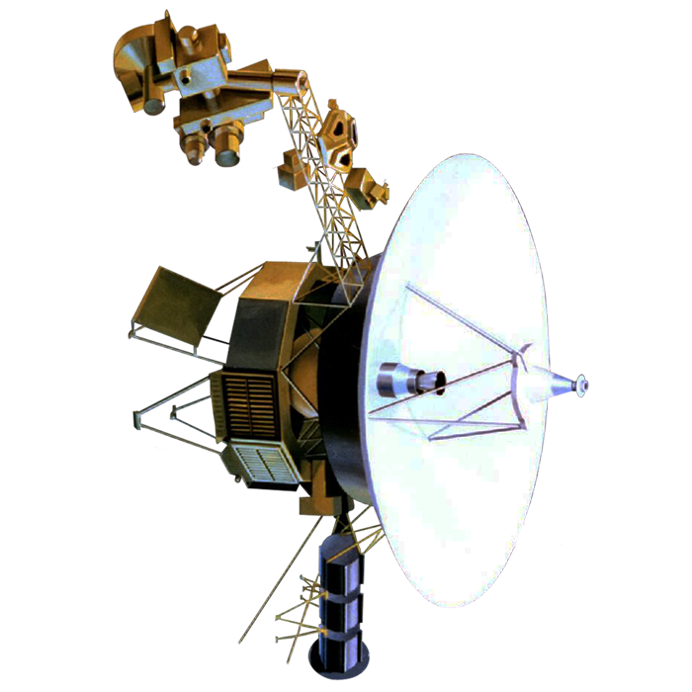
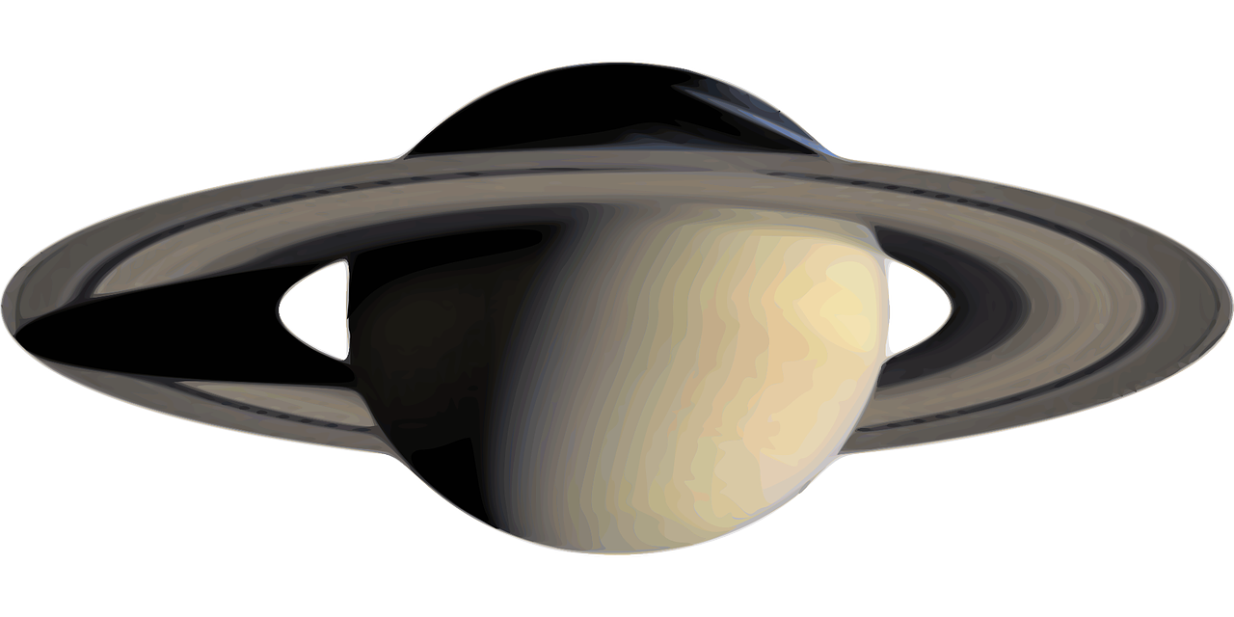
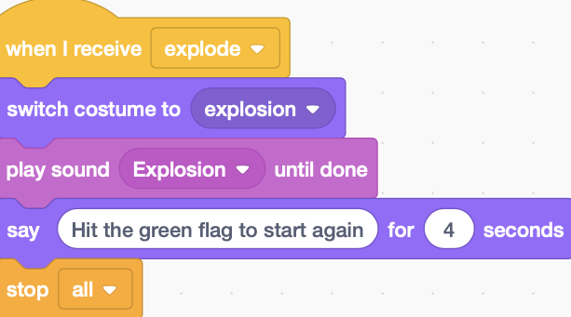
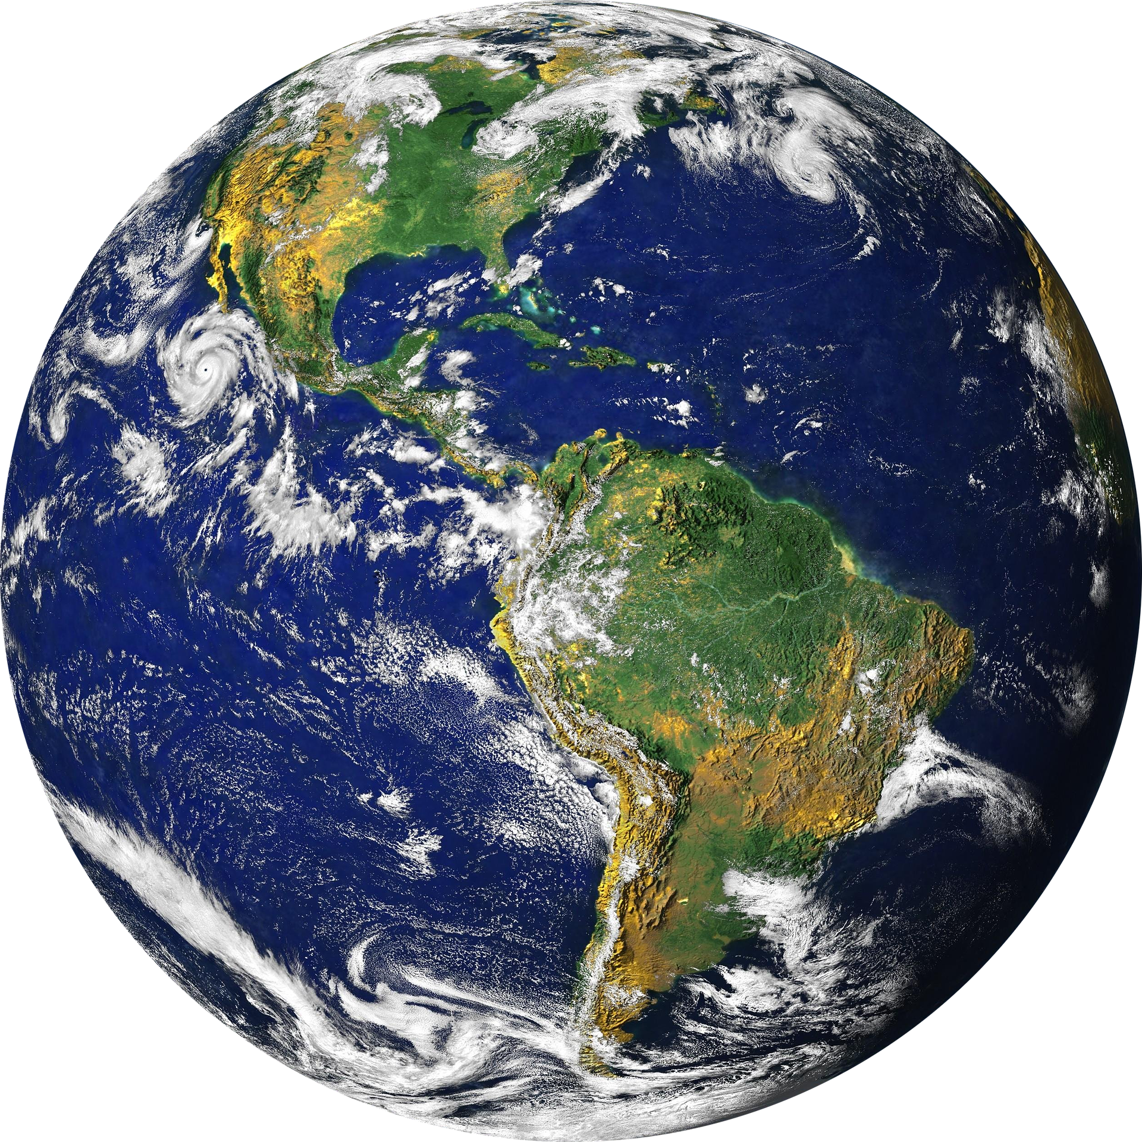
RAF Code Commanders: Cosmic Launch Project
Session 4
Brought to you by the Royal Air Force in partnership with Hyett Education
For more free and exciting STEM resources go to www.rafyouthstem.org.uk

Slide 2
Disclaimer: Included in this project are links to YouTube videos and other websites selected to support learning outcomes for students. These links and media have been checked for their suitability at the time of publication. The RAF and Hyett Education are not responsible for the content of any additional media or webpages shared by publishers, and do not endorse any services or products that they sell. The RAF and Hyett Education are also not responsible for, and do not endorse, any adverts, comments or links appearing alongside or within media, including any associated with video materials on YouTube. We recommend that YouTube is used in a ‘logged out’ state, to minimise the risk that any advertisements that are shown are associated with the previous viewing history of the PC or facilitator that is leading the session. For information on signing in and out of YouTube, visit https://support.google.com/youtube/answer/3802431 The content of third-party links may change over time. We recommend that project facilitators carefully review media and third-party links before sharing them with students.

Slide 3
We welcome feedback! If you encounter any errors or broken links in this project, or have constructive suggestions for improvement, please email Antony Hyett at antony@hyetteducation.com and provide details. Your cooperation and feedback is greatly appreciated. We’d love to see how you’re getting on with this project. Please share students’ participation, progress and enjoyment of this project on social media using the hashtag #RAFCodeCommanders and follow @rafyouthengage and @hyetteducation to keep up to date with RAF Youth & STEM and Hyett Education’s work with schools.
Feedback & Social Media

Slide 4
Session 4: Beyond the Solar System, and completing our game program

Slide 5
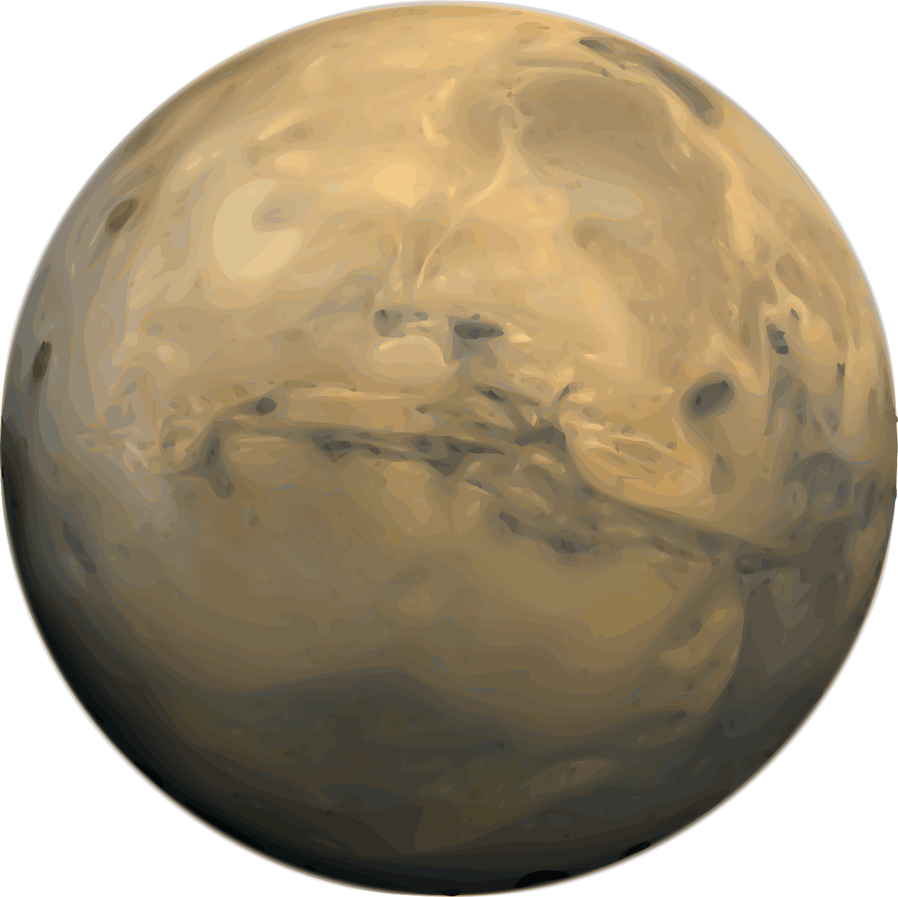
Overview
In this project you will:
Learn to code a space game using the programming tool Scratch
Learn key vocabulary in computer science, including algorithm, sequencing, selection, and iteration
Revise and extend your knowledge of our Solar System
Consider the challenges of exploring our Solar System and beyond.

Slide 6
Last session
You:
Learned how unrealistic our game is, in many, many ways …
Learned how to code what happens to the probe and the planet when the probe touches a planet i.e. how to add levels

Slide 7
This session
You will:
Learn about the true scale of The Solar System within our galaxy, and of of galaxy within the Universe …
Create an explosion if the probe hits the edge of the Stage
Code what happens if the player completes all levels
Add a timer to the game
Add sound effects to complete our game

Slide 8
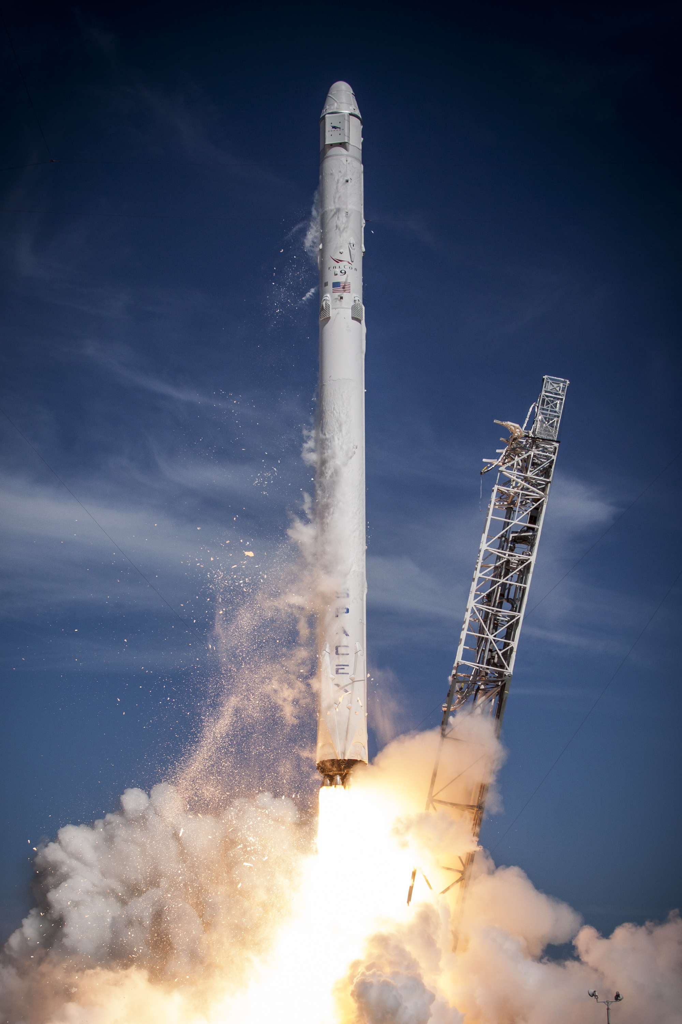
Discuss
Discuss
How long do you think it would take for humans to fly, on a rocket travelling at the speed of the Space X Falcon 9 Rocket, when leaving the Earth (about 17,500 mph), from the Earth to:
The Moon
Mars
Jupiter
Neptune
The Sun (our nearest star!)
The nearest star apart from The Sun?
Discuss with your partner, or as a group
The Space X Falcon 9 rocket
Notes:
Notes:
The SpaceX Falcon 9 rocket is a reusable rocket. (SpaceX is the aeronautical company founded by US billionaire and CEO of Tesla, Elon Musk). See https://www.spacex.com/vehicles/falcon-9/ for more on the Falcon 9.
Misconceptions:
- Students typically underestimate the distance to other planets, but overestimate the distance into space. The journey into space (defined as getting through the Earth’s atmosphere) is only approximately 100 miles. A rocket makes that journey in approximately 8 minutes.

Slide 9
Journey times within our Solar System
Learn
Travelling at 17,500 mph (the speed of the Space X rocket when leaving the Earth’s atmosphere), journey times are:
To the Moon: 14 hours (note that in the Apollo missions, this journey took 3 days)
To Mars: 4 months
To the Sun: 7 months
To Jupiter: 3 years
To Neptune: 18 years
The fastest ever speed recorded for a human-made space craft was 153,000 mph for the Parker Space probe. (This did not carry any astronauts). Even at that speed, it would take 2 years to fly to Neptune.
The Space X Falcon 9 rocket
Notes:
Notes:
The SpaceX Falcon 9 rocket is a reusable rocket. (SpaceX is the aeronautical company founded by US billionaire and CEO of Tesla, Elon Musk). See https://www.spacex.com/vehicles/falcon-9/ for more on the Falcon 9.
Misconceptions:
- Students typically dramatically underestimate the distance to other planets, but overestimate the distance into space. The journey into space (defined as getting through the Earth’s atmosphere) is only approximately 100 miles. A rocket makes that journey in approximately 8 minutes.

Slide 10
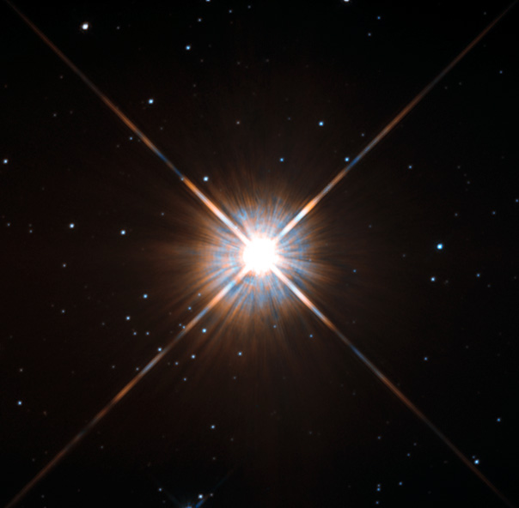
Beyond the Solar System
Discuss
Our nearest star is The Sun, which is 93 million miles away from Earth.
The journey time from the Earth to The Sun is about 7 months. (Light makes the journey in 8 minutes)
Our next nearest star is called Proxima Centauri
Discuss with a partner or as a group: How long do you think it would take to travel to Proxima Centauri?
Proxima Centauri
Notes:
Notes:
- The reality of interstellar travel is brought home on the following slide, and emphasizes the ‘gap’ between science fiction - hyperspacing between star systems at will! – and the current reality of our rocket technology.

Slide 11
Beyond the Solar System
Discuss
Proxima Centauri is 25 trillion miles away from Earth! (25,000,000,000,000 miles)
The journey time to Proxima Centauri at the speed of the Falcon 9 would be … 168,000 years …
Even if we travelled at the speed of the Parker Space probe, it would be over 18,000 years to travel there!
Proxima Centauri
Notes:
Notes:
- For comparison, modern human beings only emerged as a species about 200,000 years ago, so the journey to Proxima Centauri is similar in duration to the entire history of human beings!

Slide 12
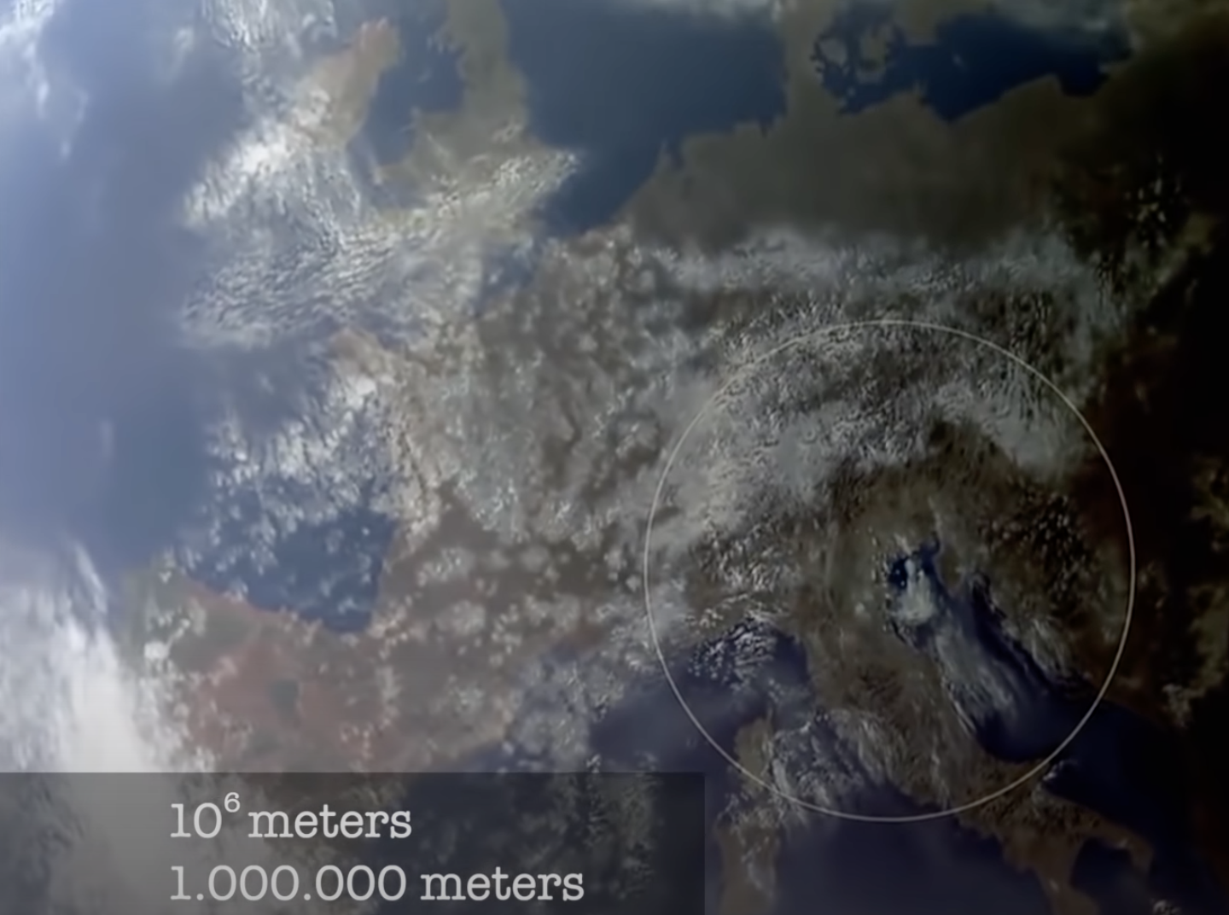
Watch: The Powers of Ten
Watch
The ‘Powers of Ten’ is a famous video explanation of the true scale of our Solar System.
Starting with a 1 metre circle on the ground in the Italian city of Venice, it moves further away from Earth. With each step away from Earth, we are moving 10 times further away.
Watch here - https://youtu.be/44cv416bKP4.
(Note: stop the video after 5 minutes if you wish, as the remainder of the video looks at the microscopic scale)
Image from ‘The Powers of Ten’
Notes:
Notes:
The ‘Powers of Ten’ places the Earth, Sun and Solar System in the context of the Milky Way galaxy, and of the Universe.
In the video, reference is made to the concept of the ‘observable universe’. The idea here is that there are parts of the universe that are so far away, that the light from them has not had time to reach The Earth yet. Scientists have good evidence that the universe is approximately 13.8 billion years old. As the universe expands in all directions, there are some parts of the universe that are more than 13.8 billion light years away … and thus, the light from those galaxies and stars has not yet reached The Earth.

Slide 13
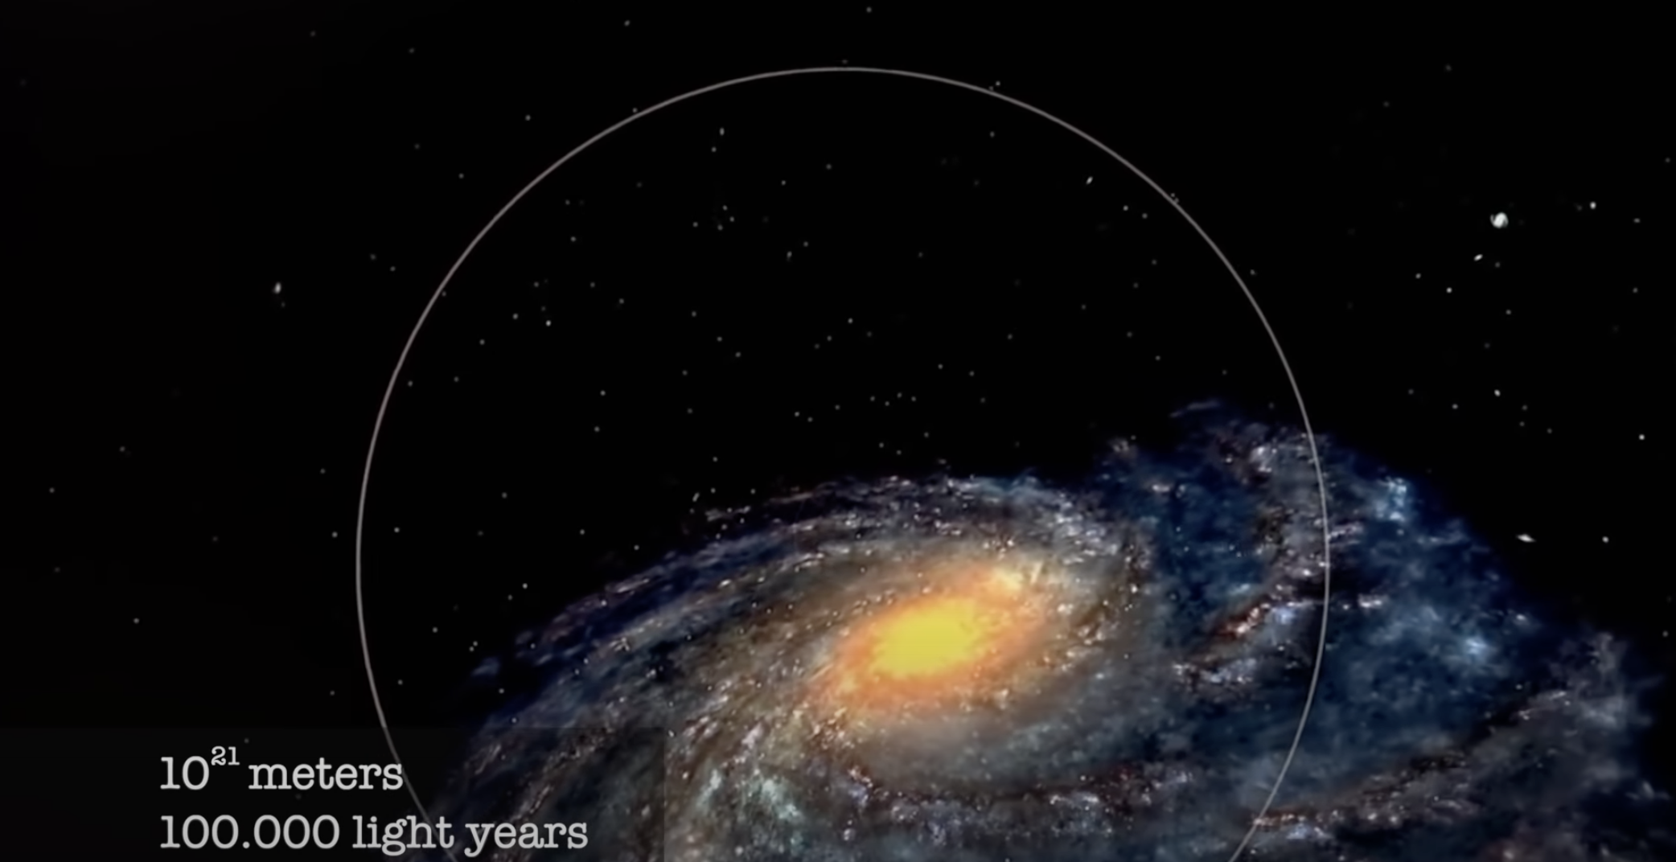
Thoughts on the universe:
Discuss
The universe is full of ‘stuff’, including galaxies containing many billions of stars of many different types, and planets (other ‘solar systems’) orbiting some of those stars.
It is very probable that there is life elsewhere in the Universe, including other intelligent life.
However, it is also highly possible that humans will never get to meet alien lifeforms, as the distances between stars and galaxies are so vast …
Image from ‘The Powers of Ten’
Notes:
Notes:
- There is lots of room for debate here! The key point is that, without a dramatic improvement in the speed of our rockets, we are unlikely to ever travel to other stars.

Slide 14
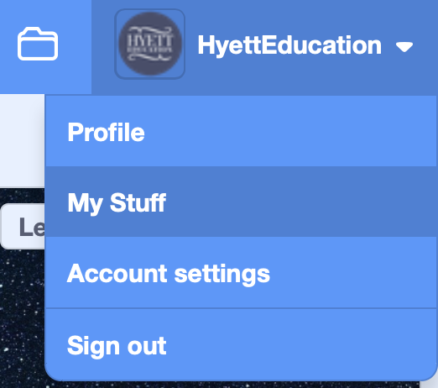
Opening up your project
Learn
Log into your Scratch accounts with your username and password
Click onto your username in the top right hand corner, then onto ‘My Stuff’
You should see your project in the list - click onto it to open it up again.

Slide 15
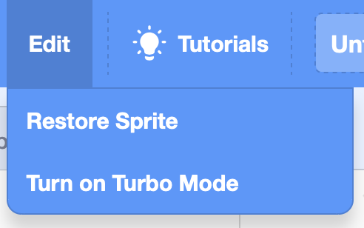
Correcting mistakes
Learn
If you make a mistake when using Scratch – e.g. by deleting pieces of code accidentally - and are using a device with a keyboard, you can ‘undo’ that mistake by pressing the Ctrl key (to the left of the space bar) and the Z key together. There is a limit to how many steps back you can take though, so do this as soon as you realise your mistake.
If you accidentally delete a sprite, go to ‘Edit’ at the top of the screen and click ‘Restore sprite’.
Notes:
Notes:
- Remind students of how to undo any accidental or unwanted changes in Scratch.

Slide 16
Back to our program
Learn
We’re going to learn how to create an explosion when the probe hits the edge of the stage.
We will achieve this using broadcast and when I receive code blocks
Watch the video clip here - https://youtu.be/lMruEuZQ1rg
6. What happens if the probe hits the edge of the screen?
Notes:
Notes:
We have already covered the key concepts required to code the explosion, including iteration, selection, and the use of the broadcast command.
Remind the students of what they saw in the gameplay video: when the probe hits the edge of the screen it explodes.
We won’t be adding sound effects yet; they are added later in this session.

Slide 17
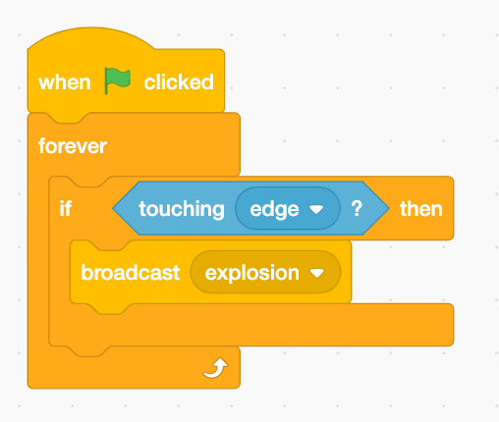
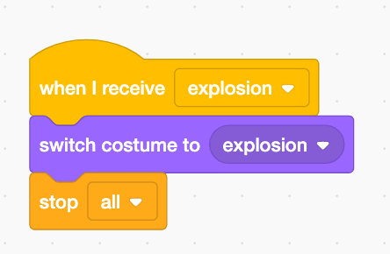
The explosion algorithms
Learn
Notes:
Notes:
- These are the finished algorithms for creating the explosion when the probe hits the edge of the Stage. Students can use these to check or correct their code.

Slide 18
What happens when the player completes all of the levels?
Learn
At the moment, as long as the probe doesn’t hit the edge of the stage, the game never ends!
Watch the video here to find out how to change the stage background to a ‘well done’ message when the player has sent the probe successfully to all eight planets - https://youtu.be/PuEVDkZJGzc
9. What happens if the probe successfully reaches all eight planets?
Notes:
Notes:
The key elements of this are already in place in the template, including the ’well done’ backdrop for the stage.

Slide 19
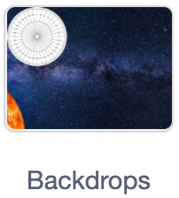
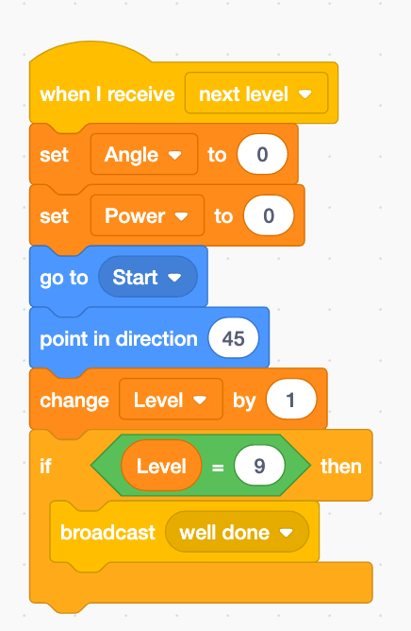
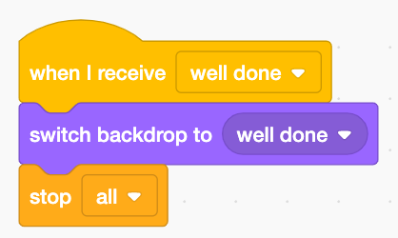
Creating a well done message - algorithms
Learn
Notes:
Notes:
- The finished algorithms for ending the game for students to use in checking or correcting their code.

Slide 20
Adding a timer
Learn
Adding a timer allows players to compete against one another to see who can finish the game most quickly!
Watch the video here to find out how to create a timer - https://youtu.be/tx0Ohc2m21A
8. What happens to the timer as the game is played?
Notes:
Notes:
- Adding a timer is very straightforward in Scratch. Point out that the ‘when green flag is clicked’ algorithm we added in a previous session already resets the timer to 0.

Slide 21
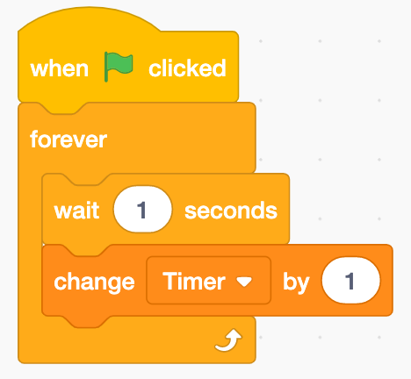
Adding a timer
algorithms
Learn
Notes:
Notes:
- The finished algorithm for adding a timer for students to use in checking or correcting their work.

Slide 22
What is wrong with many famous movie scenes set in outer space?
Discuss
A famous movie scene - https://youtu.be/5p0IP-FVG2I?t=2m13s
What is wrong with the science in this scene, especially when the planet explodes?
Notes:
Notes:
We will be moving on to adding sound effects to our program next.
The purpose of the film clip is to discuss what space ‘sounds like’.

Slide 23
What is wrong with many famous movie scenes set in outer space?
Discuss
There is no sound in space!
Sound requires a gas (like air), liquid, or solid to travel through, as sound travels by vibrating particles, which then vibrate their neighbouring particles, and so on.
Outer space is an almost complete vacuum - there are very, very few particles. Therefore sound cannot travel through space. In the scene from ‘Star Wars: A New Hope’, the planet would have exploded in complete silence …
Notes:
Notes:
- There are lots of experiments that can be used to demonstrate this. In secondary schools, students may have seen a demonstration in which a ringing bell is placed in a bell jar, and all of the air is sucked out of the jar until the ringing bell is silent. See this video clip - https://youtu.be/ce7AMJdq0Gw for an example of this demonstration in practice.
Common misconceptions:
Students are often surprised that there is no sound in space, as they are used to seeing scenes in movies / TV shows in which sounds (lasers, explosions) are commonplace.
Point out to them that, in a spacecraft, there is air being pumped into the craft, so there will be sound inside the craft – astronauts can still speak to each other on the International Space Station, or in the Apollo craft travelling to The Moon.

Slide 24
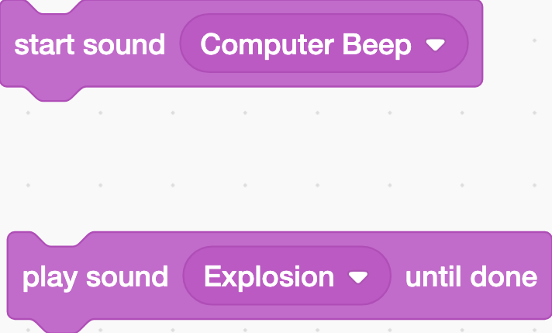
Adding sound effects
Learn
However … we’re going to add sound effects to make our game more fun to play!
Watch the video here to find out how to add sound effects - https://youtu.be/CGpscewDWj8
Notes:
Notes:
The video shows the basic principles of adding sound effects. The exact sound effects that students choose to use are up to them.
Once the sound effects are added, the ‘basic’ version of the game is complete. In session 5, students will be given a set of possible extension activities to complete.

Slide 25
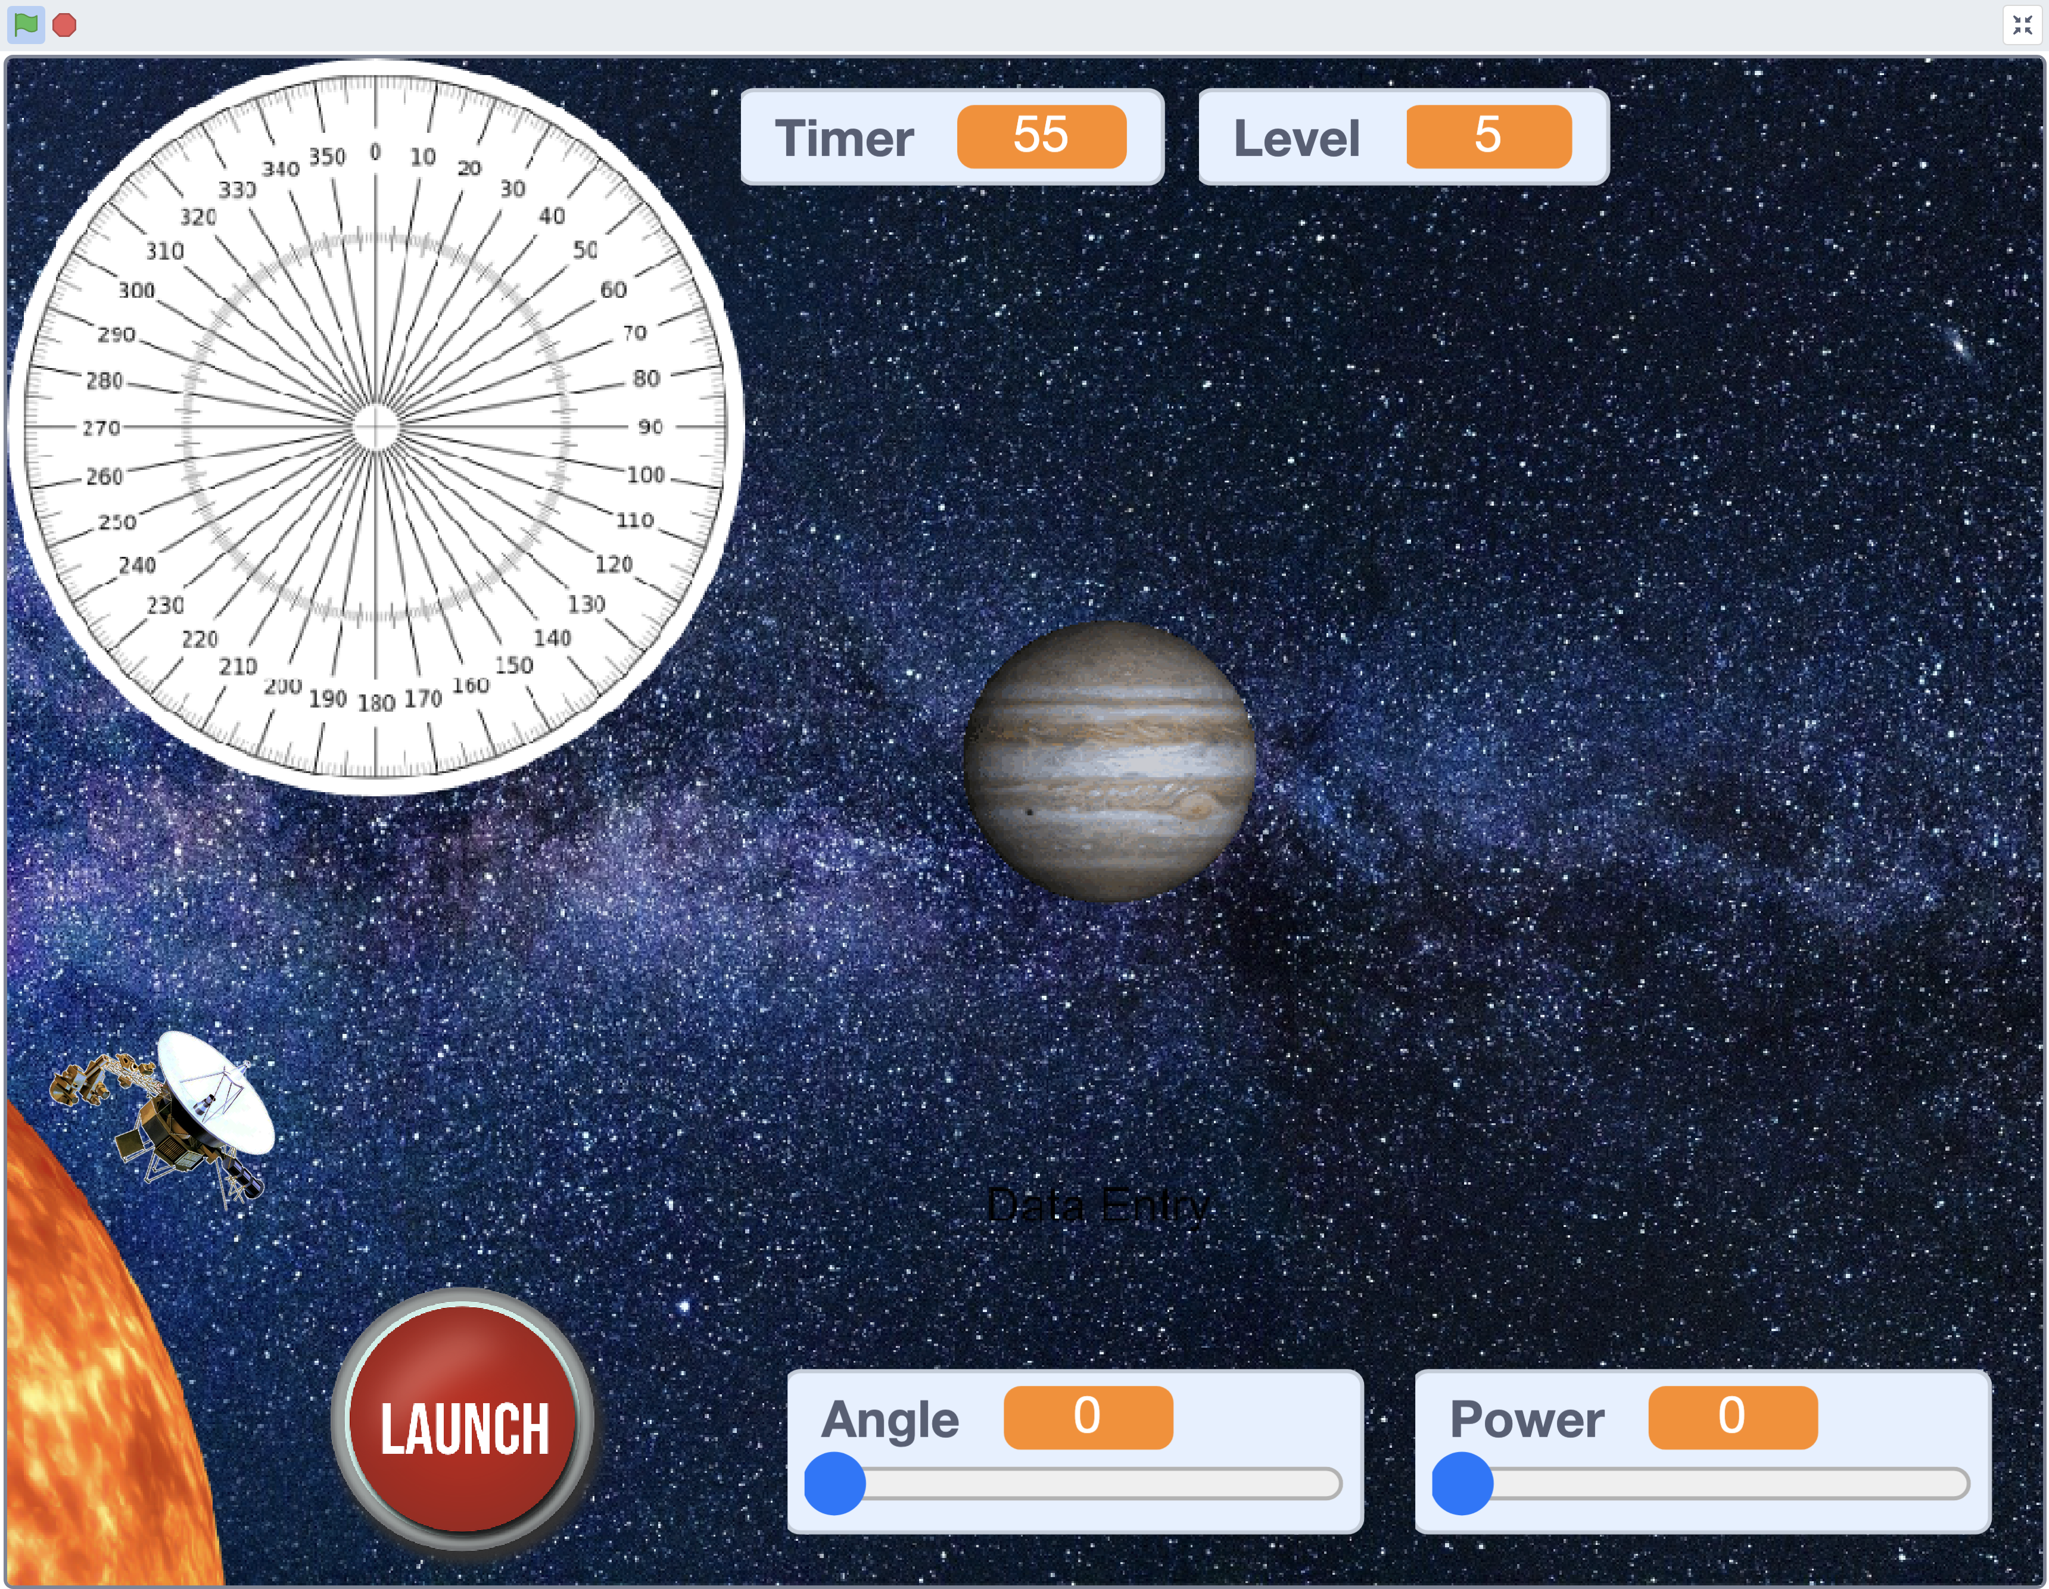
Testing and competing in your game!
Notes:
Notes:
- Congratulate the students on completing their games!

Slide 26
For reference, a completed version can be found at https://scratch.mit.edu/projects/425127673
Learn
Notes:
Notes:
- The link here is to a completed version of the game, with annotations (comments) added. This may be helpful for comparison with student projects, for correction of any bugs / issues.

Slide 27
Checking our knowledge and understanding
https://create.kahoot.it/v2/share/raf-code-commanders-session-4-quiz/b85053b5-c3ca-4ee1-b697-2e539ae01aa8
Learn
Notes:
Notes:
Each of the Kahoot Quizzes includes 5 multiple choice questions, and covers questions relating to both the Space Science and coding aspects
Remember that the facilitator will require a free Kahoot account to use the quizzes. Students will not lead a login; they join a quiz by typing in a unique numerical access code that is shown on-screen when the quiz is launched.

Slide 28
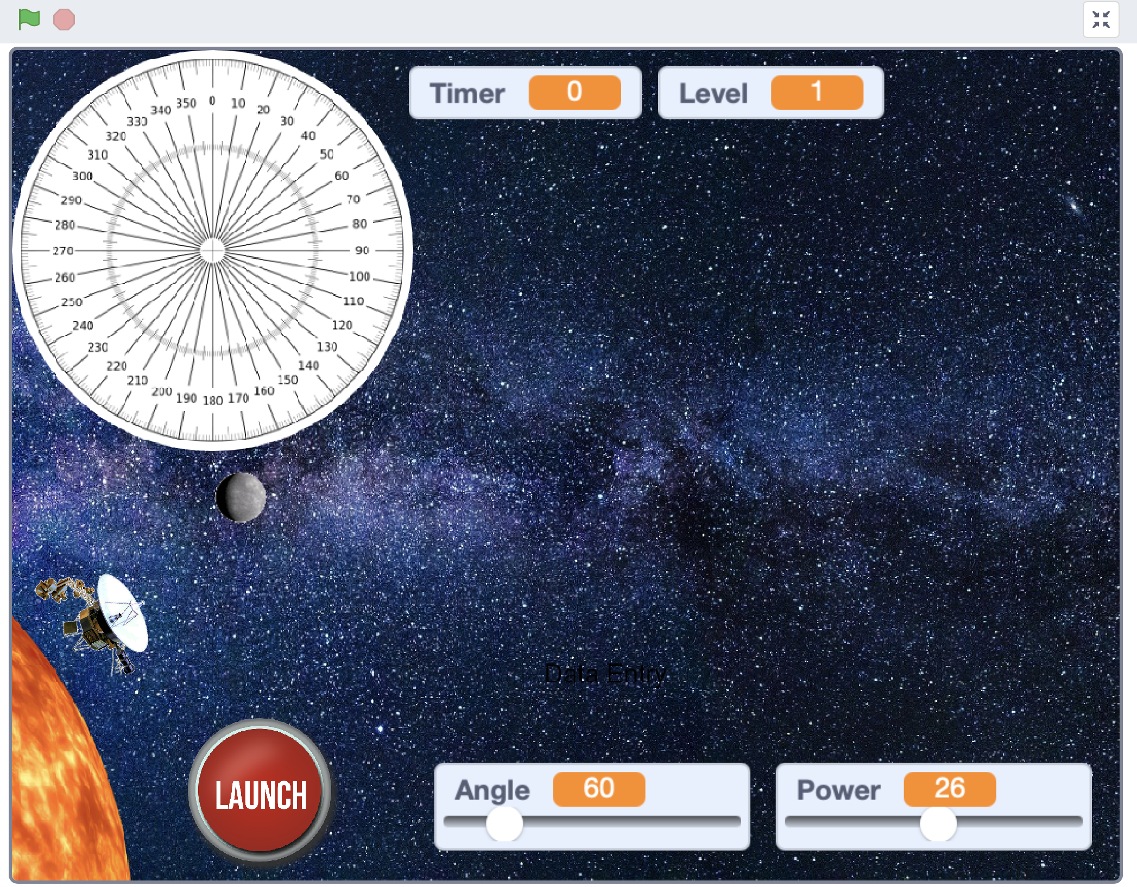
Next time
You’ll consider the real-world challenges of sending humans to Mars.
You’ll be given a set of extension challenges to complete!
Working more independently, can you add new features and gameplay elements to your game?

Slide 29
Brought to you by the Royal Air Force in partnership with Hyett Education. For more free and exciting STEM resources go to www.rafyouthstem.org.uk. Special thanks to Flt Lt Michelle Randall (RAF Youth & STEM), Antony Hyett (Hyett Education – www.hyetteducation.com) & Richard Anderson (TechMentor UK – www.techmentor.uk).
Project credits

Slide 30
Other credits
Planet and Sun images - pixabay.com: labelled for free, unrestricted use
Space X Falcon 9 image - https://commons.wikimedia.org/wiki/File:Launch_of_Falcon_9_carrying_CRS-6_Dragon_(17170624642).jpg, used under a Creative Commons CC0 1.0 Universal Public Domain Dedication
Proxima Centauri image - https://commons.wikimedia.org/wiki/File:New_shot_of_Proxima_Centauri,_our_nearest_neighbour.jpg, used under a Creative Commons Attribution 4.0 Unported license
The relative sizes of The Sun and planets - https://commons.wikimedia.org/wiki/File:Planets2013.svg: used under the Creative Commons Attribution-Share Alike 3.0 Unported license.
Still images from ‘The Powers of Ten’: https://youtu.be/44cv416bKP4.

