Slide 1
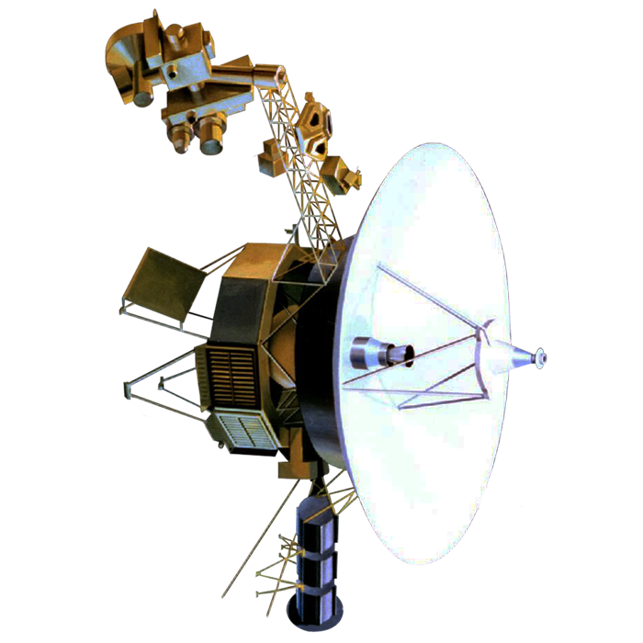
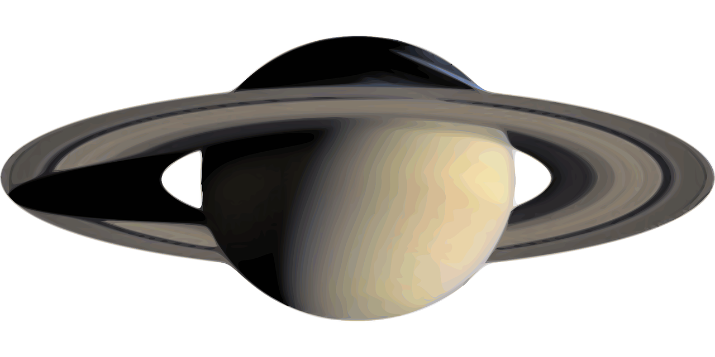
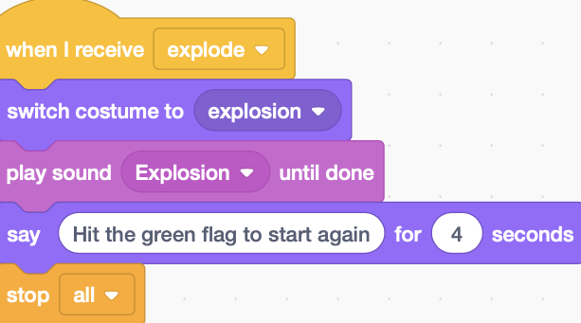
RAF Code Commanders: Cosmic Launch Project
Session 1
Brought to you by the Royal Air Force in partnership with Hyett Education
For more free and exciting STEM resources go to www.rafyouthstem.org.uk

Slide 2
Science, Technology, Engineering and Math (STEM) are key subjects that support research and help solve problems on Earth and in Outer Space. In this project, you will learn how to apply computer science to creating your own video game, while also learning about the Solar System and space travel. Have fun!

Slide 3
Disclaimer: Included in this project are links to YouTube videos and other websites selected to support learning outcomes for students. These links and media have been checked for their suitability at the time of publication. The RAF and Hyett Education are not responsible for the content of any additional media or webpages shared by publishers, and do not endorse any services or products that they sell. The RAF and Hyett Education are also not responsible for, and do not endorse, any adverts, comments or links appearing alongside or within media, including any associated with video materials on YouTube. We recommend that YouTube is used in a ‘logged out’ state, to minimise the risk that any advertisements that are shown are associated with the previous viewing history of the PC or facilitator that is leading the session. For information on signing in and out of YouTube, visit https://support.google.com/youtube/answer/3802431 The content of third-party links may change over time. We recommend that project facilitators carefully review media and third-party links before sharing them with students.

Slide 4
We welcome feedback! If you encounter any errors or broken links in this project, or have constructive suggestions for improvement, please email Antony Hyett at antony@hyetteducation.com and provide details. Your cooperation and feedback is greatly appreciated. We’d love to see how you’re getting on with this project. Please share students’ participation, progress and enjoyment of this project on social media using the hashtag #RAFCodeCommanders and follow @rafyouthengage and @hyetteducation to keep up to date with RAF Youth & STEM and Hyett Education’s work with schools.
Feedback & Social Media

Slide 5
Session 1: Getting started!

Slide 6
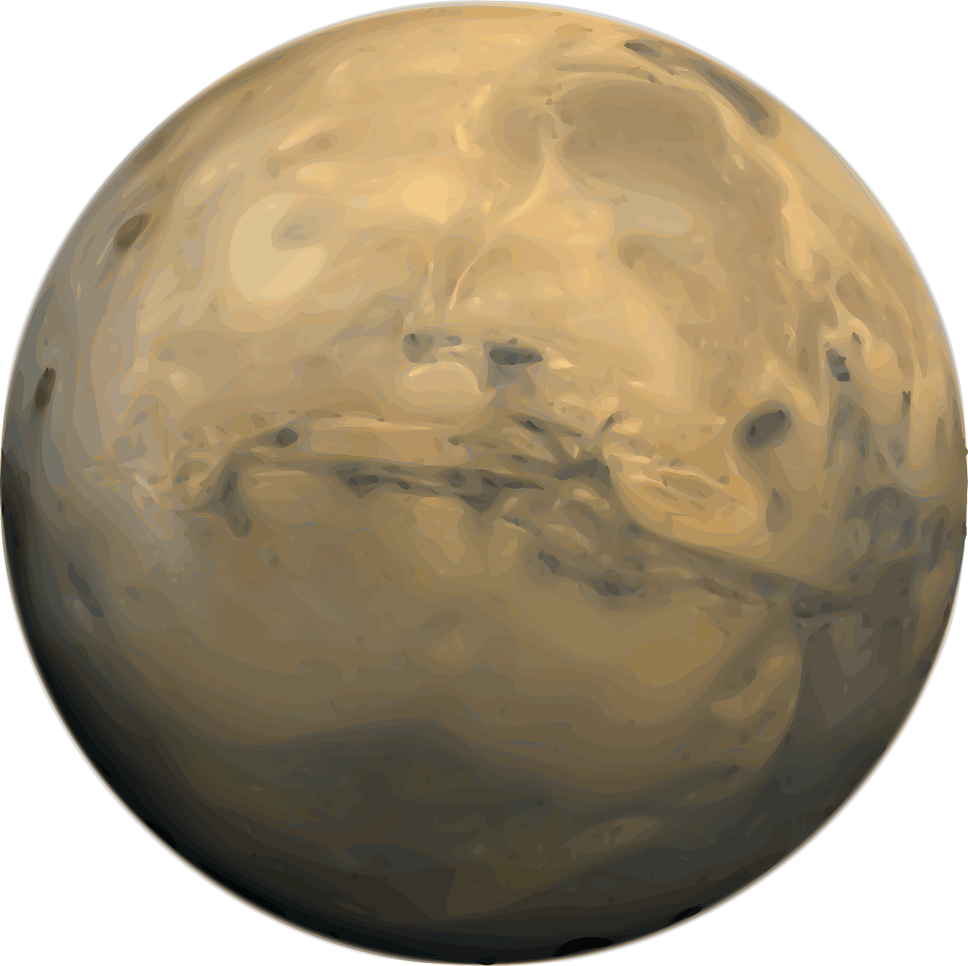
Overview
In this project you will:
Learn to code a space game using the programming tool Scratch
Learn key vocabulary in computer science, including algorithm, sequencing, selection, and iteration
Revise and extend your knowledge of our Solar System
Consider the challenges of exploring our Solar System and beyond.

Slide 7
Discuss
“What is an algorithm?”
Notes:
Notes:
Students will have different levels of experience and understanding of computer science principles from their previous experiences in school and/or at home. Take account of that in both the level of discussion, and in the pairings / groupings of students you facilitate.
Common misconceptions:
The most common misconception about algorithms is that they are always ‘run’ on computers. In fact, the term ‘algorithm’ applies to any set of instructions that are run in sequence, as will be explored over the next slides and video clips
Algorithms can be represented in a range of different ways: as a list of instructions, as a recipe, as ‘pseudocode’ (pretend computer-like code written in more natural language), or as flowcharts. Even musical notation is a representation of the algorithms of a piece of music.

Slide 8
Here’s a video clip to help you!
Watch
‘What is an algorithm?’
https://youtu.be/2Do-q47hKxI
From ‘What’s an algorithm?’ by Richard Anderson (TechMentor UK)
Notes:
Notes:
The first video linked here is a good interactive introduction to the concept of an algorithm, with prompts to pause the video and questioning points within it. It also has the advantage of being presented by the same presenter (Richard) who will be delivering the Scratch tutorials later in the project. The video also utilizes flowcharts in explaining algorithms, showing that algorithms are not always run on computers. (Note that the end of the video references a separate project (Flappy Parrot), so you may need to clarify with the students).
Common misconceptions:
The most common misconception about algorithms is that they are always ‘run’ on computers. In fact, the term ‘algorithm’ applies to any set of instructions that are run in sequence, as will be explored over the next slides and video clips.
Algorithms can be represented in a range of different ways: as a list of instructions, as a recipe, as ‘pseudocode’ (pretend computer-like code written in more natural language), or as flowcharts. Even musical notation is a representation of the algorithms of a piece of music.

Slide 9
… from the dictionary
“An algorithm is a step-by-step procedure for solving a problem or accomplishing some end”
Merriam Webster Dictionary
Notes:
Notes:
Emphasize the aspect here of algorithms being designed to solve a problem. This could be of many different types: how to bake a cake, how to make a character move in a video game, how to search the Internet for information.
Common misconceptions:
The most common misconception about algorithms is that they are always ‘run’ on computers. In fact, the term ‘algorithm’ applies to any set of instructions that are run in sequence, as will be explored over the next slides and video clips.
Algorithms can be represented in a range of different ways: as a list of instructions, as a recipe, as ‘pseudocode’ (pretend, computer-like code written in more natural language), or as flowcharts. Even musical notation is a representation of the algorithms of a piece of music.

Slide 10
… an easier definition
“An algorithm is a set of instructions, placed in the right order to make something happen”
Notes:
Common misconceptions:
The most common misconception about algorithms is that they are always ‘run’ on computers. In fact, the term ‘algorithm’ applies to any set of instructions that are run in sequence, as will be explored over the next slides and video clips.
Algorithms can be represented in a range of different ways: as a list of instructions, as a recipe, as ‘pseudocode’ (pretend computer-like code written in more natural language), or as flowcharts. Even musical notation is a representation of the algorithms of a piece of music.

Slide 11
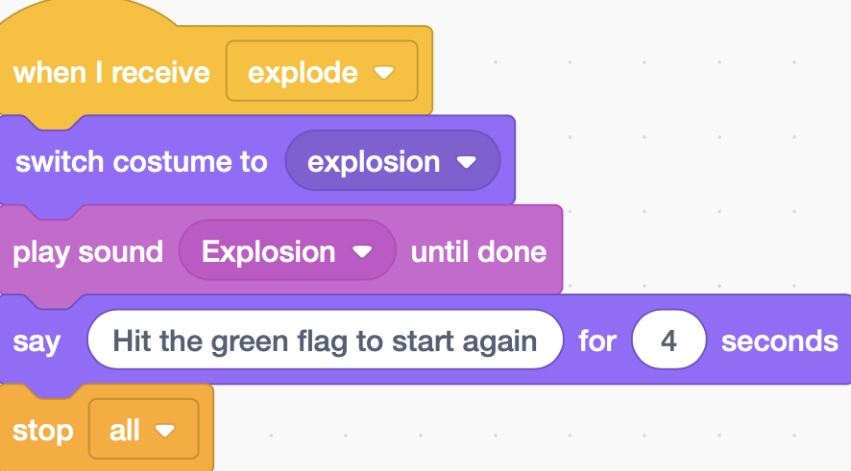
Algorithms are everywhere!
Learn
Playing music is an algorithm
Following a recipe is an algorithm
Algorithms are often used to make computers do what we want them to do.
Many of your favourite websites use algorithms to decide what to show you: Google, YouTube and Facebook all use lots of algorithms
We’re going to be using a programming tool called Scratch to create our own algorithms.
An algorithm in Scratch
Notes:
Notes:
This is an important slide to emphasize. Any technology commonly used in everyday life is almost certain to rely heavily on algorithms.
Common misconceptions:
Students sometimes think that games are the only programs that software developers create. Point out to them that all of the apps, websites, streaming services, and social media or messaging platforms they use rely heavily on algorithms created by programmers. Most programmers do not write games!
The most common misconception about algorithms is that they are always ‘run’ on computers. In fact, the term ‘algorithm’ applies to any set of instructions that are run in sequence.
Algorithms can be represented in a range of different ways: as a list of instructions, as a recipe, as ‘pseudocode’ (pretend computer-like code written in more natural language), or as flowcharts. Even musical notation is a representation of the algorithms of a piece of music.

Slide 12
Discuss
Can you think of any other examples of algorithms?
Notes:
Notes:
Other possible examples include dance routines, household chores (washing up, hoovering, ironing, washing clothes), driving a car
We could reasonably describe ‘growing up’ and learning as a process of embedding and creating a huge range of new algorithms in the human brain: learning how to speak is about mastering the necessary algorithms to manipulate the mouth, tongue and voice box in order to make words. Similarly for learning how to read and write. Parents and teachers support children in developing these algorithms, stored in the human brain.

Slide 13
In an algorithm, the order of instructions is very important
Learn
In most algorithms, the order of instructions is critical to making it work properly.
Getting the sequence of our code correct is very important.
If the sequence is wrong, it’s like playing music with ‘the right notes, but not necessarily in the right order’!
An algorithm in Scratch
Notes:
Notes:
- There are lots of examples you might discuss with students on the first point. What would happen if we added the flour to a cake after it had been baked?

Slide 14
Let’s get started!
Learn
Log into your Scratch accounts with your username and password
Open up the Scratch template at scratch.mit.edu/projects/419026147. Type this carefully!
Click on the ‘Remix’ button at the top of the webpage to create your own copy.
Give your project its own name by typing into the box at the top of the screen.
Scratch should save your project on its own, but, if you see ‘Save Now’ at the top right, click that to save your work.
Notes:
Notes:
See the ‘overview’ document for information on different approaches to getting the students set up in Scratch. It is important that each student (or pair of students) has their own account so that work can be saved and retrieved as the sessions proceed.
Scratch 3 is also available to download – visit
Emphasize the point about the ‘Save now’ button. In particular, if the speed or reliability of the internet is variable in the venue you are using for sessions, you may need to ‘Save Now’ more often, as the auto-saving can be less reliable.
Misconceptions:
- Scratch is not ‘a game’. It is a visual programming language and creation tool.

Slide 15
Session 1: Exploring Scratch

Slide 16
In Scratch
Learn
code is the instructions that we use
coding is putting those instructions together to create algorithms
an algorithm is one set of instructions combined together
a computer program is all of those algorithms together - the whole project.
An algorithm in Scratch
Notes:
Notes:
- These points are important to emphasize. Try to be consistent in using the correct language during sessions, and encourage the students to do the same.

Slide 17
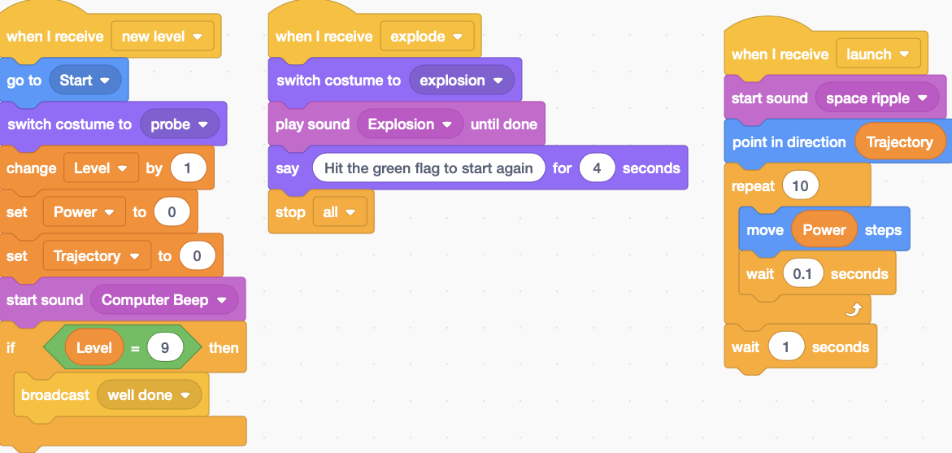
An algorithm
A computer program is made from more than one algorithm
Another algorithm
And another one!
Notes:
Notes:
On the slide are three algorithms, each of which is made up of a number of pieces of code.
The whole thing is a program.
The act of creating this is coding.

Slide 18
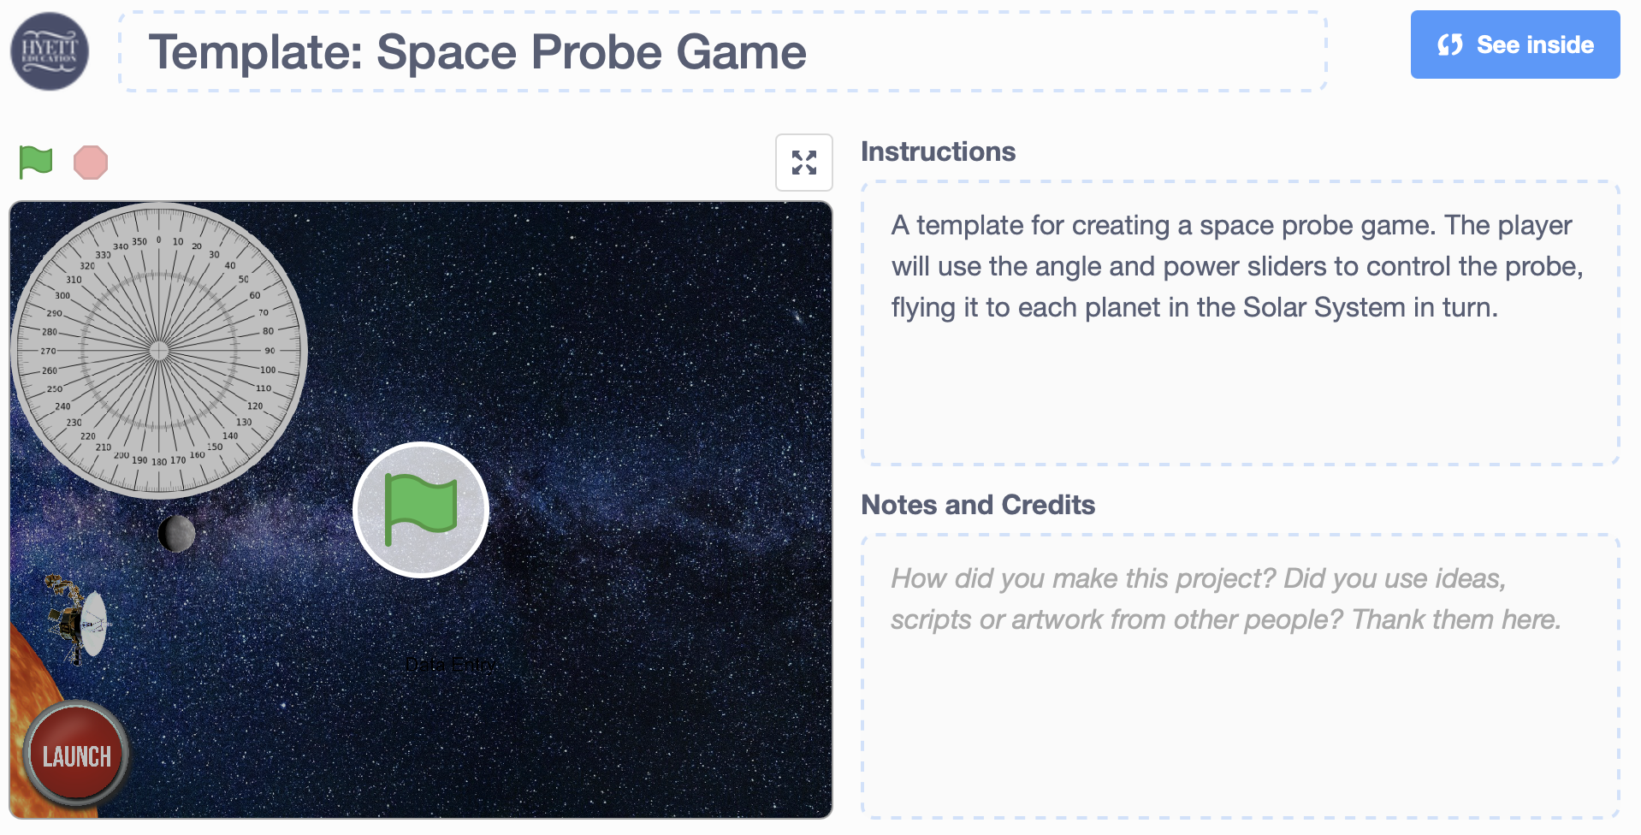
Exploring Scratch
Watch
Watch this video clip, which introduces you to the basic layout of Scratch: https://youtu.be/uBUU4j9gsFA
Don’t click onto anything in your Scratch project yet!
Make sure that you don’t drag items around, or place any new objects into your project!
Notes:
Notes:
- The video clip provides an introduction to Scratch. It is not intended that the students manipulate the project yet. If they do, the next slide provides information on how to ‘undo’ any accidental changes!

Slide 19
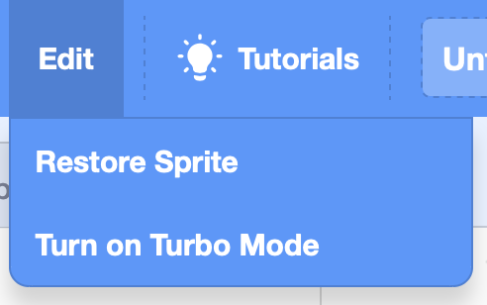
Correcting mistakes
Learn
If you make a mistake when using Scratch – e.g. by deleting pieces of code accidentally - and are using a device with a keyboard, you can ‘undo’ that mistake by pressing the Ctrl key (to the left of the space bar) and the Z key together. There is a limit to how many steps back you can take though, so do this as soon as you realise your mistake.
If you accidentally delete a sprite, go to ‘Edit’ at the top of the screen and click ‘Restore sprite’.
Notes:
Notes:
An important piece of information to share with the students.
This slide will be included in all of the later sessions too, as a reminder.

Slide 20
Discuss
“What are the names of the planets in our Solar System?
Which planet is closest to The Sun, and which is furthest away?
What order are they in as you move away from The Sun?
Which planet is the smallest and which is the largest?
Notes:
Notes:
This is an opportunity to assess the students’ prior knowledge of the Solar System
Remember: since 2006, Pluto is no longer considered a planet. Pluto is now considered to be a dwarf planet, the largest of the objects in the Kuiper belt, a ring of bodies beyond the orbit of Neptune.
Misconception:
- Some students think that The Sun, and The Moon, are also planets. Remind them that the planets (including Earth) orbit The Sun, and that The Moon orbits the Earth. There are many other moons around other planets in the Solar System. Mars has two moons orbiting around it, for example, while Jupiter has over 75!

Slide 21
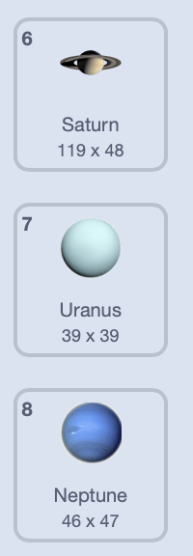
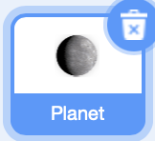
Exploring Scratch
Learn
To check your answers, click onto the in your Scratch template
Click onto
Click onto each of the costumes to check your knowledge on the order and size of the planets. Don’t drag the planets around the stage.
Discuss: why do you think the last costume is a balloon?
Discuss
Notes:
Notes:
This is an opportunity for the students to look at the list of planets under the ‘Costumes’ tab in Scratch.
If a student accidentally moves or deletes a sprite, remind them of the information on the ‘Correcting Mistakes’ slide.

Slide 22
Video clip: ‘Solar System 101’: https://youtu.be/libKVRa01L8
Watch
Notes:
Notes:
This video, from National Geographic, introduces students to the origins and structure of The Solar System

Slide 23
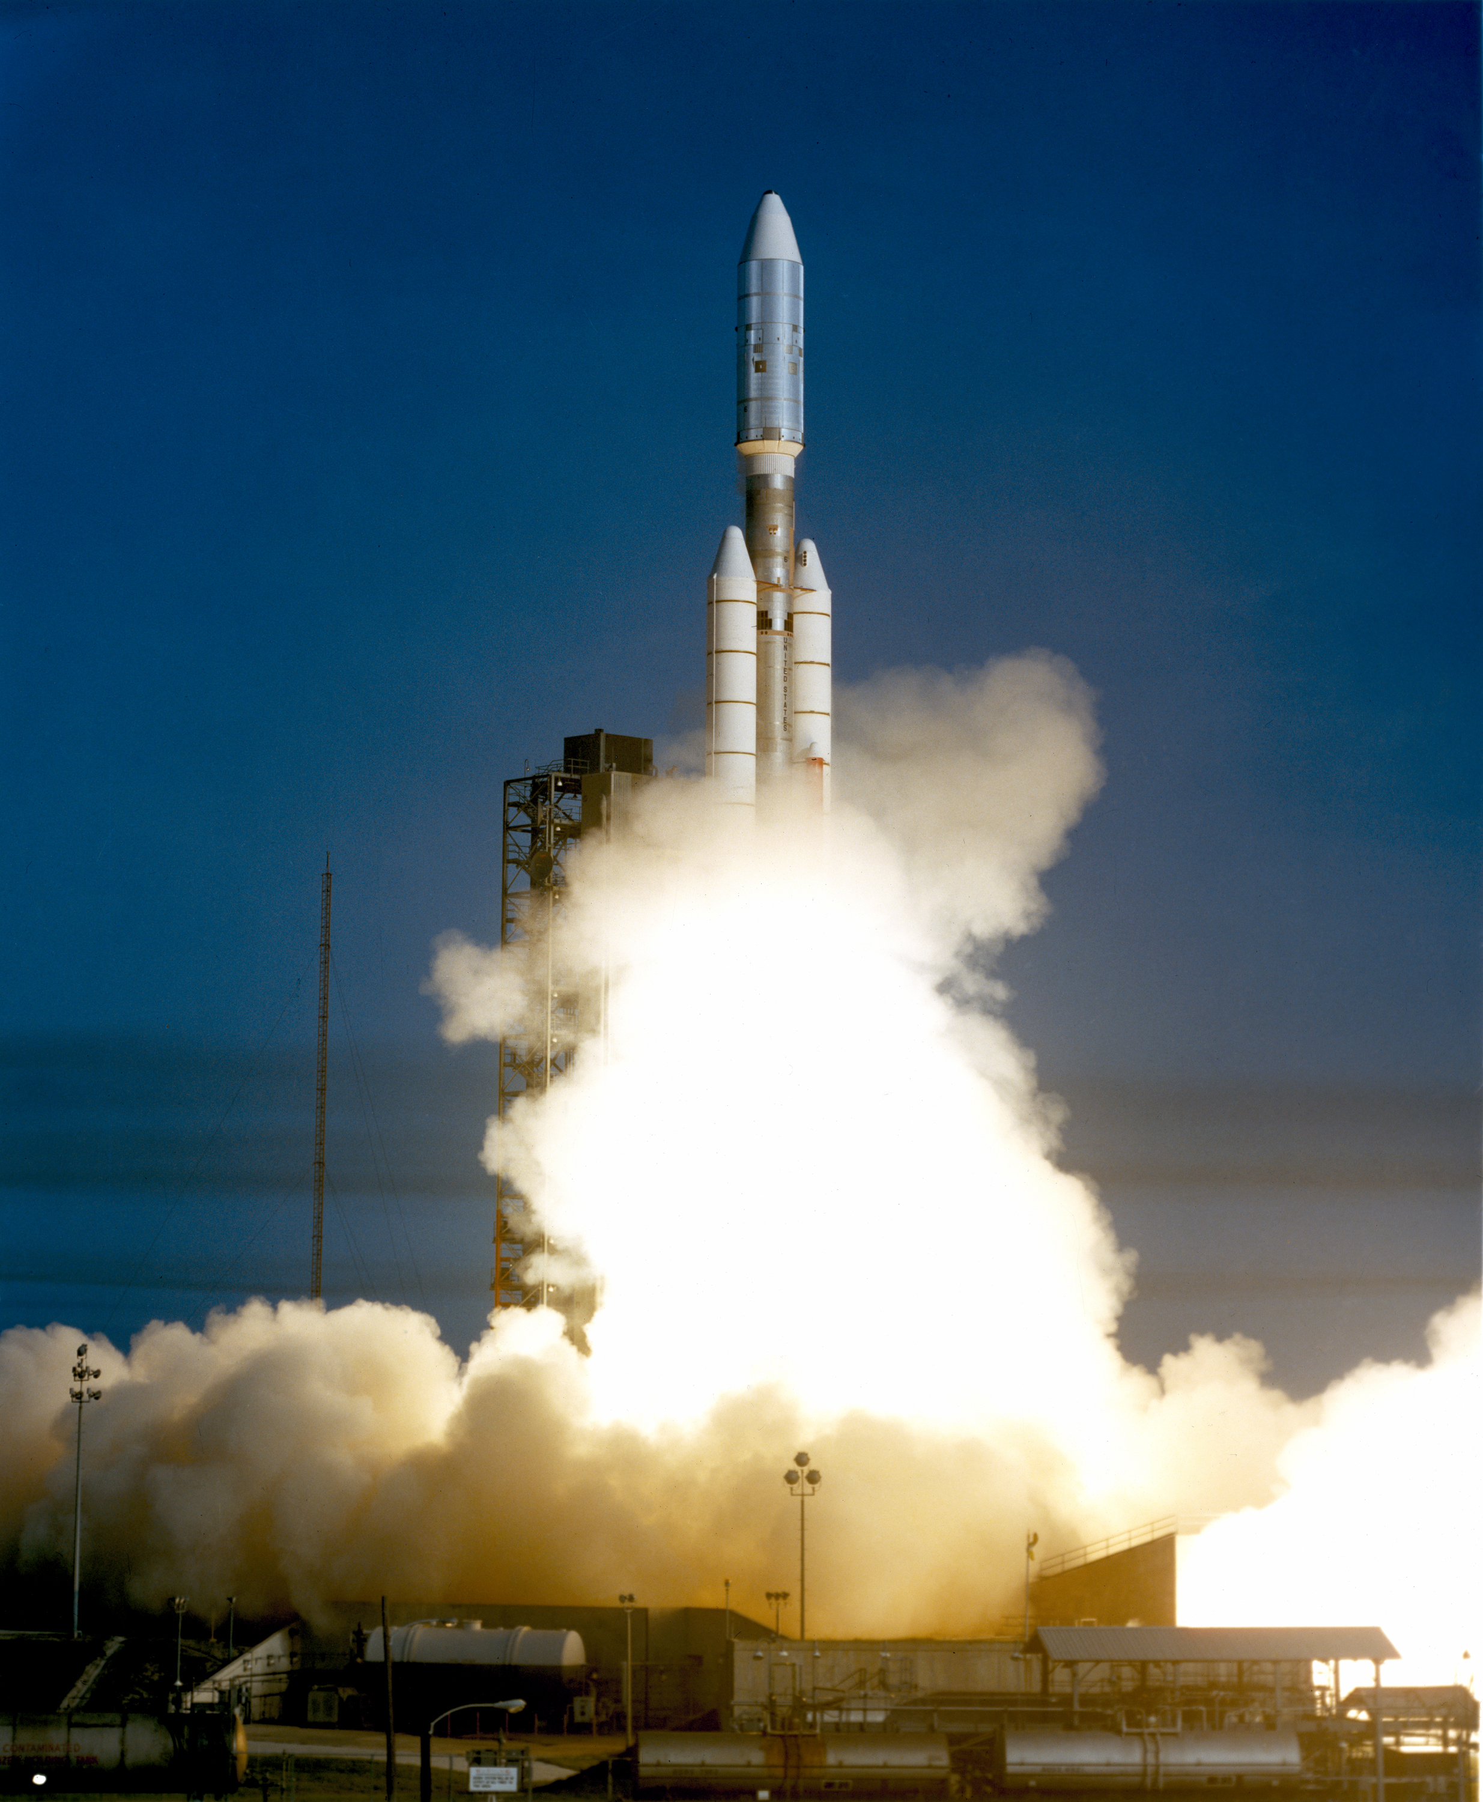
The probe in our game is Voyager One
Learn
A probe launched from Earth in 1977 to explore our Solar System
Even today, over 40 years later, it still receives data and instructions from Earth.
After visiting Jupiter and Saturn, it has now left our Solar System, heading to a nearby star called AC + 79 3888, which it should reach in about 40,000 years …
Notes:
Notes:
- For more information on Voyager One, see https://en.wikipedia.org/wiki/Voyager_1

Slide 24
The probe in our game is Voyager One
Learn
Voyager One is currently over 13 billion miles away from Earth.
It carries ‘The Golden Record’, a time capsule which contains information about Earth and humans for any aliens who might find the probe in the distant future!
The probe sprite in our template has a costume. Can you think why?
Notes:
Notes:
- The explosion costume will be used if the probe hits the edge of The Stage.

Slide 25
Decomposition
Learn
It is difficult to create all of our algorithms at once, so it is often better to break down the finished program into a set of simpler problems.
We solve each of these problems in turn.
We call this decomposition.
Notes:
Notes:
- Decomposition is a key concept in computer science, and allows programmers to create incredibly sophisticated programs by solving a series of problems in turn
- In programming our game, we are going to model this approach, by working on different aspects of the game, in turn, over the course of the project.

Slide 26
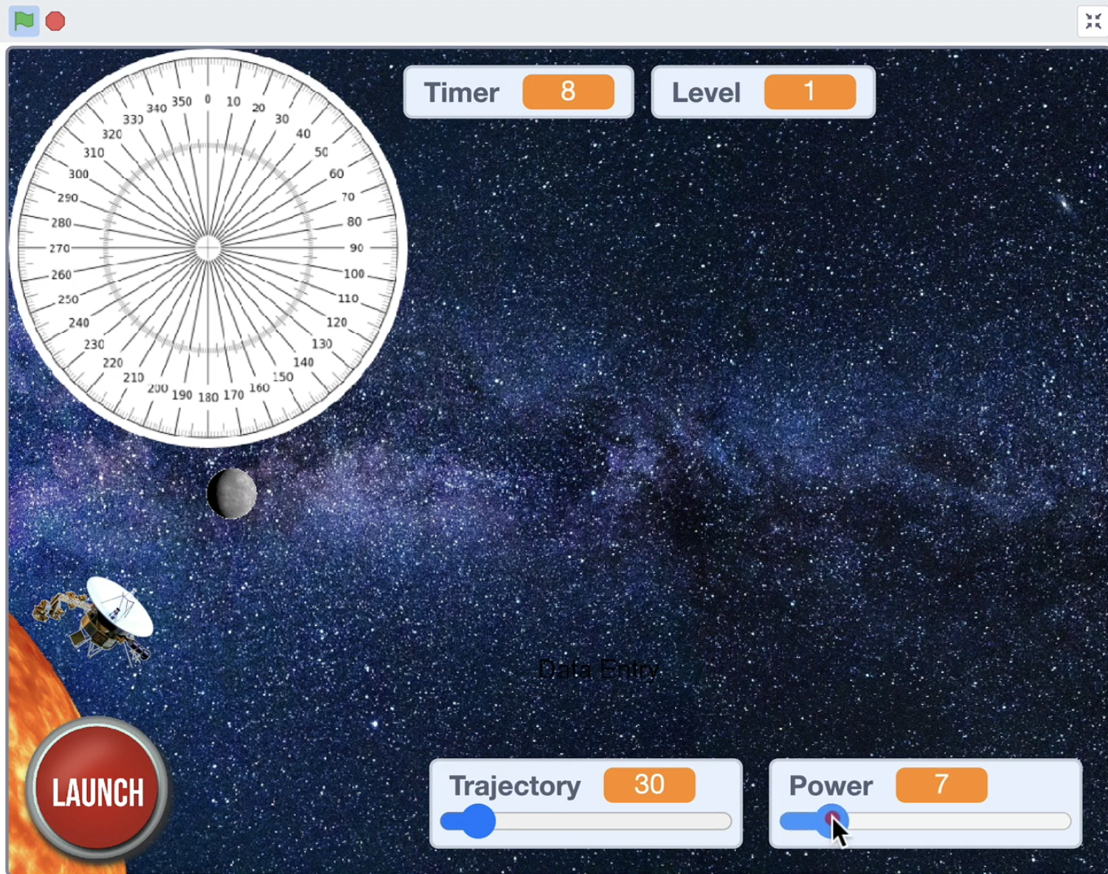
Looking at the completed project
Watch
To help us break down (decompose) our finished project into smaller steps, you’re going to watch a video clip now of the finished game being played.
While you are watching, think about, and discuss the questions on the next slide.
Look over the questions on the next slide first, then watch the video, then discuss the questions again.
Discuss
Notes:
Notes:
- This is an important activity in the project, as it will allow the students to appreciate the different aspects of the completed game, and how the player interacts with the probe when playing.

Slide 27
1. How does the player start the game?
4. What happens to the probe when it touches a planet?
7. When does the ‘Level’ at the top of the screen change?
2. How does the player control the movement of the probe?
5. What happens to a planet when it is touched by the probe?
8. What happens to the timer as the game is played?
3. How does the player launch the probe?
6. What happens if the probe hits the edge of the screen?
9. What happens if the probe successfully reaches all eight planets?
Analysing gameplay
Notes:
Notes:
- This slide is also available as a printable PDF resource; you may wish students to have a copy of this as the film on the next slide is played, and to annotate / write their ideas onto that printout.

Slide 28
Watch the gameplay demo video
https://youtu.be/QhOCT0MfLoI
Discuss
Notes:
Notes:
- The gameplay video shows the complete game being played. Play the video for the students and ask them to consider the questions on the previous slide (these questions are repeated again on the following slide, for discussion).

Slide 29
1. How does the player start the game?
4. What happens to the probe when it touches a planet?
7. When does the ‘Level’ at the top of the screen change?
2. How does the player control the movement of the probe?
5. What happens to a planet when it is touched by the probe?
8. What happens to the timer as the game is played?
3. How does the player launch the probe?
6. What happens if the probe hits the edge of the screen?
9. What happens if the probe successfully reaches all eight planets?
Discuss
Analysing gameplay
Notes:
Notes:
This slide is also available as a printable PDF resource
Review the questions and the answers the students have given before moving on.

Slide 30
1. How does the player start the game?
By clicking the green flag
2. How does the player control the movement of the probe?
By setting the trajectory (angle) and power for the probe
Notes:
Notes:
- We’re looking at the first two questions from the previous activity, and will now move onto making those work in Scratch.

Slide 31
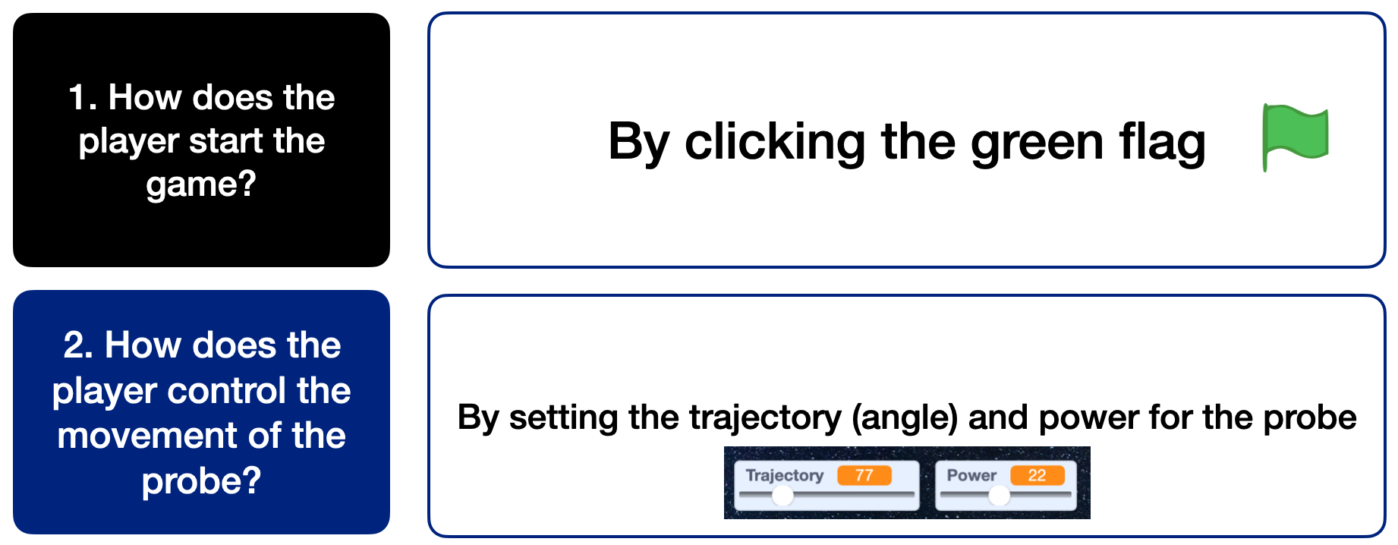
Getting our probe launching!
Watch
You’re going to learn how to get the probe moving!
Video clip: https://youtu.be/Ml_aPduxKeo
Listen and watch carefully.
At some points in the video, you’ll be asked to pause playback.
You will be asked to predict what will happen, or to experiment with your code to create algorithms in Scratch.
Discuss
Notes:
Notes:
This is the first tutorial video for the students to watch.
As the video plays, the presenter (Richard) will suggest at various points that the video should be paused for either a) students to discuss a question / problem with their partner or as a group, or b) to complete part of the coding activity.
If a student finds that their probe disappears off the edge of the stage, see the next slide for the solution.

Slide 32
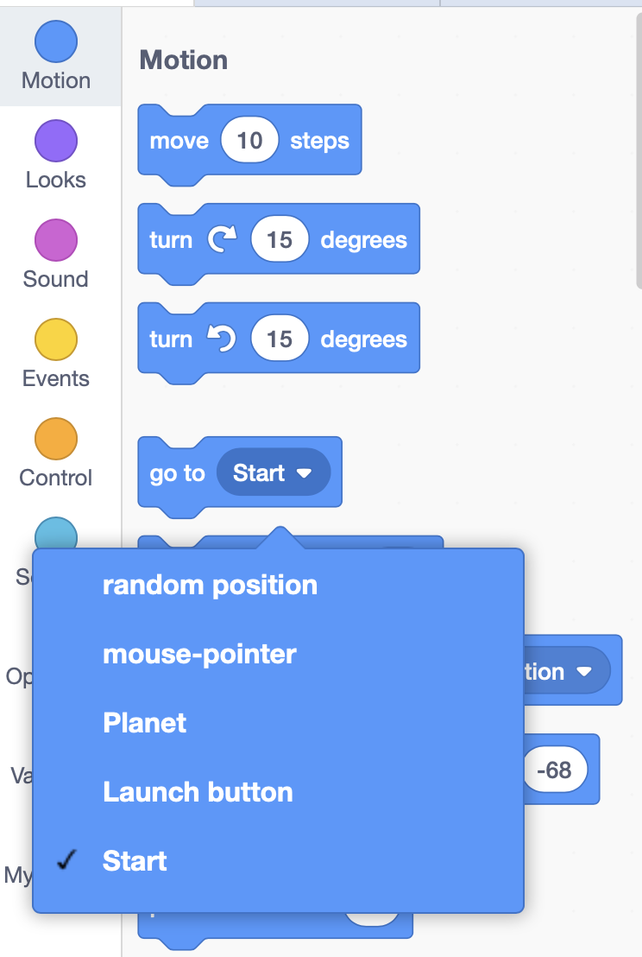
I’ve lost my probe … what do I do?
Learn
If your probe disappears off the edge of the stage, click onto the Motion code blocks, and look for the ‘Go to’ command.
Select ‘Start’ from the drop-down menu.
Double-click onto the code block to move the probe back to the red cross. (You do not need to drag this block into the coding area).
Notes:
Notes:
If the probe disappears off the edge of the Stage, and can’t be dragged back, follow this solution.
(We’ll be adding code later to return the probe to its starting point when the green flag is clicked).

Slide 33
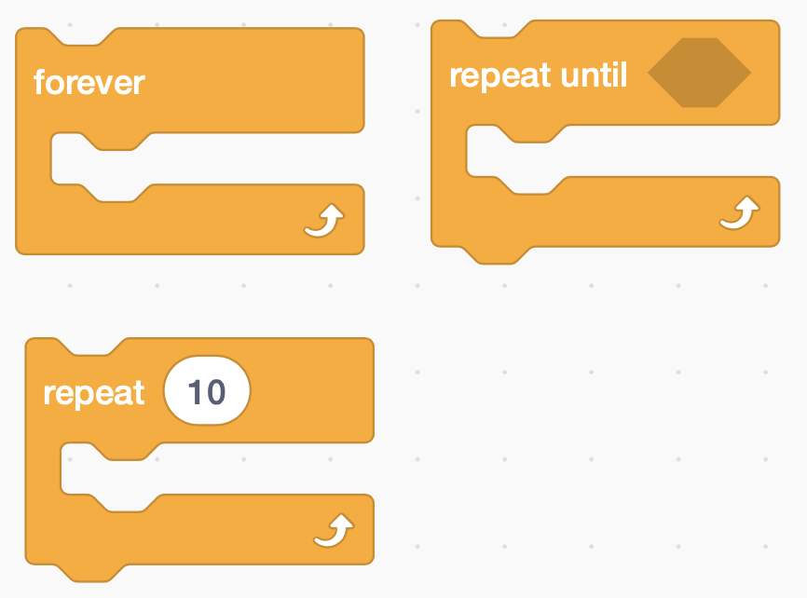
Iteration
Learn
The word iteration means to repeat sections of code to make them run more than once.
Iteration is sometimes called repetition.
You might also hear the word ‘loop’ to describe iteration.
In Scratch, all code for iteration are listed under ‘Control’.
Examples are ‘forever’, ‘repeat’ and ‘repeat until’
Notes:
Notes:
Iteration is the technically-correct word for repeating something in our code.
At KS2, teachers are more likely to call this repetition.
At secondary school level, the term iteration is used instead.

Slide 34
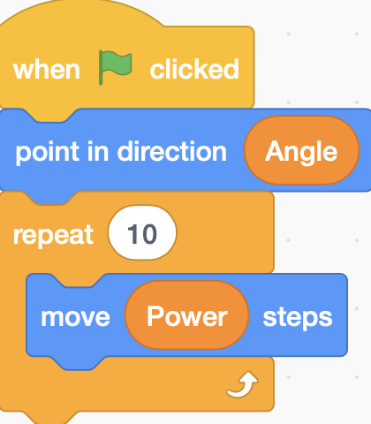
The completed algorithm
Learn
Notes:
Notes:
- This is the completed algorithm from the end of the tutorial video for reference, and for use by any students / groups who need to check or correct their code.

Slide 35
Checking our knowledge and understanding
https://create.kahoot.it/v2/share/raf-code-commanders-session-1-quiz/a5668a3b-e843-4c90-abe2-e05307ae69a2
Learn
Notes:
Notes:
Each of the Kahoot Quizzes includes 5 multiple choice questions, and covers questions relating to both the Space Science and coding aspects
Remember that the facilitator will require a free Kahoot account to use the quizzes. Students will not lead a login; they join a quiz by typing in a unique numerical access code that is shown on-screen when the quiz is launched.

Slide 36
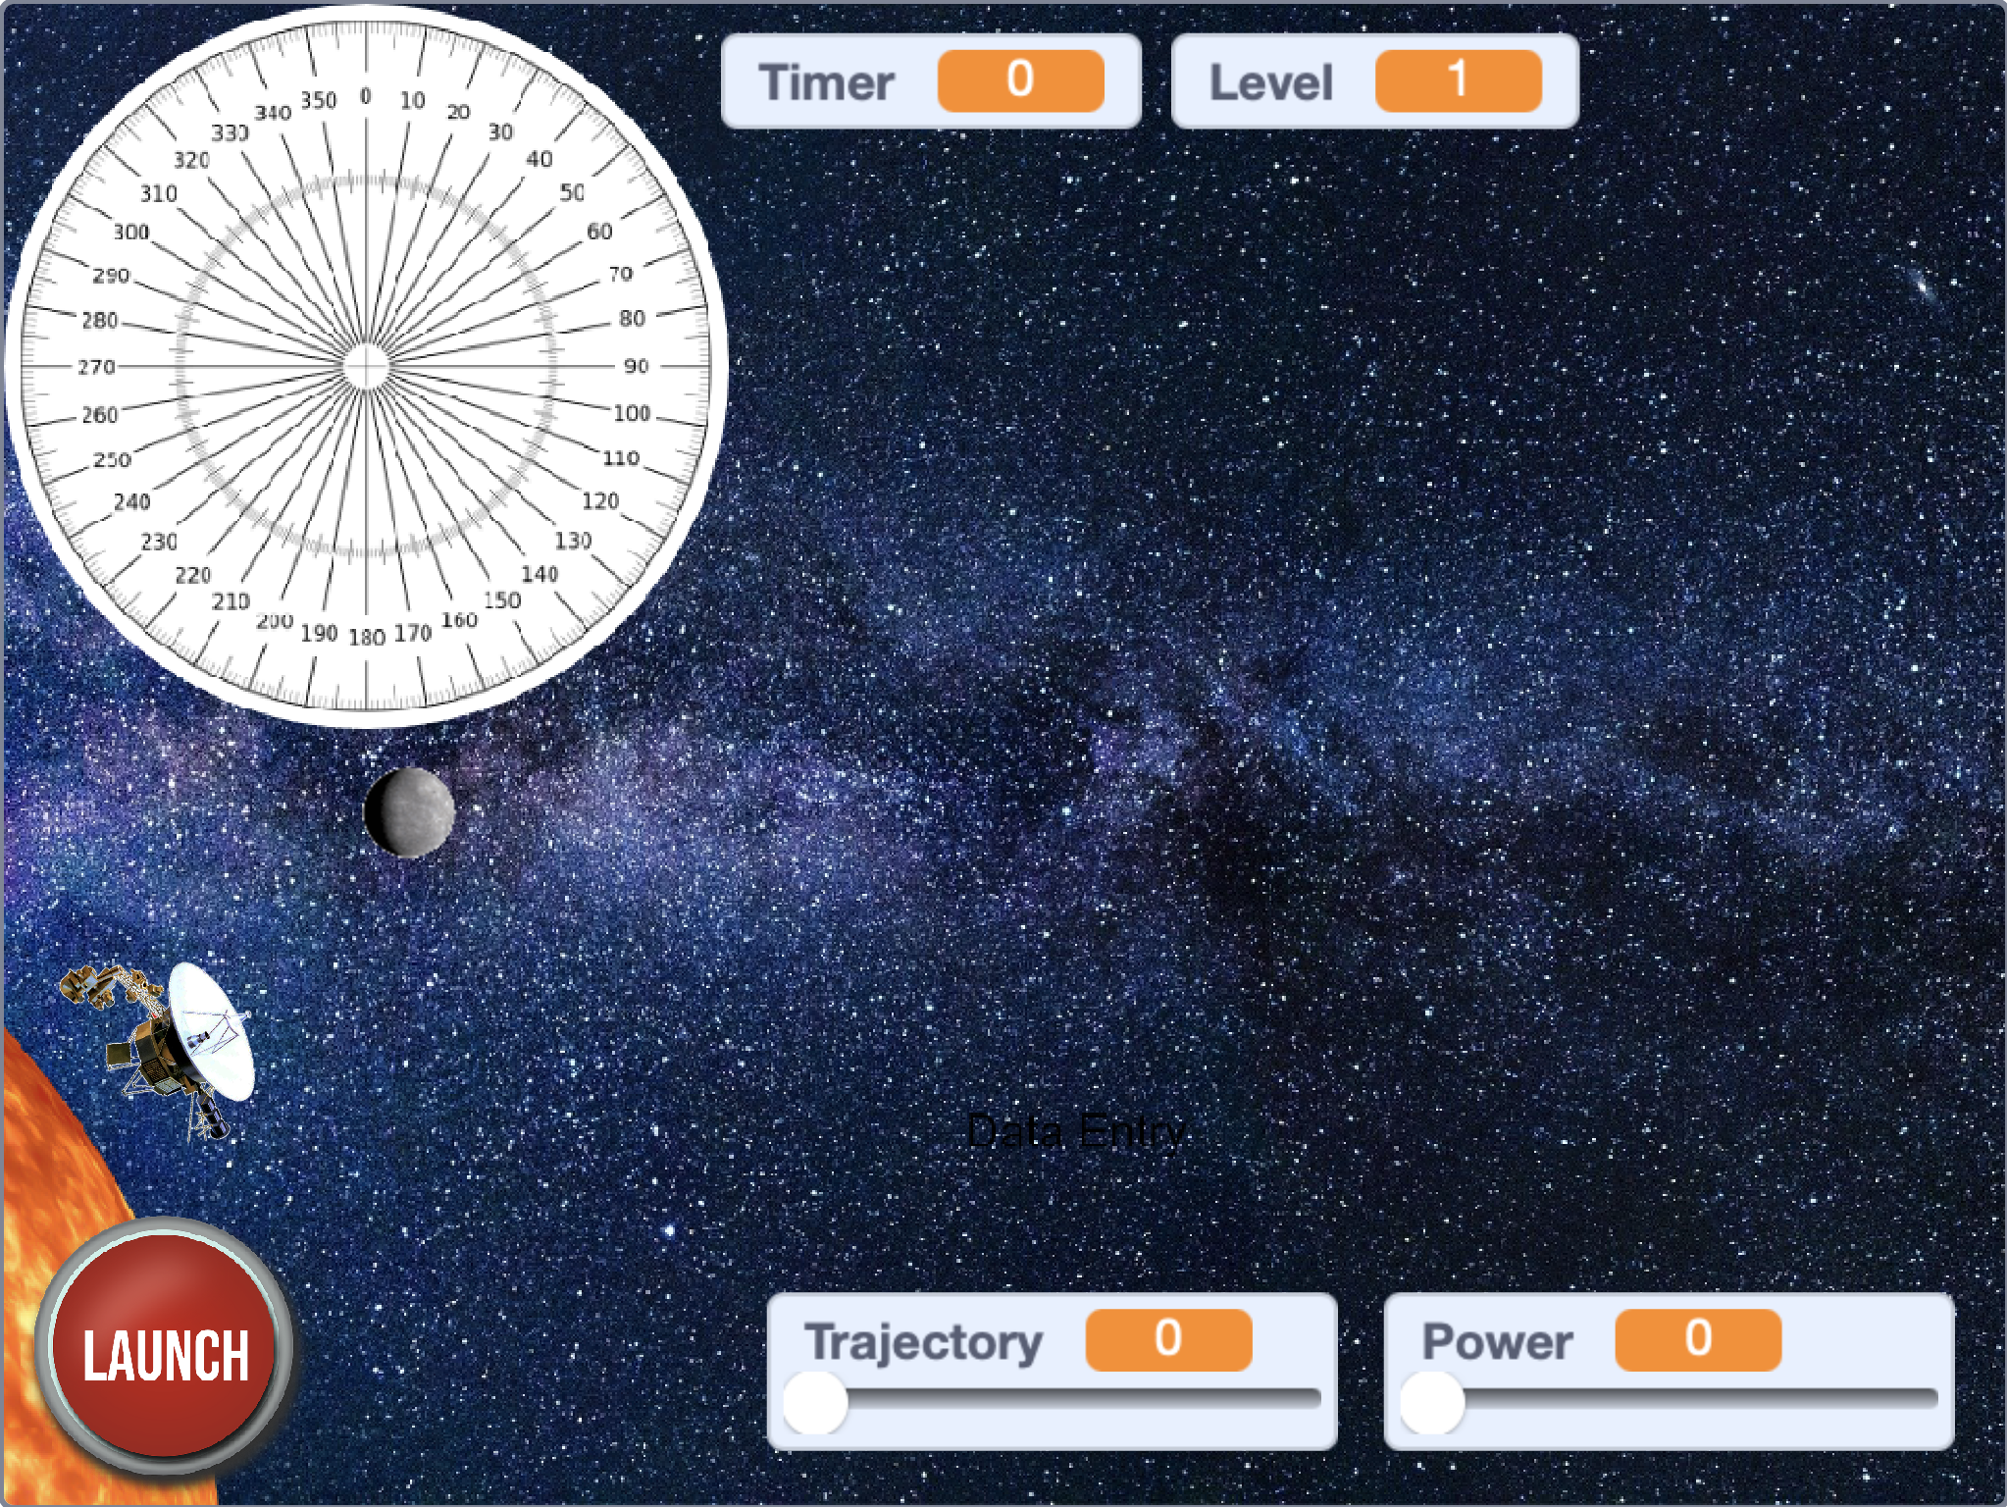
Next time
Making the Launch button work
Learning what a variable is
Learning how to reset our program every time the green flag is clicked
Considering ways in which our game is realistic and very unrealistic compared to launching a real space probe.

Slide 37
Brought to you by the Royal Air Force in partnership with Hyett Education. For more free and exciting STEM resources go to www.rafyouthstem.org.uk. Special thanks to Flt Lt Michelle Randall (RAF Youth & STEM), Antony Hyett (Hyett Education – www.hyetteducation.com) & Richard Anderson (TechMentor UK – www.techmentor.uk).
Project credits

Slide 38
Other credits
Planet and Sun images - pixabay.com: labelled for free, unrestricted use
Voyager One probe image - Public domain (NASA) - https://en.wikipedia.org/wiki/Voyager_1#/media/File:Voyager_spacecraft_model.png
Music (Gameplay Demo video): ‘New Dawn’ from BenSound.com - used under a free license with attribution
Compass image - Images used from Wikimedia Commons: Used under a Creative Commons Attribution-Share Alike 3.0 Unported License.

